Slide 1

Effectiveness Of Video Observed Therapy In The Management Of Tuberculosis:
A Multi-district Randomised Control Trial
Dr Kartik Kaliyana Sundaram

Slide 2
Background
Tuberculosis (TB) is an infectious disease that is a major global health issue, The WHO estimates that there are approximately 1.8 million lives lost worldwide to TB in 2020 alone (WHO, 2020).
DOTS is a method of drug administration where healthcare workers visually observe TB patients taking their daily cocktail of antibiotics over a duration of 6 months.
However, compliance to DOTS still poses as a challenge,1 in 10 TB patients fails(Liew et al., 2015).
Logistical issues, costs, and distance to healthcare facilities-factors for poor compliance.Report says patient need to spend an estimated RM3,010 (USD 725 (Elamin et al., 2008).
What will happen if there is poor compliance?
  Repeat the entire TB regime if the patient missed >25% of treatment in a month
  Lead to multidrug TB resistance resulting in extended DOTS to 18 months.
  (Naing et al., 2001). (Chung-Delgado et al., 2015).

Slide 3
Research Justification
In Malaysia, the incidence rate of TB is 92/100,000, out of which the mortality rate is 3.69%. As reported in 2014, the number of patients with MDR TB was 160.
The advent of a Video Observed Treatment (VOT), whereby a patient will be able to conduct live teleconference with healthcare provider and report their drug administration would be beneficial.
A proposed intervention with VOT in TB treatment is a practical move as it can
  improve treatment compliance
  reduce treatment cost
  reduce the risk of COVID-19 transmission
  reduce the risk of COVID-19 infections

Slide 4
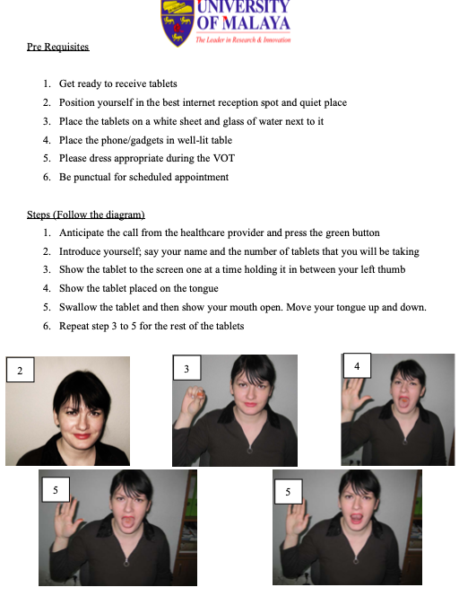
APPENDIX F: INSTRCTIONS FOR VOT (ENGLISH VERSION)

Slide 5
Research Question
What is the effectiveness of Video Observed Therapy (VOT) in the management of tuberculosis (TB) compared to the traditional Directly Observed Treatment Short Course Strategy (DOTS)?

Slide 6
General Objective
The general objective of this study is to compare the effectiveness of VOT with traditional DOTS in the management of TB.
Specific Objectives
To develop VOT intervention in the management of TB.
To compare the effectiveness of VOT as compared to traditional DOTS.
To measure patient’s satisfaction using VOT.

Slide 7
Study Design
This study will consist of two phases.
  Phase 1 of the study is the development of the VOT intervention.
  Phase 2 of the study will be comparing the effectiveness of VOT against traditional DOTS using a randomized controlled trial.

Slide 8
Phase 1: Development of the VOT Intervention
Expert Review
  This will be done using a focus group discussion (FGD) with selected experts.
  The experts that will be selected will be as follows,
    Respiratory physician from the Chest clinic
    Family medicine specialist
    Medical officer in charge of DOTS at a primary clinic
    Staff nurse or medical assistant from a DOTS team
    Health inspector of a district TB unit
    Digital health expert
The study will be done in two rounds with the first round starting with open-ended questions in groups and the second round with Likert scale rating questions.
Extensive Literature Review
  Information regarding the barriers of traditional DOTS, evidence-based information will be identified, the need for intervention will be determined and the current practice will be gathered.
  The aim is to create an effective yet feasible VOT model for observing TB patients consuming their anti TB medication.
Notes:
The development stage of the framework as used by Bleijenberg et al. (2018) will be used as a more specific guide for the intervention (Bleijenberg et al., 2018).
This intervention should be conducive and applicable to all TB patients in the Malaysian setting. To develop a suitable intervention, information from two main domains are important.
Once a consensus is reached at the end of both rounds, then a conclusion is drawn for the development of VOT intervention modelling.
The main aim of this focus group discussion is to aide in the development of the whole process of “WhatsApp” application as a VOT platform and to fine-tune the process if needed.

Slide 9
Phase 2
Development of VOT process
VOT= Video observed therapy, DOTS= Directly observed therapy, short course, FBC= Full blood count, RP= Renal profile, LFT= Liver function test
Selection of participants
Randomisation 1:1
VOT
Traditional DOTS
Monitoring
DOTS clinic counselling and Baseline FBC, RP and LFT
Repeat LFT at 2 weeks
Repeat sputum AFB at the end of intensive phase
Outcome Assessment
Primary Outcome: To compare treatment adherence, to compare seroconversion of sputum smear positive to negative
Secondary Outcome: Detection side effects, Degree of patient and provider’s satisfaction, money and time spent by patient.

Slide 10
Study Outcome
  Primary Outcome
    Treatment adherence in percentage from both arms (Number of days medicine consumed/over 60 days intensive period).
  Secondary Outcome
    Number of successful sero-conversion patients from sputum smear positive to sputum smear negative by the end of the intensive phase.
    Number of reported side effects detected from both arms.
    Number of patients having side effects detected from both arms.
    The degree of satisfaction of the participants from both arms.
    Overall time spent by patients from both arms.
    Overall money spent by patients from both arm (self-reported).

Slide 11
Part 2 : Current progress…
Current hurdle : Financial / Grant to run research
Cost of entire thesis : Rm 29,300 – Rm 56,300
Notes:
It will be emphasized to the participants that participation is voluntary and they are also allowed to clarify any doubts they might have.
They are also allowed to drop out of the study at any point by informing the staff.
All the information provided during this research will be kept strictly confidential and used exclusively for the purpose of this study.

Slide 12
Study Budget
Item | Description | Cost(RM)
Proposal Development | Printing | 100
Data Collection | Usage of application Sure Adhere app(KIV) | Rm 24,000
Usage of facilities | Rental of phone(20),Laptop rental (10) | Rm 14,400
Data analysis (by researcher) | Research Assistant wage(KIV) | Rm 3000
Internet package | Internet usage (Rm 35X 240) | Rm 8,400
Preliminary report/ Final report | Printing | 500
Manuscript publication | Submission fees | 6000
 | Total | RM 56,300 RM 29,300( without SureAdhere&RA)

Slide 13
Grant and its fate
First grant by Dr Wong,3rd SV
Grant application was REJECTED by NIH
Officially known in August 2022
Unsure the reason
Notes:
It will be emphasized to the participants that participation is voluntary and they are also allowed to clarify any doubts they might have.
They are also allowed to drop out of the study at any point by informing the staff.
All the information provided during this research will be kept strictly confidential and used exclusively for the purpose of this study.

Slide 14
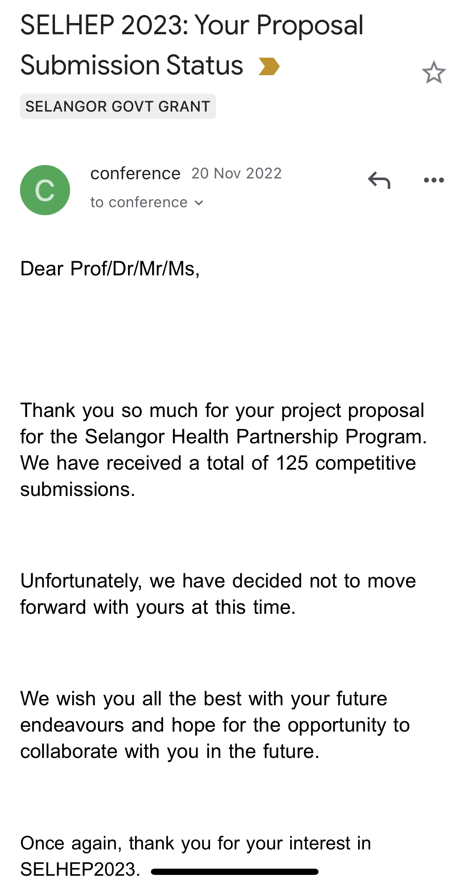
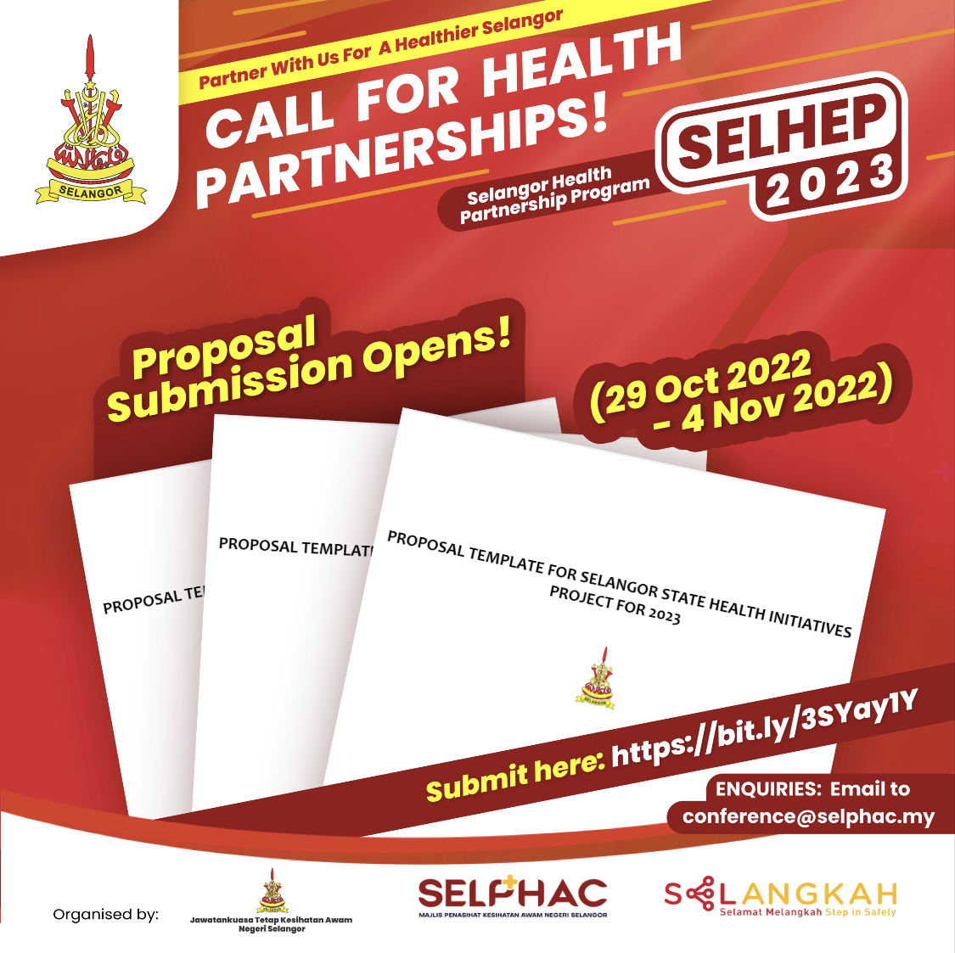
Grant and its fate
Second grant applied with Selangor State Health Dept
but REJECTED.
Notes:
It will be emphasized to the participants that participation is voluntary and they are also allowed to clarify any doubts they might have.
They are also allowed to drop out of the study at any point by informing the staff.
All the information provided during this research will be kept strictly confidential and used exclusively for the purpose of this study.

Slide 15
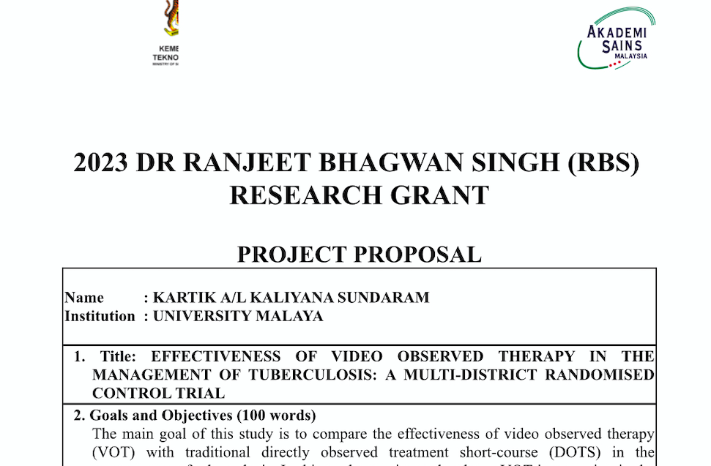
Grant and its fate
Submitted for Dr.Ranjeet Bhagagwan Singh Grant.
Results STILL PENDING.
Notes:
It will be emphasized to the participants that participation is voluntary and they are also allowed to clarify any doubts they might have.
They are also allowed to drop out of the study at any point by informing the staff.
All the information provided during this research will be kept strictly confidential and used exclusively for the purpose of this study.

Slide 16
What is the Public Health Significance?
Tackling TB is one of the crucial health initiatives laid by WHO, and the Malaysian government is trying to focus completely on this. Innovative yet feasible innovation like this could lead to curing TB quicker and reducing the spread, thus, overall achieving the target END TB by 2035.
Healthcare workers are burdened and under numbered. This study if successful could be adapted into the system, eventually reducing their burden without compromising the treatment. This will lead to reduction in job stress, mental health issues and improving quality of life.
Holistic approaches can be adapted and expanded in the future by incorporating other vital records, TB contact tracing and cluster identification.

Slide 17
Thank you for your Attention

