Slide 1


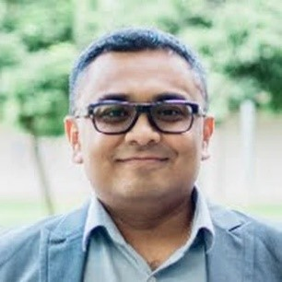
Science Communication
Assoc Prof Dr Vinod Balasubramaniam Monash University Malaysia

Slide 2
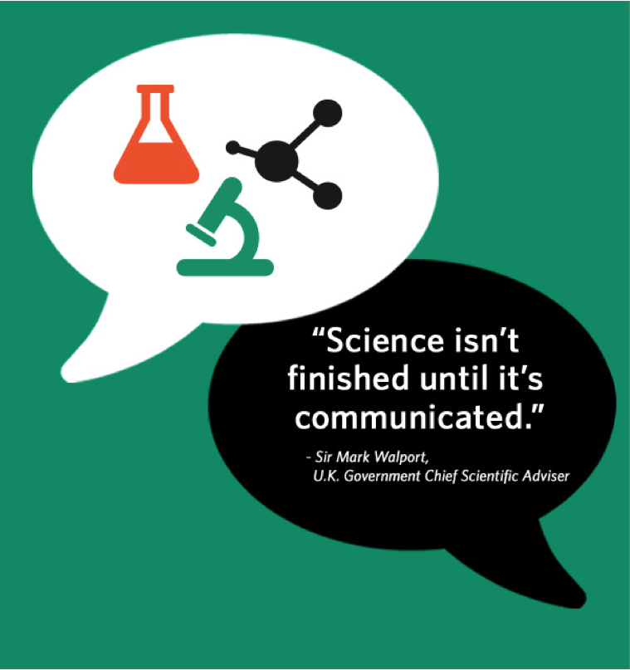
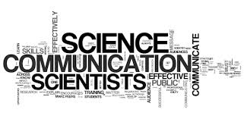

Slide 3
Background/Disclaimer:
  PhD in Molecular Virology
  Trained at Monash University Malaysia and Department of Microbiology, Icahn School of Medicine, Mount Sinai New York
  Work predominantly on crosstalk between RNA viruses with pandemic capabilities and different hosts
  ‘Accidental’ Science Communicator
  Not trained formally on Science Communication
  COVID19 myths and misinformation
  ‘Understanding the virus’ and ‘Vaccines’
  Majority of the examples will be based on recent pandemic

Slide 4
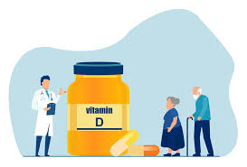
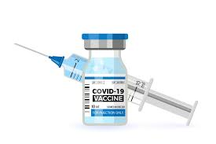
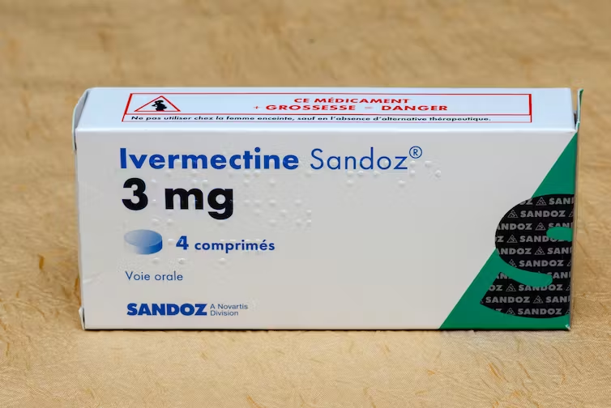
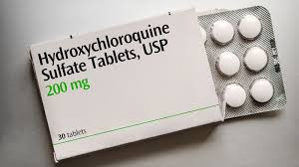
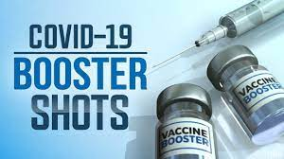
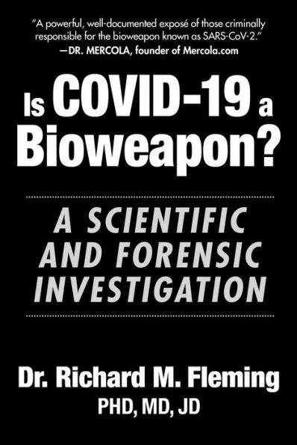
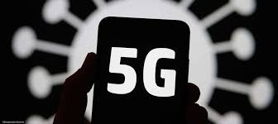
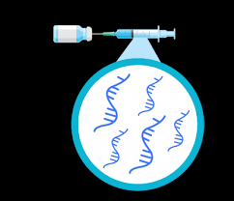
COVID19 ‘Infodemia’

Slide 5
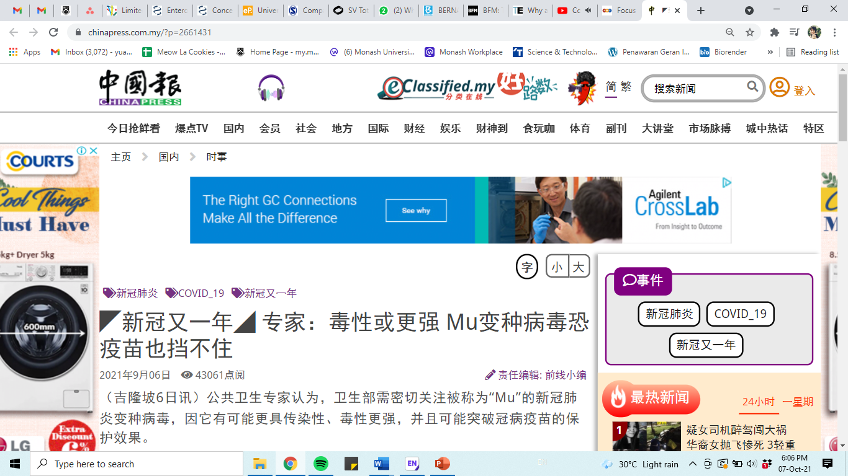
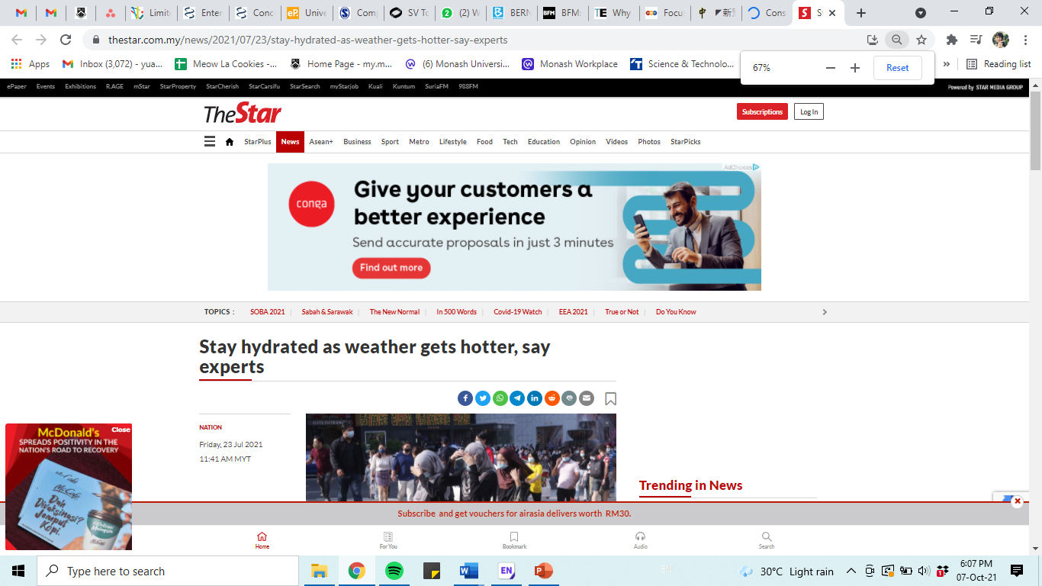
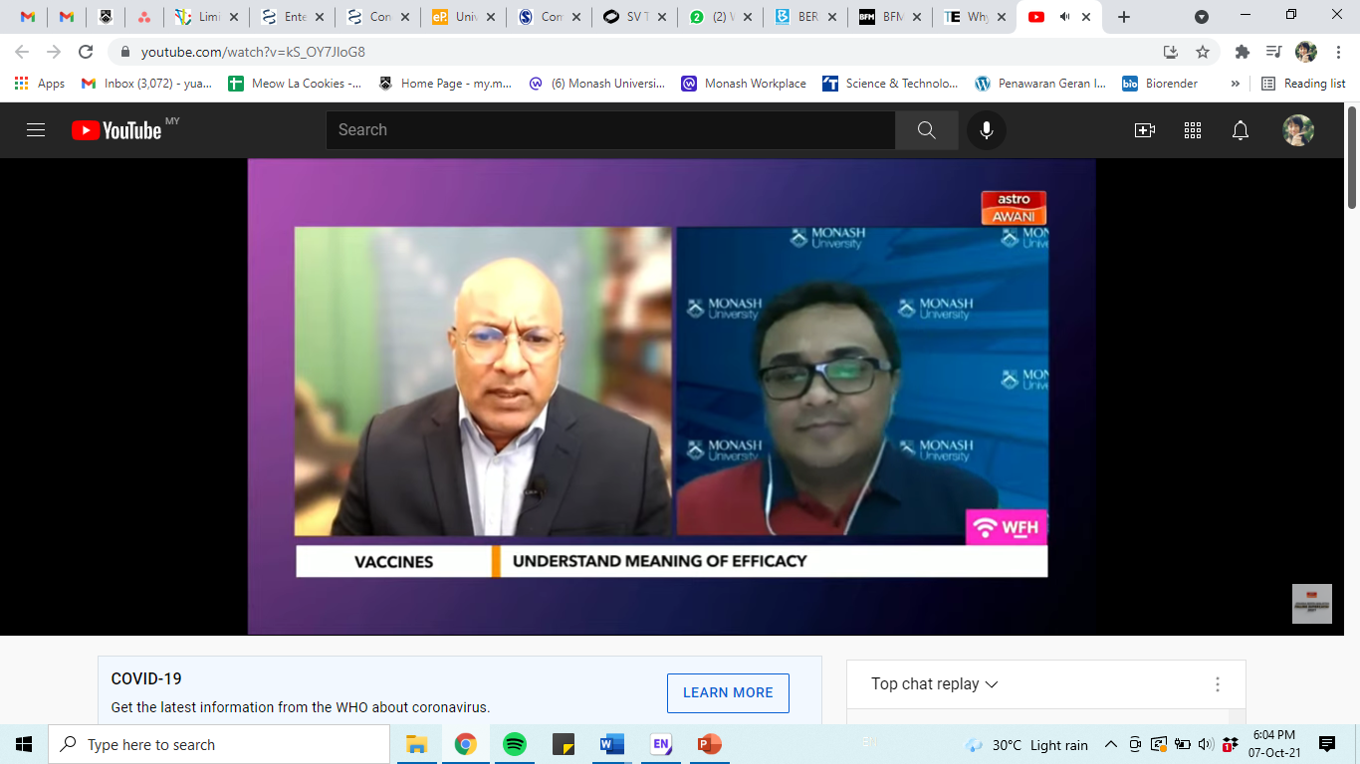
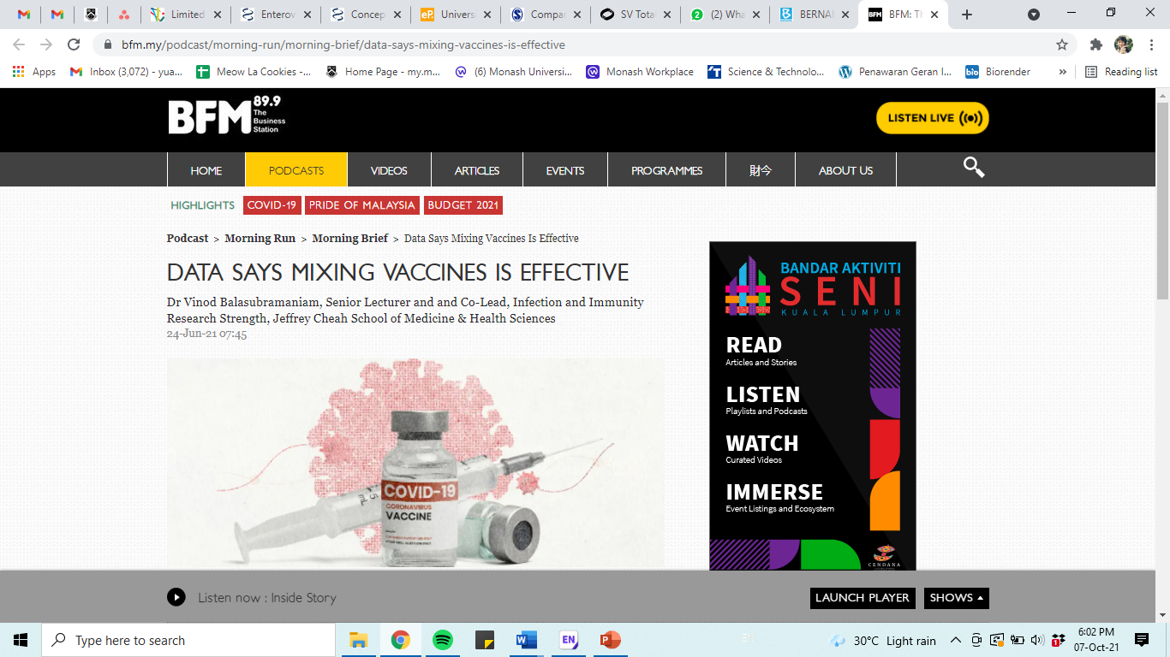
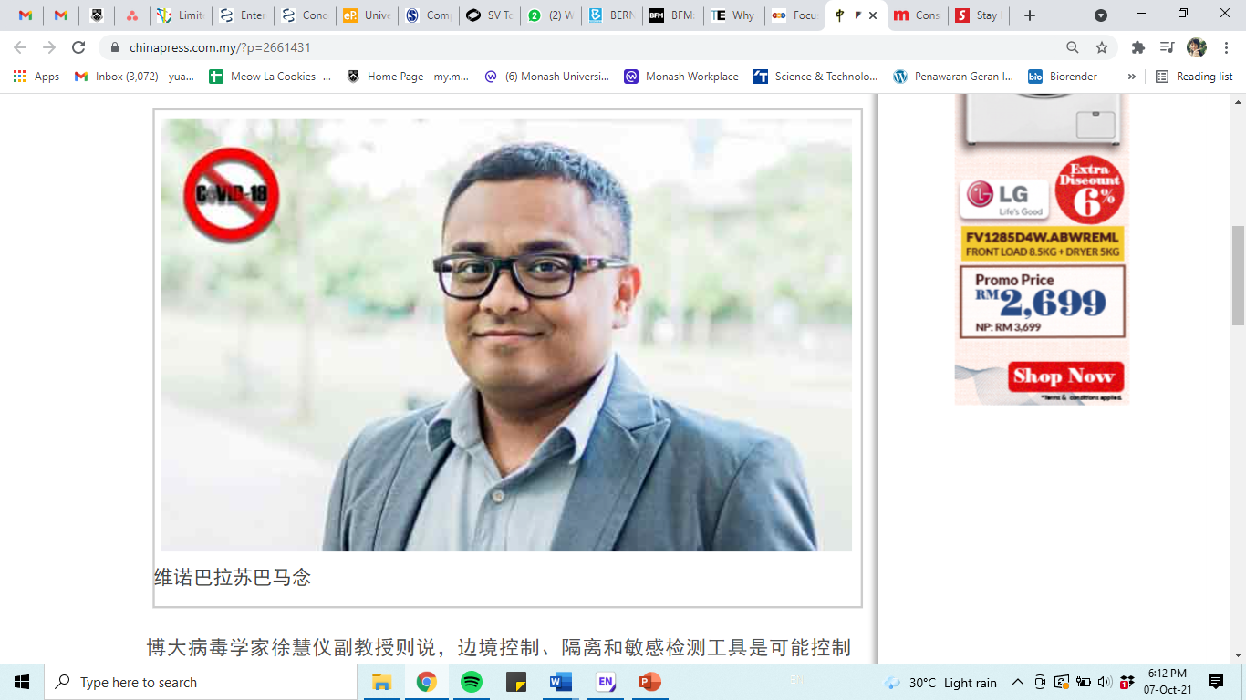
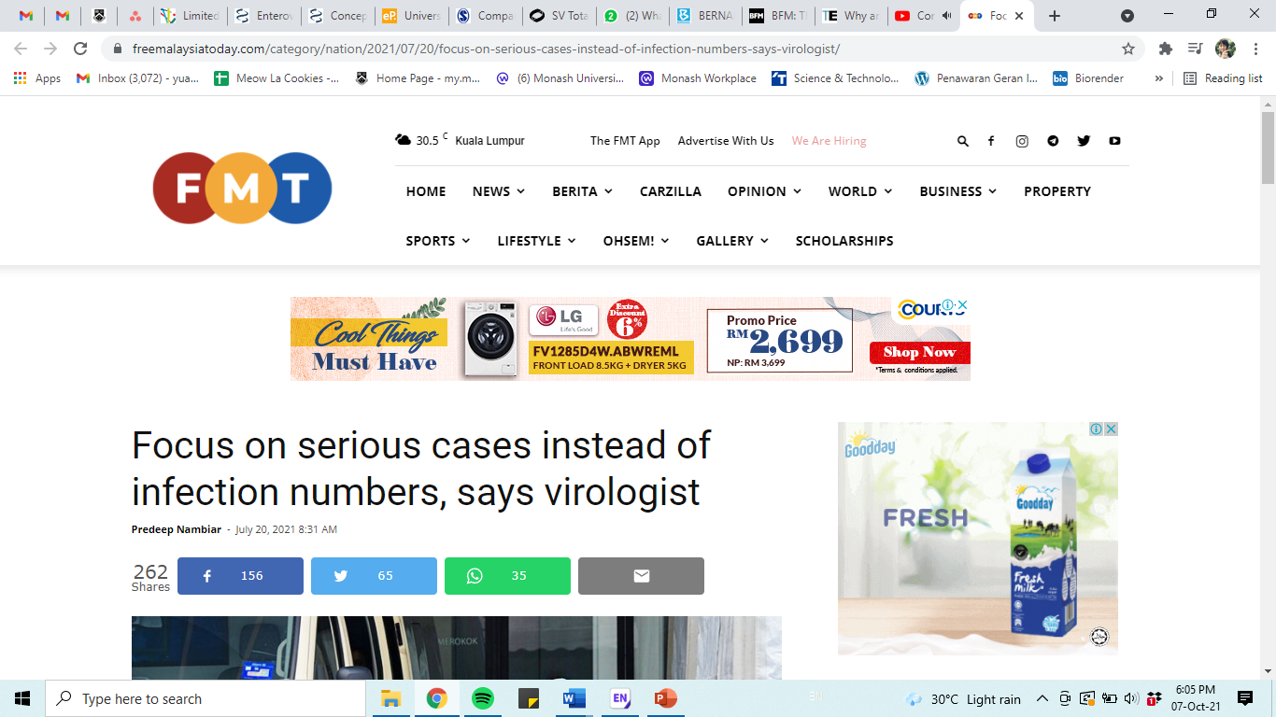
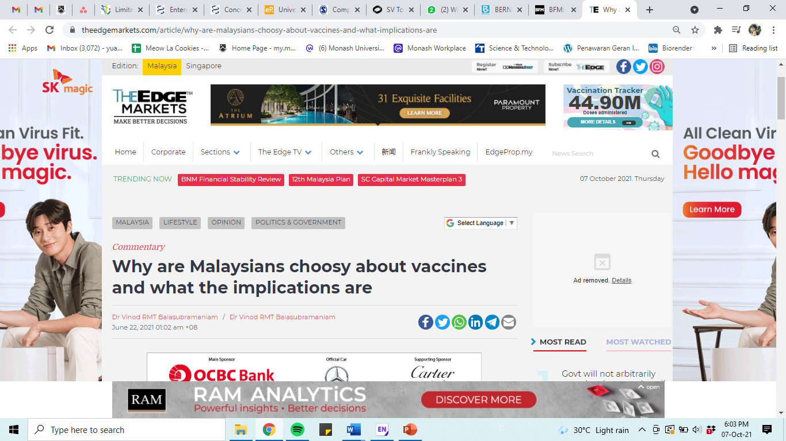
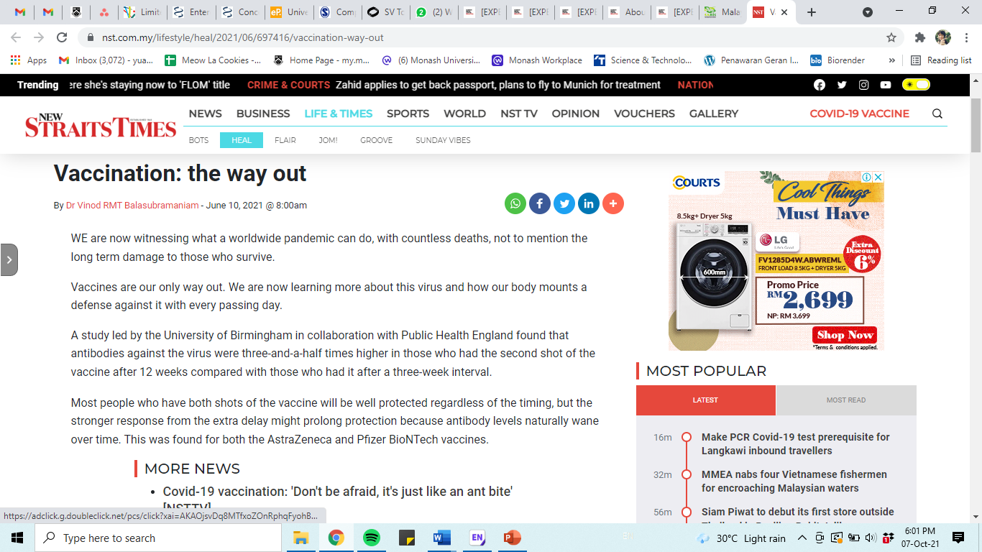
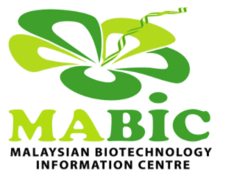
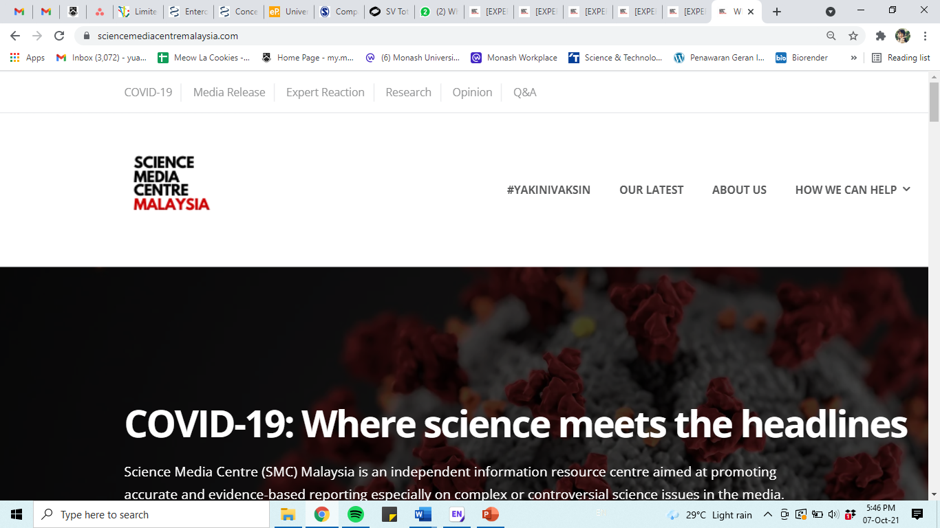

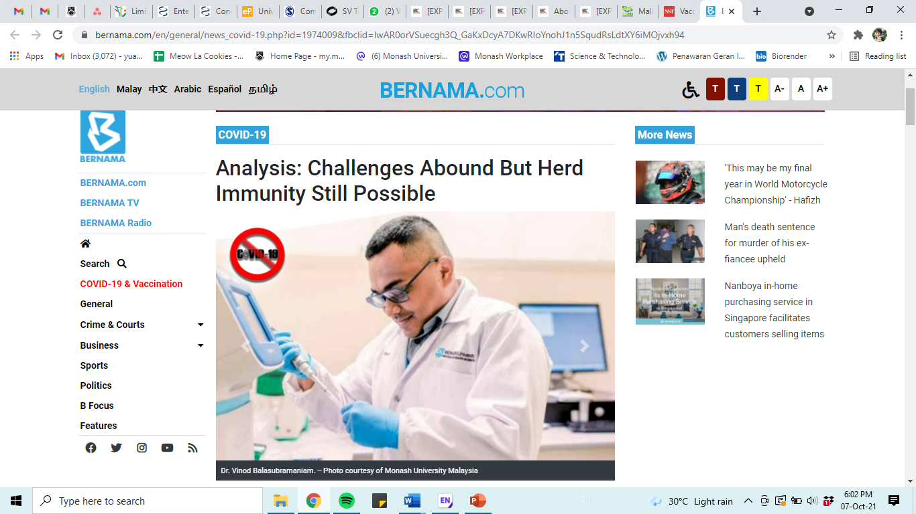
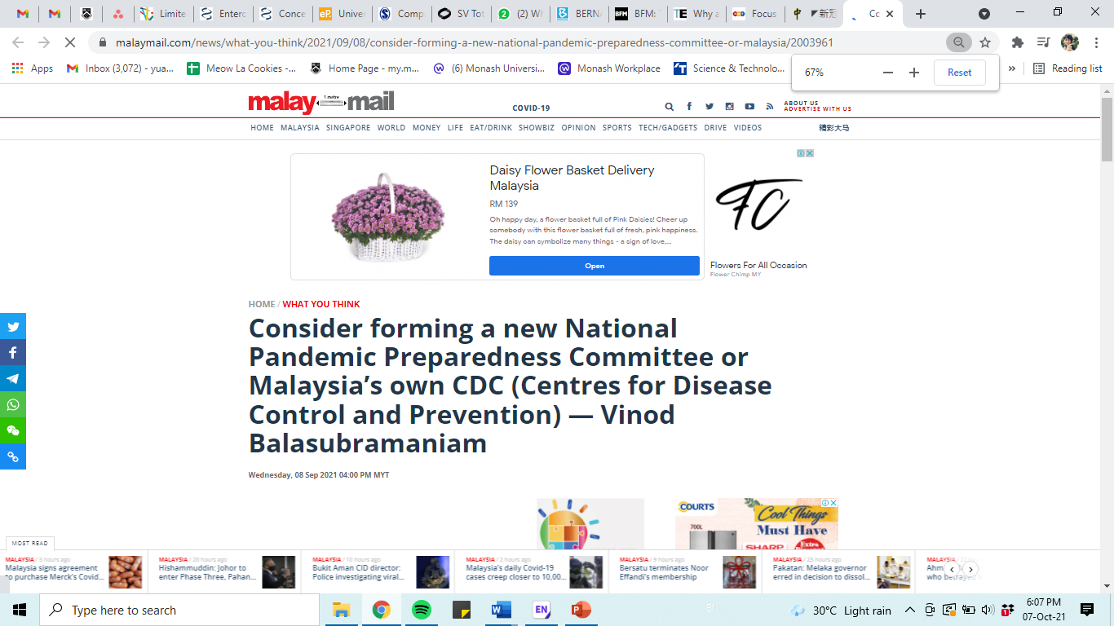
National
COVID-19 cases Globally
→ ~700 million COVID-19 cases
→ ~ 7 million COVID-19-related deaths
Plethora of misinformation (infodemic) regarding the pandemic in the earlier stages.
Disseminate facts to the public instead of plethora misinformation currently being circulated in social media.
First approached by Malaysian Biotechnology Information Centre – Expert Reactions on COVID-19 for Science Media Centre (SMC) Malaysia.
Following that, extensive interviews invite/approach by some of the biggest media portals in the world both national and international based on our work and expertise.
National Media
→BERNAMA TV English, BERNAMA TV Tamil, China Press, Astro Awani, The Star, New Straits Times, The Edge, Free Malaysia Today, BFM89.9 radio, Business Today

Slide 6
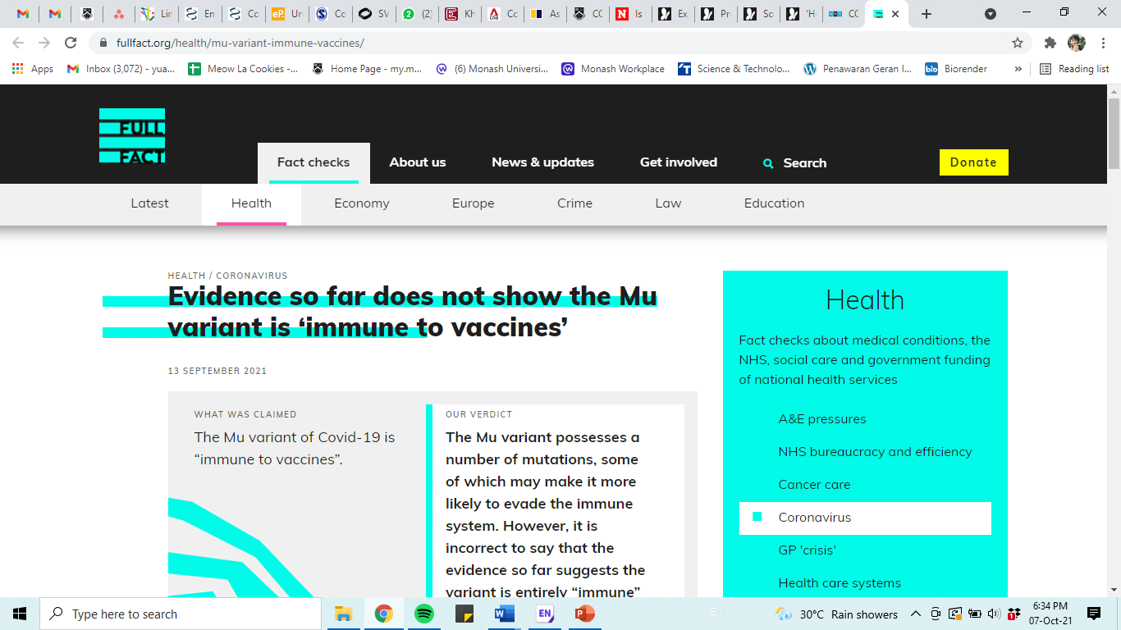
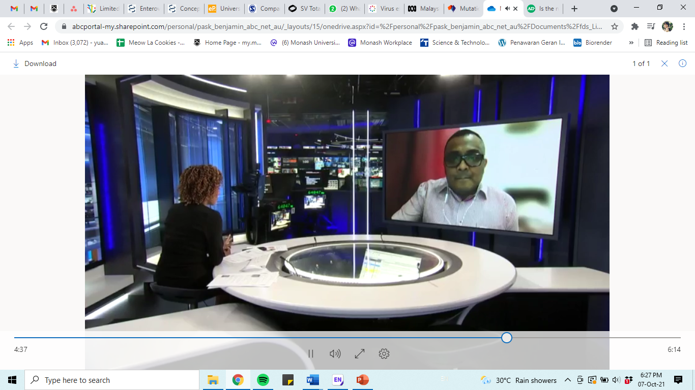
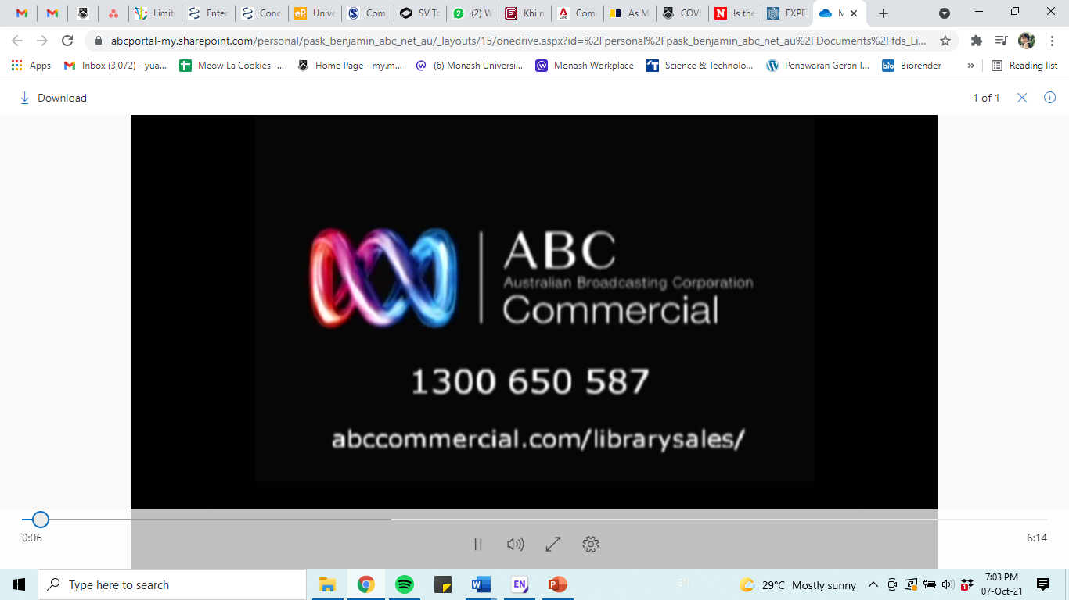
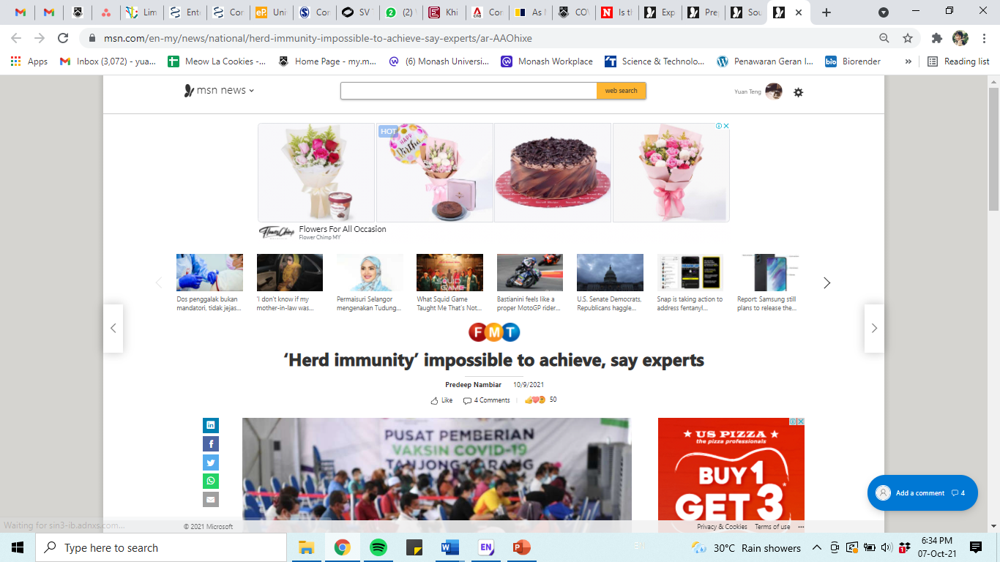
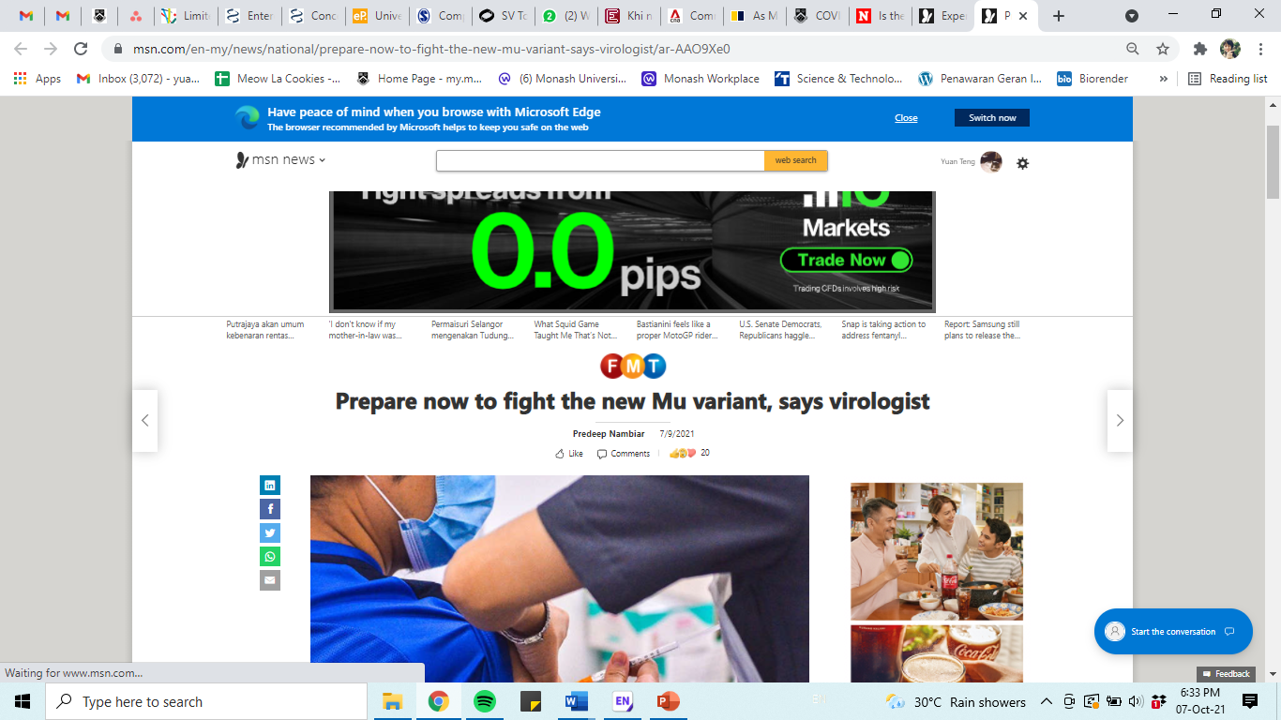
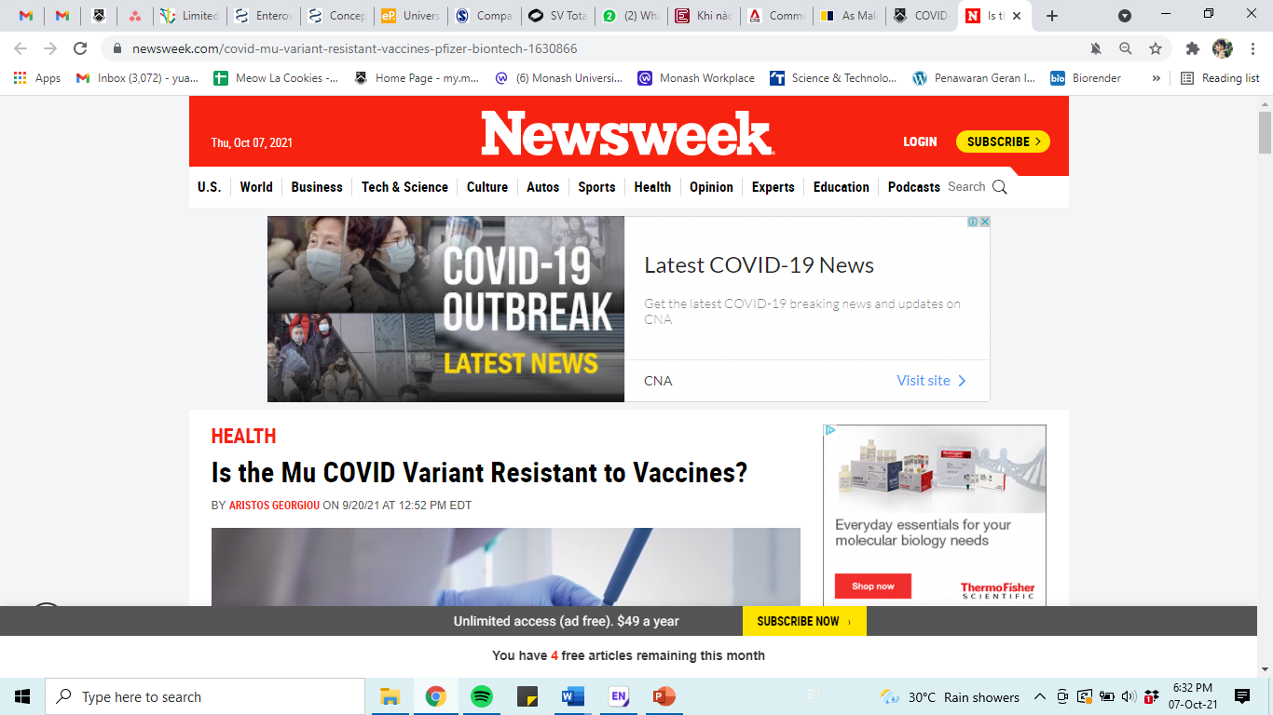
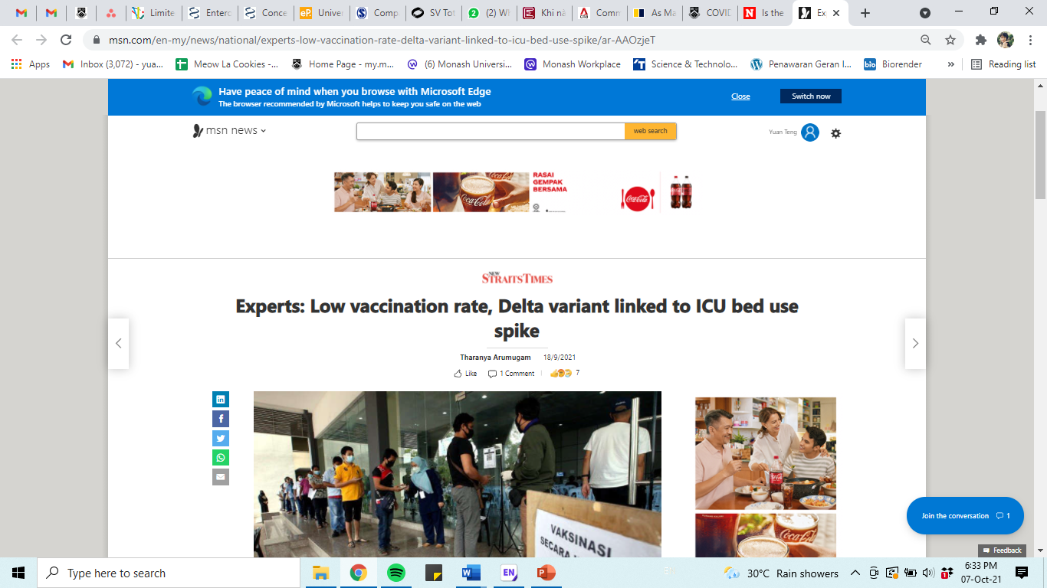
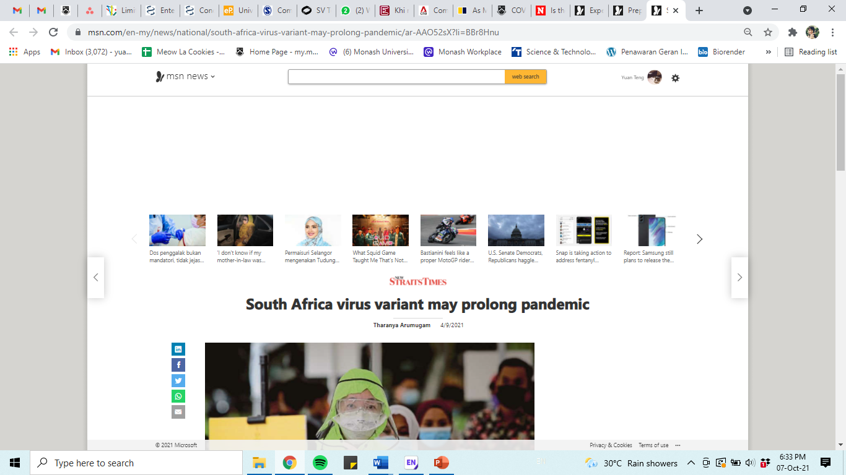
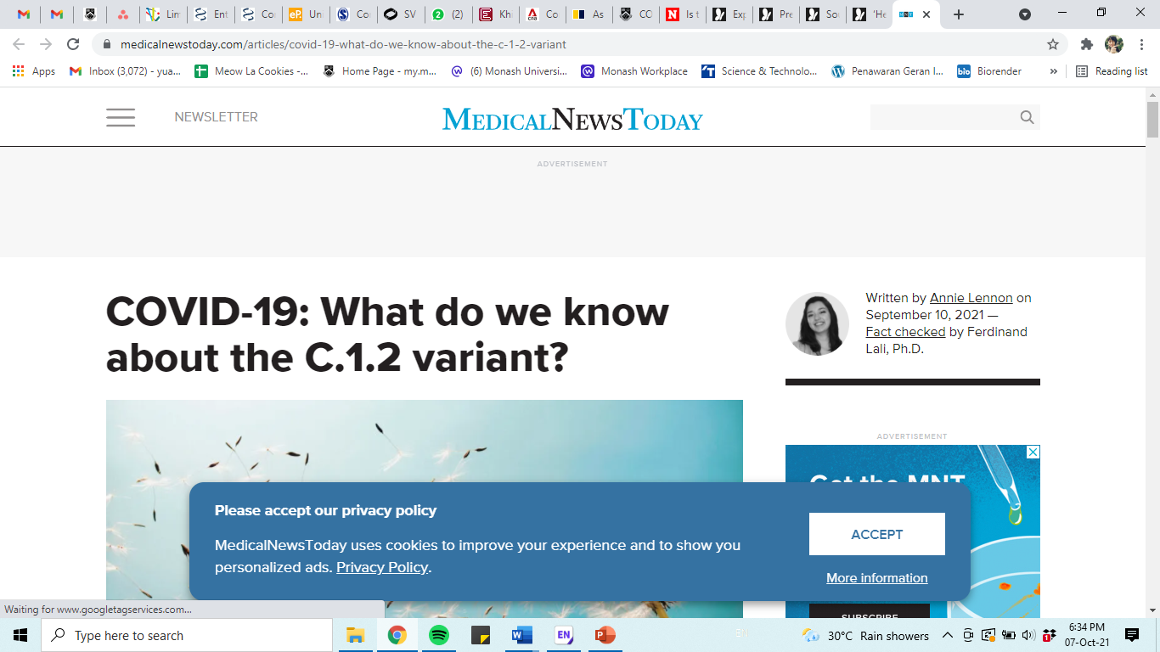
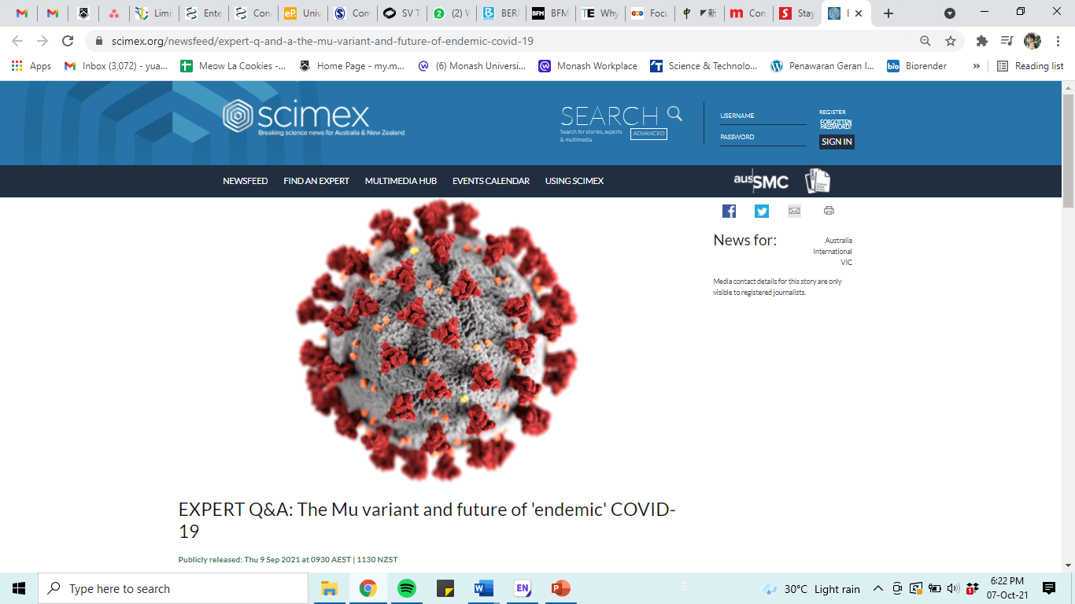
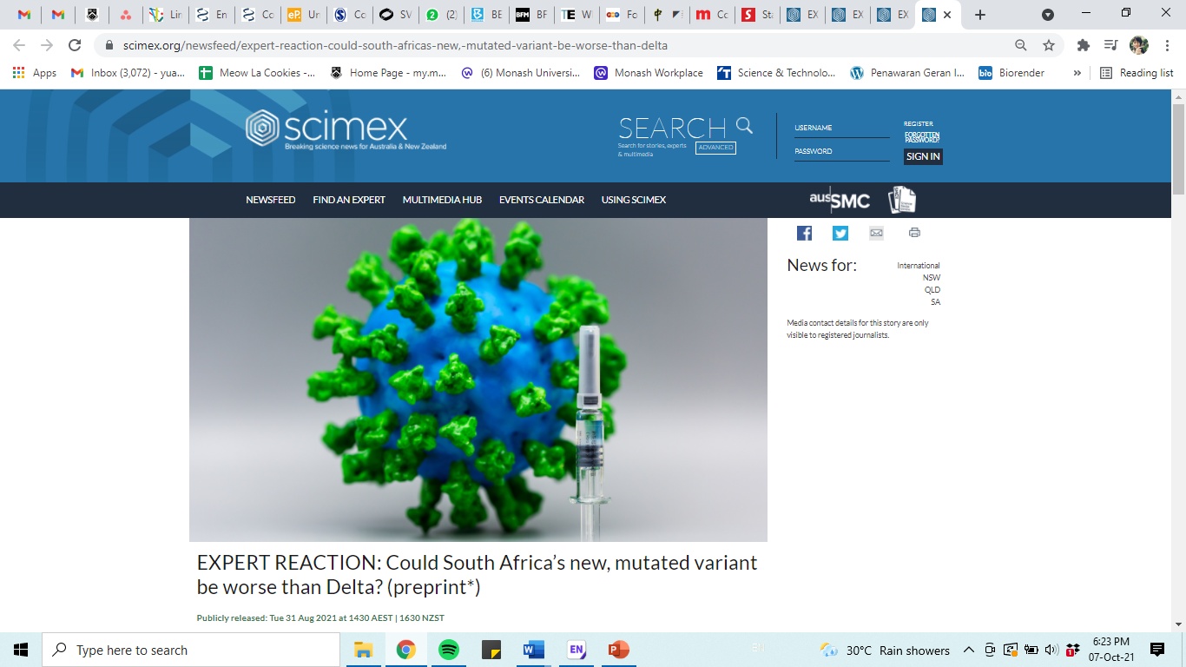
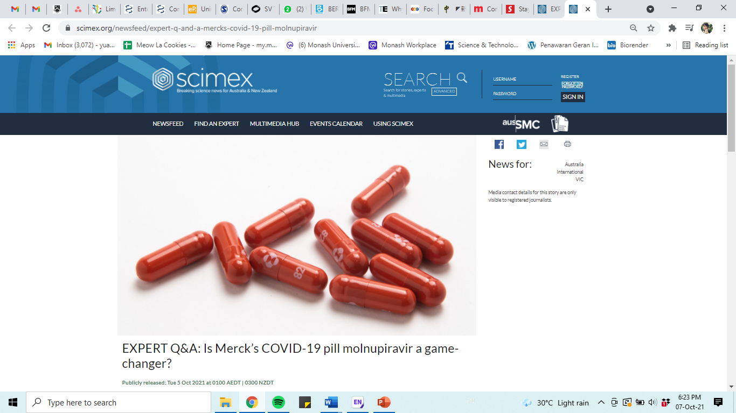
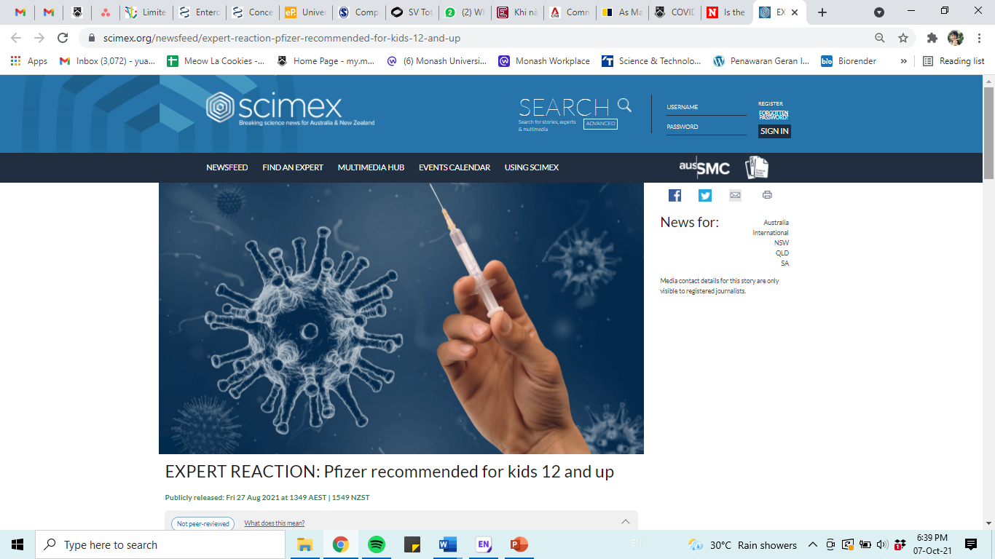
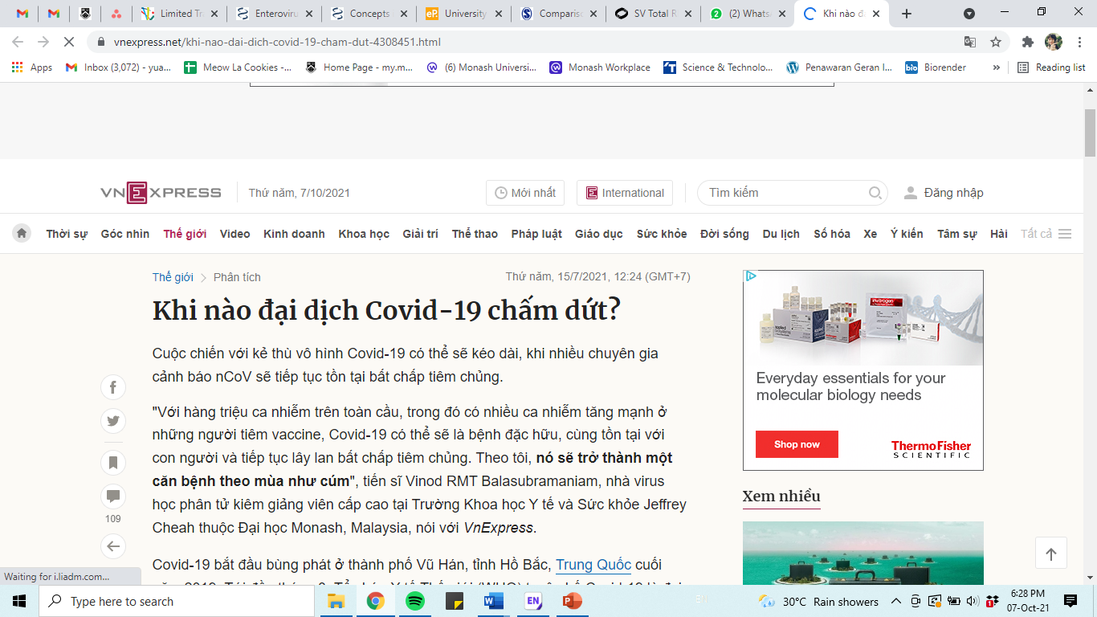
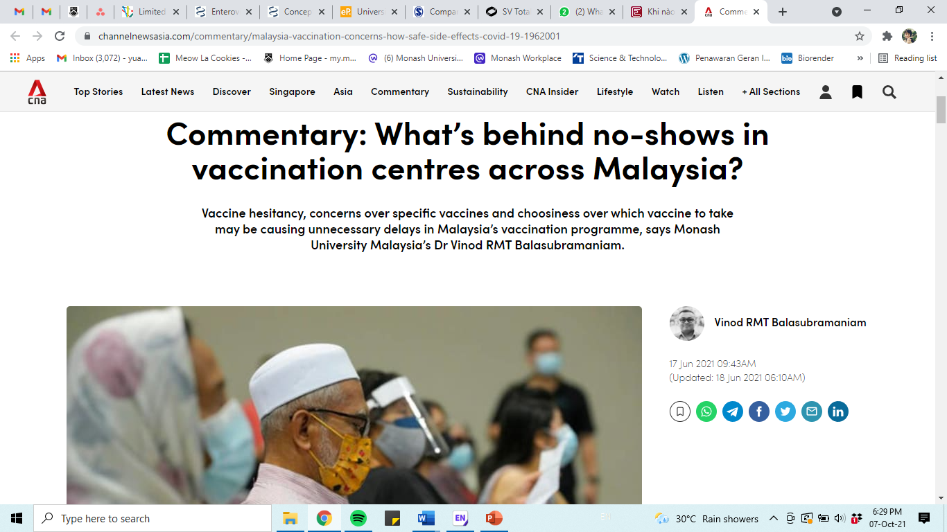
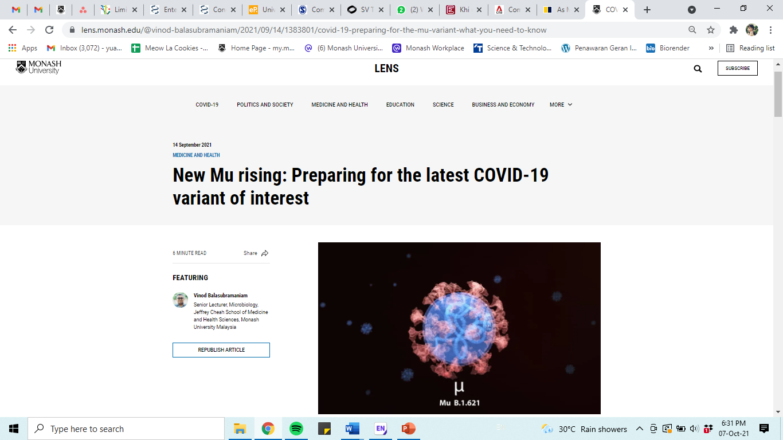
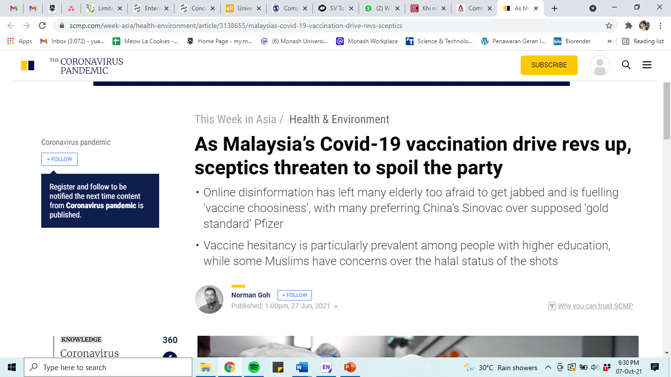
International
International Media
→From the US, UK, Australia, Hong Kong, Singapore, Vietnam, Indonesia, New Zealand, Netherlands, Brunei and many more
One of the biggest impact is to be featured in Newsweek (one of the oldest New York based magazine with more than 100 million users per month)
Approached also by biggest medical health sites/news portal such as Medical News Today (US), Full Facts (UK), ABC News (Aus), CNA (Singapore), SCMP (Hong Kong) and continue collaboration with Scimex, the breaking science news portal for Australia & New Zealand, an initiative of the Australian Science Media Centre., in EXPERT REACTION
The focus of the interviews are mainly on various aspects of the pandemic:
  The emerging variants,
  Holistic management of the pandemic,
  Preparation for future pandemics,
  Importance of vaccination in fighting the pandemic.
  Impact
  → to provide better understanding on pertinent matters which includes the transmission of the disease, social distancing, vaccine advocacy and education of misinformation in Malaysia.
  Increasing our visibility to worldwide scientific community, and public

Slide 7
Measuring Impact/Reach?
Mentioned/quoted more than 1000 times in worldwide media (2020-2023)
Quoted/interviewed in majority of Tier 1 media in the world including Medical News Today, Full Facts (UK), Cosmos, Australian Science Media Centre, MSN News, Yahoo News, ABC News, Daily Mail (UK), Australian Doctor Group, BFM, The Star, NST and Bloomberg.
Main ‘go-tos’ for tier 1 media titles
Listed infectious diseases expert in Australian Science Media Centre.
Top performing article published in Monash Lens. The news had 87.9 million reach.
Combined media value of more than RM3.5 million.
Invited for the launch of 'Sputnik V' vaccine for COVID19 as part of the roundtable discussion panel.

Slide 8

I think I know what Science Communication Is. But what is Science Communication????
Science Communication is broadly defined as “the practice of informing, educating, sharing, wonderment, and raising awareness of science related topics covering science outreach (typically conducted by professional scientists to non-expert audiences) and science” in-reach” (expert to expert communication from similar or different scientific backgrounds)”
Adapted from Science Communication in Practice: A Malaysia Perspective with Global Relevance, ASM

Slide 9
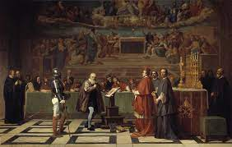
Initiation the era of Science Communication
The 1633 trial of Galileo is a cautionary tale in science communication.
Began in 1609 when Galileo’s studies led him to support heliocentrism – a model of the universe with the sun at its center – over geocentrism!
Published these findings as a series of dialogues between two philosophers and a layman; an attempt to promulgate this knowledge to the lay public and not just academics
Twenty four years after his first experiments, he was tried by the church, found guilty of heresy and sentenced to formal imprisonment
‘Trial of Galileo’
Why???
Source: https://www.lindau-nobel.org/blog-the-challenges-of-science-communication/

Slide 10

Understanding need of science communication
We are living in times of deep uncertainties and are facing an unprecedented convergence of threats and multiple crises (public health, economic, political, environment) due to the coronavirus outbreak.
The pandemic has triggered a massive infodemic and accelerated the dissemination of misinformation, fake news, half-truths, conspiracy theories, rumours, hoaxes and lies.
Different kinds of information disorders have been around for decades, while the COVID19 public health emergency has certainly acted as a catalyst for the proliferation of disinformation in a digital communication infrastructure.
How science communication can solve modern day miscommunication issues of science
To counteract mis/disinformation, science journalism based on an evidence-based paradigm could be a model
Providing evidence rather than opinions and reporting facts and research transparently may improve the quality and credibility of journalism, reconnect it with the public, and build trust in news media
Source: ERUM – Enhancing Research Understanding through Media (2019-1-AT01-KA203-051482)

Slide 11
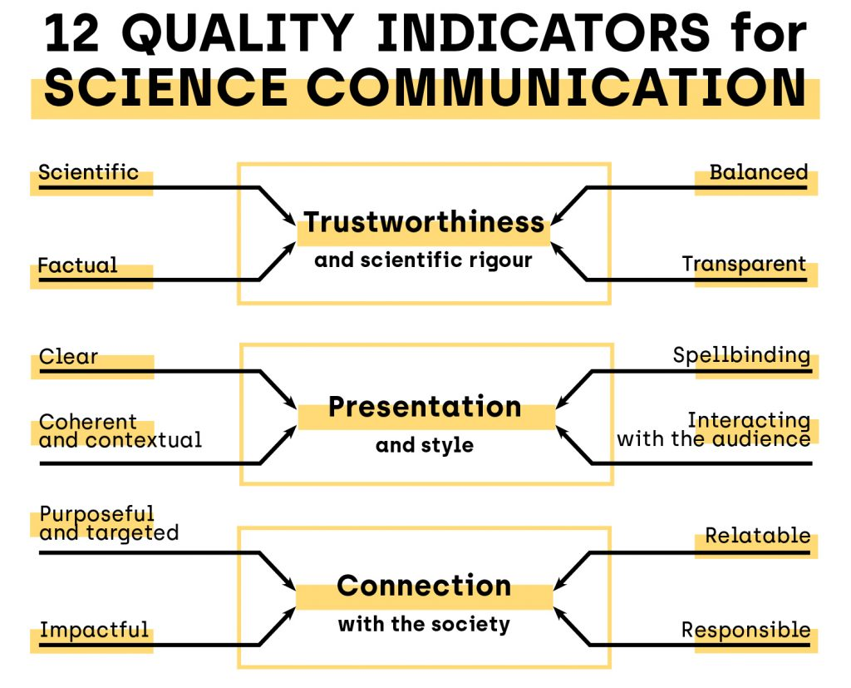
https://questproject.eu/social-media-improving-science-communication-by-the-tools-of-science/

Slide 12
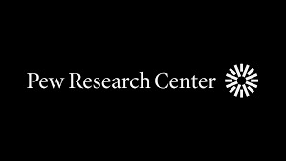









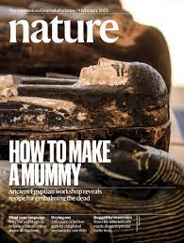
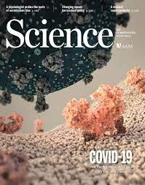
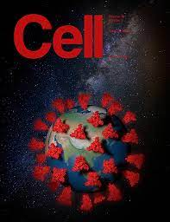
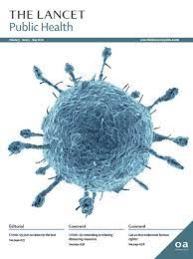

Source???

Slide 13
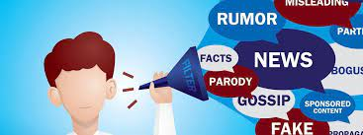
The phenomenon of disinformation
Disinformation threatens the virtue of knowledge. The notion of truth becomes corrupted when the public believe and give credibility to false, inaccurate, or misleading messages.
This situation is particularly relevant in the digital age, where users of media platforms are exposed to different sorts of persuasive statements with uncertain origins and a lack of authenticity.
How does academia understand the disinformation problem, and are we equipped to offer solutions?
Magnitude?
By the end of 2020, more than 300 million Twitter users were posting some 350,000 tweets per minute or around 500 million per day. The number of texts, photos, and videos posted on Facebook was just as colossal, thanks to its nearly 2.5 billion users across the globe
Reference: Bienvenido León, Ignacio López-Goñi & Ramón Salaverría (2022) The Covid-19 catastrophe: A science communication mess?, Church, Communication and Culture, 7:1, 6-22, DOI: 10.1080/23753234.2022.2031236

Slide 14
Science and disinformation
Although the spread of false or misleading content about Covid-19 has reached previously unknown levels, this is by no means the first time that disinformation about science-related issues has spread
Case 1: Asbestos
Case 2: Tobacco
Asbestos is a building material that was widely used between 1860 and 1980 (and is still used in some countries), despite overwhelming evidence that it is carcinogenic and that it causes asbestosis (a type of pulmonary fibrosis)
As some research indicates, asbestos producers developed powerful disinformation campaigns in an attempt to deny or cast doubt on the credibility of studies showing the harmful effects of asbestos on human health, even though this knowledge is well-established in the scientific community
Another relevant case is that of tobacco. Doctors warned about the harmful effects of cigarettes in 1964, but it was not until 1999 that American health authorities declared that smoking was a cause of cancer.
Why did it take so long to clearly alert the population to this danger?
The answer can be found in a 2006 ruling in which a U.S. federal tribunal found tobacco manufacturers guilty of ‘conspiring to deny, distort, and minimize the hazards of cigarette smoking to the public
Reference: Bienvenido León, Ignacio López-Goñi & Ramón Salaverría (2022) The Covid-19 catastrophe: A science communication mess?, Church, Communication and Culture, 7:1, 6-22, DOI: 10.1080/23753234.2022.2031236

Slide 15
What urges the need of the communications between scientists and public and what the current gaps ??
Why we fall for fake news: Hijacked thinking or laziness?
A lack of trust
2. Peer pressure and perception
Between scientists, science writers or journalists, and the public itself. Why?
Institutions also carry some responsibility due to expending more effort bolstering their own reputations, rather than meticulously reporting their research.
Public resistance to scientific messages may stem in part from the continuous stream of exaggerated claims
scientists need to be more aware of possible reasons for communication failure with the public
There are all kinds of reasons that a scientific message will meet resistance, including political and economic, as in the case of global warming, religious, as in the case of natural selection and big bang theory, and social, as in the case of anti-vaccine movements
Mis-information from lobby groups is a more serious problem (influence legislation and government actions on behalf of their clients and can work with individuals and non-profit organizations to achieve their goals.
Peer influence positively influences behavioural intention to share misinformation
Fear of missing out positively influences behavioural intention to share misinformation
Reference: https://doi.org/10.15252/embr.201643379

Slide 16
3. Targeting audiences
4. Communicating uncertainty
Communicators can and should at least attend to the half of the problem that they do have control over: the engagement process itself
How? Packaging the whole truth?
Scientists should be more honest about the nature of the research and the uncertainties involved, even at risk of sowing confusion
This way, the process of understanding and embracing the scientific facts will be much easier to the public.
Give examples, probabilities etc
There is also a growing emphasis on science communication as a two-way process by which the course of research can be influenced by societal feedback.
Embracing the creativity inherent in science can open up routes for collaboration, and many scientists say working with artists, journalists, and people from other fields improves their research.
Reference: https://doi.org/10.15252/embr.201643379

Slide 17
5. The role of journalists
6. Social Media
Exaggeration of scientific data by media?
One good example: Pathomap study in NYC - genomic analysis to take a microbial snapshot of the whole New York subway
Public fears were stoked up by findings of various pathogenic bacteria amid the city's “microbiome”. “This caused a pretty big stir, particularly because terms like “anthrax” and “bubonic plague” were thrown around
Genomic data is complex, and explaining or communicating genomic data and findings is truly difficult, especially to non-scientific audiences, but it can also leave room for a bit of panic when done wrong.
Further clarification were promptly addressed by the PI of the study, some media outlets exaggerated or flat-out misinterpreted the implications of these data”.
Social media outlets - important modes of public communication for both scientists and journalists.
Double edged sword? - Huge potential for amplifying knowledge and equally spread misinformation; indeed, this is more likely to go viral than reliable information from scientists
Challenge for scientists to counter propaganda and hysteria on social media, as well as to engage more directly with people.
In particular, being open about uncertainties and open questions could help earn public trust in science.
Reference: Afshinnekoo E, Meydan C, Chowdhury S, Jaroudi D, Boyer C, Bernstein N, Maritz JM, Reeves D, Gandara J, Chhangawala S et al (2015) Geospatial resolution of human and bacterial diversity with city-scale metagenomics. Cell Syst 1: 72–87

Slide 18
Steps of successful science communication
Step 1: Spotting a science story worth covering
Discovering a good science story is the first important step towards successful science news reporting.
Large number of good sources to turn to for ideas and inspiration, including
press releases from reliable institutions
Blogs by world-leading scientists
Podcasts, webinars, or social media platforms, amongst others
Important Questions to be asked:
How do I find the story (or, to be more precise, how does the story find me)?
How do I know it is worth covering?
Reference: https://uni-foundation.eu/uploads/2021_ERUM%20-%20IO2-CommunicationGuidelines.pdf

Slide 19
What ignites the need of science communication in times of crisis?
COVID19 story
Society was faced with a level of misinformation that was probably unknown until then.
The overall experience has allowed us to learn some important lessons which can be immensely valuable in dealing with future crises
Concepts like viruses, PCR, antibodies, vaccines, and immunity have been headline news. There has been a high demand for information, and a great effort has been made to convert complex scientific concepts into information that is accessible to all citizens.
There have been examples of specialized science journalists who have done an exceptional job
The pandemic has also shown that scientific communication and dissemination are of vital importance, due to the intermediary role they play between science and society.
Scientific knowledge enriches public debate, strengthens democracy, and forms critical and free minds. Communicating science is much more than publishing an article in a journal. High-quality scientific communication can help to explain scientific knowledge and bring that knowledge to citizens.
Reference: Bienvenido León, Ignacio López-Goñi & Ramón Salaverría (2022) The Covid-19 catastrophe: A science communication mess?, Church, Communication and Culture, 7:1, 6-22, DOI: 10.1080/23753234.2022.2031236

Slide 20
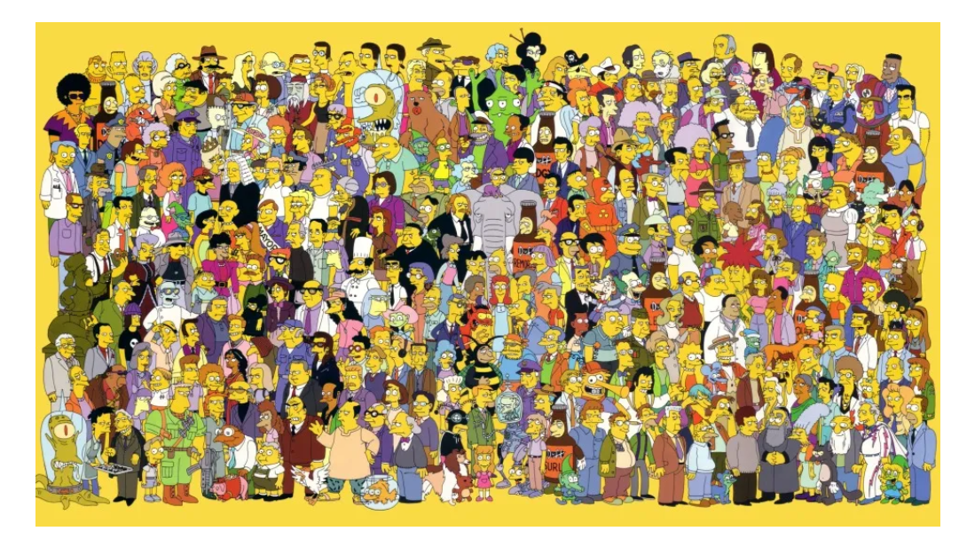
Step 2: Know your audience
How to know your audience better:
Identify audience types
Consider the most appropriate mode of communication for engaging with particular audiences.
Consider factors that influence individual reception and use of information.
Reflect on the appropriate audience level for different communication objectives.
Appraise the importance of culture and different world views.
Increase equity and inclusivity
Imagine you list your audience as “Simpsons characters.” D’oh! They’re all quite different, so if your audience is that broad, the only thing they might have in common is general antipathy toward Shelbyville
Reference: https://medium.com/science-communication-media/there-is-no-general-public-starting-with-audience-for-stronger-science-communication-plans-6603a81da8d6; https://link.springer.com/chapter/10.1007/978-3-030-91628-2_3#citeas

Slide 21
A good recipe to communicate with broader range audience:
Consider the following examples from the American Association for the Advancement of Science (AAAS):
General public wants to know how your research impacts their lives and their societies. This communication could take the form of a formal presentation, or it could be a casual conversation with friends and neighbours.
The media wants to know what makes the findings of your research important, including how it’s different from what others have done.
Peers will be interested in determining whether your work may provide an opportunity for future collaboration.
Leadership at your company/institution needs to know if a project has achieved the expected results and should progress to the next phase, or if changes are needed.
Source: https://graduate.northeastern.edu/resources/tips-for-effective-science-communication/

Slide 22
Step 3: Avoid Jargon
When your goal is to reach a wide audience, such as everyone around the globe, you shouldn't use technical terms.
Avoiding jargon doesn't mean you should never use technical terms — scientific terminology is sometimes unavoidable — only that you keep it to a bare minimum.
Example 1: Using jargon is typical of the World Health Organization, as illustrated by a press conference where Maria Van Kerkhove, WHO's Covid-19 technical lead, made an unnecessary distinction between asymptomatic and presymptomatic transmission that many people found confusing.
Example 2: Distinguishing between droplets and aerosol particles is what led WHO to try and define 'airborne' — a word with a popular meaning — in a scientific sense, so it would be technically correct in stating "FACT: #COVID19 is NOT airborne."
Source: https://www.forbes.com/sites/jvchamary/2021/05/31/science-communication-tips/?sh=41ef20a65450

Slide 23
Step 4: Be relatable
But a distinction between droplets and aerosols can't be communicated through clear language. Use sentence like 'spread by drops that fly through the air'
One way to avoid scientific jargon is to incorporate analogies and stories into your scientific communication. For example, to help distinguish between weather and climate, you can use “If you don’t like the weather, wait a few hours. If you don’t like the climate, move.”
A personal or professional anecdote will make a potentially complex topic seem more approachable, and it may leave an audience with something to remember. Just be sure that it ties back to your key findings or overall message.
Conversations can enhance scientific communication. Instead of simply presenting information in a lecture format, it’s important to engage with an audience whenever possible by taking questions after a presentation, responding to relevant comments on social media, and striving to address misconceptions instead of dismissing them. Conversations allow a dialogue to take place, which can help an audience get more comfortable with a scientific concept.
Source: https://graduate.northeastern.edu/resources/tips-for-effective-science-communication/

Slide 24
Step 5: Ways of communicate effectively
Choose the format/medium of communication:
Oral
Visual
Written
What is the best format, medium, or genre to reach the intended audience?
Which communication format am I best prepared to work in?
(i) Oral communication:
Live talk can maximize interactions with the audience, allowing the speaker to establish rapport, check for comprehension, and respond to questions.
The audience also has the opportunity to incorporate visual information such as the speaker’s body language and slides or other visual aids.
The live talk relies on consistent attention from audience members to follow the flow of information; those who become distracted are likely to miss information and may have difficulty re-engaging with the presentation
Reference: https://www.ncbi.nlm.nih.gov/pmc/articles/PMC7566313/

Slide 25
Once the format has been selected, answer these questions to identify how the format will affect the content and style:
What constraints does the format impose?
Is the format primarily written, oral, visual, or a combination of these?
Audiences expect communication products to adhere to common characteristics of the genre or format. Examples??
Newspaper readers will look for headlines to orient themselves and select articles to engage with.
Podcast listeners will identify the beginnings and endings of episodes in response to familiar theme music or other regular audio features.
Scientists expect journal articles to present information in a particular sequence (abstract, introduction, methods, results, discussion, conclusion, and references).
While the common features of the genre and readers’ expectations place constraints on the scientific communication product, they also help audiences quickly orient themselves to the format and more deeply engage with the scientific content.
Reference: https://www.ncbi.nlm.nih.gov/pmc/articles/PMC7566313/

Slide 26
(ii) Written communication:
Academic writing:
Focused academic articles on narrow and often highly technical topics;
Structure them carefully, as required by targeted academic journals;
Objective, dispassionate, and scientific
(b) Popular writing:
Make complicated topics more accessible and entertaining
Encouraging people to read rather than skim
Opening up a whole new world of learning to many more people than an academic article would.
Key differences between academic writing and popular writing
 | Academic writing | popular writing
Target Audience | research community | general public
Purpose | Report breakthroughs in the scientific fields | Educate, create awareness and sharing of information, knowledge and research experience to the public
Length | Very lengthy with scientific Jargon (average 10000-50000 words) | Very short with casual words (500-1000 words)
References | Long list of references with high accuracy and reliability | Minimum reference is required
Peer review | Peer reviewed by scientific fields | Review by editor, who is not a subject matter expert. Validation with experts if necessary
Source: https://www.tckpublishing.com/how-to-write-popular-nonfiction/; https://www.akademisains.gov.my/asm-publication/science-communication/

Slide 27
Activity: Try out yourself!
Write your research topic without using jargon.
2. Write a brief about your project (50-100 words) using minimum jargon.
3. Make it interesting, why the public should read and give importance to your research work?
4. How is it going to benefit them directly or indirectly?

Slide 28
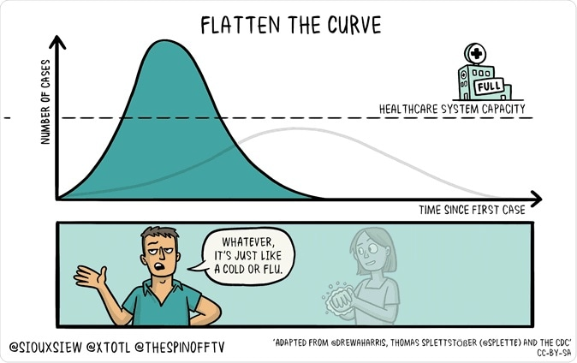
(ii) Visual communication:
On 9 March 2020, 2 days before the World Health Organization declared COVID-19 a global pandemic, two of the authors (microbiologist and infectious diseases expert Associate Professor Siouxsie Wiles and cartoonist Toby Morris) released their first output together: an animated GIF known as “Flatten the Curve”. The graphic went viral on Twitter with over 10 million impressions in 3 days.
Source: https://www.news-medical.net/news/20200312/Flattening-the-curve-why-is-it-important-for-coronavirus.aspx

Slide 29

Example visual communication:
Selection of graphics produced by Wiles and Morris. Wiles and Morris' graphics include illustrations of the “bubble” concept for households (A), how the incubation period of the virus results in a “lag” (B), dual-meaning words (C), different ways to detect a COVID-19 infection (D), COVID-19 variants (E), masks (F), how mRNA vaccines work (G), how the COVID-19 vaccines were developed so fast (H), the concept of “community immunity” (I), contact tracing (J), the “The Swiss cheese model” (K), and how to correctly take a nasal swab (L).
Reference: https://www.frontiersin.org/articles/10.3389/fcomm.2023.1087120/full

Slide 30
Challenges in the field of Science Communication
Various deep rooted factors that tend to keep science at the bottom of newsgathering, packing and dissemination as pointed out below
Use of Scientific Jargons and Complicated Statistics in Scientific Manuals
Scientific research remains an endless source of new and old terminologies that drive journalists mad.
Mountains of raw data contained in research papers worsen it.
It is a major professional challenge for even those with the best mass communications skills when one is to reduce piles of jargon and statistics into short, simple and clear message
2. The Social Responsibility Demands:
Sustainable coverage of science remains elusive for many media houses.
Even skilled science reporters first need to develop at least some strong interest in the coverage of science issues
Despite being science journalists they are always bound to ask, ‘what is the people impact and is it for the common or public good?’
https://www.jheaonline.org/pdf/Wabwire_jhea.8.7165.pdf

Slide 31
3. The Diverse Nature of Science Issues
Science issues tend to be diverse ranging from space science and engineering to the alarming evolution of highly drug-resistant tuberculosis (TB) and malaria germs apart from genetically engineered crops and microbes.
There is need to specialize and cope with rapid changes in the world of science and technology.
In Africa; health, environment, agriculture and emerging world of biotechnology are at the core of science reporting
4. Journalistic Stereotypes and Myths
There is an assumption that when dealing with serious academic, professional and research issues, scientists have their own communication outlets especially peer-reviewed and high indexed scientific journals that are inaccessible to the general public
Creates conflict and distrust with journalists
Reference: https://www.jheaonline.org/pdf/Wabwire_jhea.8.7165.pdf

Slide 32
Coping with the challenges in the field of science communication:
Tips for working with the Media
Communicate simply and clearly: well-written executive summary-style document, which outlines the key points of the research findings
Build relationships: Ask your public affairs or media specialists to help communicate your published work to journalists to educate the public about it.
Set an embargo: The most important way to make your findings as a researcher newsworthy to reporters is to make sure it’s new.
Prevent misrepresentations: Some scientists are wary of seeking press attention, fearing their findings might be exaggerated, sensationalized or otherwise misrepresented.
vi. Finding a hook: Press release should use one or two angles — or ‘hooks’ — that appeal to news values.
Common hooks for science news include:
Broad impact: does what the researchers found affect a large segment of the population?
Currency: does the research findings connect to issues that are already in the spotlight?
Injustice: does the findings highlight ethnic, socio-economic or other inequalities?
Irony: are the findings unexpected?
Controversy: are the findings likely to elicit a backlash from special-interest groups?
Local: are the findings especially relevant to a particular geographical area?
Reference: https://www.jheaonline.org/pdf/Wabwire_jhea.8.7165.pdf

Slide 33


Slide 34


Slide 35


Slide 36
Take home message?
Protection from past infection against re-infection from pre-omicron variants was very high and remained high even after 40 weeks.
Protection was substantially lower for the omicron BA.1 variant and declined more rapidly over time than protection against previous variants.
Protection from severe disease was high for all variants.
The immunity conferred by past infection should be weighed alongside protection from vaccination when assessing future disease burden from COVID-19,
Providing guidance on when individuals should be vaccinated,
Designing policies that mandate vaccination for workers or restrict access, on the basis of immune status, to settings where the risk of transmission is high, such as travel and high-occupancy indoor settings.

Slide 37


