Slide 1


A Pathway for Reduction in HIV-related Stigma: A Tele-Training Model for Malaysia and the Region
By Rumana Akhter Saifi, MSS, MA, MPH,PhD
Director
CERiA: Centre of Excellence for Research in AIDS
Faculty of Medicine
University of Malaya
and
Senior Lecturer
Faculty of Medicine
Universiti Malaya

Slide 2
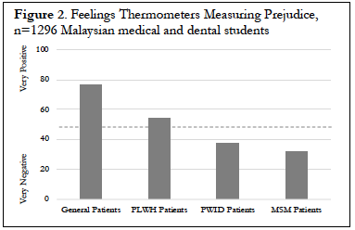
Background: Stigma and HIV
Stigma → global barrier to HIV testing, prevention + linkage to care
Forms of clinician stigma:
  Stereotypes: group-based beliefs applied to individuals
  Prejudice: negative emotions and feelings about group members
  Discrimination: unfair or unjust behaviors towards group members
Notes:
Stigma is a global barrier to hiv testing, prevention + linkage to care
There are a few forms of clinician stigma that we’re particularly interested in:
Stereotypes… group-based beliefs that are applied to individuals
Prejudice… negative emotions and feelings about group members
Discrimination… unfair or unjust behaviors towards group members
These are all interrelated, with stereotypes and prejudice leading to discrimination
We’ve done some preliminary research starting in 2014 with medical and dental students, as well as practicing clinicians, looking at stigma towards key populations and plwh
This graph just shows feelings thermometers towards patient groups
100 would indicate that participants feel very positive towards the group, or very little prejudice, and 0 indicates very negative, or a great deal of prejudice
What you can see is that students told us they felt pretty positive about patients in general, ambivalent about people living with hiv, and then more negatively about people who inject drugs and men who have sex with men patients

Slide 3
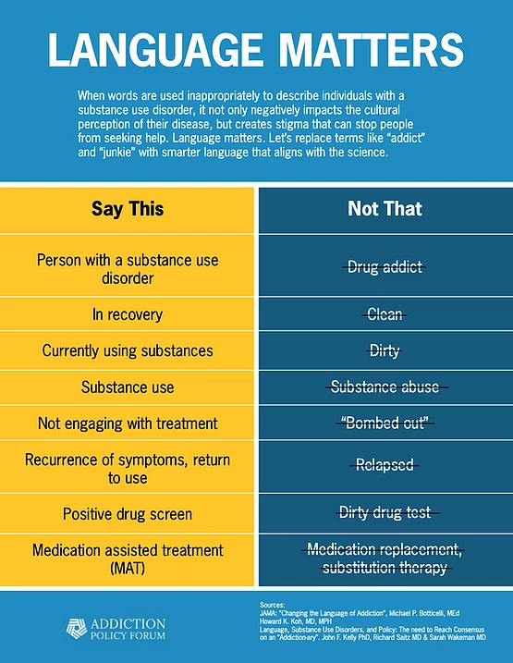



Stigma Reduction Tool: Language
Language…
  Spreads stereotypes OR
  Promotes impressions that substance use disorders are treatable, chronic illnesses
Use person-first language:
  Person with a substance use disorder
  Person living with HIV
Resources:
  Language Matters, Addiction Policy Forum
  Addictionary, Recovery Research Institute: https://www.recoveryanswers.org/addiction-ary/
  UNAIDS Terminology Guidelines: https://www.unaids.org/sites/default/files/media_asset/2015_terminology_guidelines_en.pdf
Notes:
Language is another way to change stigma among perceivers
Thinking more about intersectionality, here’s an example from the substance use disorder field
Research shows that language can spread stereotypes 🡪 individuals described as substance abusers are seen as deserving of blame and punishment, and unlikely to benefit from treatment
Research also shows that language that is scientifically accurate and person first – like person with a substance use disorder - has been shown to promote perceptions that substance use disorders are chronic yet treatable health conditions
Changing language is not necessarily easy. But there are great resources out there to help us with this tool – from the Addiction Policy Forum and the Addictionary at the recovery research institute at MGH
And, UNAIDS has a resource on terminology guidelines related to HIV that was created in partnership with the Global Network of People Living with HIV

Slide 4
Contact Theory
Prejudice toward outgroups may be reduced with interpersonal contact^{1,2}
Mechanisms³
  Greater knowledge, reduced stereotypes
  Less anxiety, fear
Reduced prejudice may result in reduced discrimination
¹Allport (1954), ²Tajfel et al., (1971), ³Pettigrew & Tropp (2008)
Notes:
Contact Theory provides some insight into how to address stigma among these individuals.
CLICK Contact theory was initially proposed by Allport, who was a contemporary of Goffman. Allport held that prejudice toward outgroups may be reduced through interpersonal contact. And, outgroups are just groups of people that are different in some way from the self. For example, heterosexual individuals may view LGBTQ people as outgroup members.
CLICK It has been proposed that contact leads to reduced prejudice through learning about outgroup members, which leads to greater knowledge and less stereotypes. Contact may also lead to less anxiety about and fear of outgroup members.
CLICK And ultimately when prejudice is reduced, discrimination may also be reduced. In healthcare settings, reduced discrimination can mean improved health outcomes for stigmatized groups

Slide 5
Education and Information
What is it?
  Approaches designed to share information about HIV and PLWH to increase knowledge
  Modes: in person, online, written
What were the findings?
  Most common stigma reduction intervention
  Reduces stigma, possibly through stereotype and fear reduction
What should we do?
  Share information, along with other strategies
Stangl, Lloyd, Brady, Holland, & Baral (2013) Journal of the International AIDS Society.
Notes:
In the longer term, we really would want to reduce stigma within communities so that no PLWH would experience enacted stigma, anticipate stigma, or run the risk of internalizing it
The literature highlights several things that are helpful in reducing stigma
CLICK one, not surprisingly – is information. This is sharing knowledge about HIV and people living with HIV – in person, online, or through written materials – to increase knowledge
CLICK a review of HIV stigma interventions suggests that this is the most common HIV stigma reduction intervention
And its effective – it reduces stigma, possibly by addressing stereotypes and fear
CLICK this review suggests that targeting information, along with other strategies, is important

Slide 6
Skills Building
What is it?
  Typically targets healthcare providers
  Training in infection control: personal protective equipment, needlestick prevention, cleaning and disinfection
What were the findings?
  Second most common stigma reduction intervention
  Reduces stigma, possibly by reducing fear
What should we do?
  Ensure adequate skills training for people working with PLWH in healthcare settings
Stangl, Lloyd, Brady, Holland, & Baral (2013) Journal of the International AIDS Society.
Notes:
CLICK Skill building is a stigma reduction strategy typically used with healthcare providers
This involves targeted training in things like infection control – how to use personal protective equipment, cleaning and disinfection. This is really to address fears about infection that are unsubstantiated
CLICK This review of stigma interventions found that this is the second most common stigma reduction intervention AND that just by giving people proper training – training that could be used with all types of patients – reduces stigma
CLICK So, bolstering skills training in addition to sharing information, may be paticularly helpful in healthcare settings

Slide 7
Resilience Interventions
Spiritual Peace
  Sense of peace and meaning from spiritual beliefs
Activism
  Engaging in action to bring about social change
Social Support
  Material support, behavioral assistance from others
Perceived Community Support
  Access to accepting/supportive services and organizations
Chaudoir, Norton, Earnshaw, Moneyham, Mugavero, & Hiers (2012);
Earnshaw, Lang, Lippitt, Jin & Chaudoir (2015); Earnshaw, Rosenthal, & Lang (2016). AIDS Care.
Notes:
We might also be concerned that these stigma interventions might take a long time – stigma is hard to change, after all.
There’s been more attention being paid to how we can protect people from stigma while we are trying to change it. We know that people with some characteristics are more resilient to stigma – so they may be experiencing stigma from others, but they are able to maintain positive health despite that stigma. We know that people with more spiritual peace, who engage in more activism, who have more social support from others, and who perceive more community support from organizations and local services are more resilient to stigma
So these may represent intervention targets to buffer or protect people from stigma

Slide 8
Our Project
Implementating stigma reduction tools via a popular tele-training platform to reduce clinician stigma and disparities in HIV testing, prevention and linkage to care in Malaysia
AIM 1
AIM 2
Project ECHO for stigma reduction
Evaluate key elements that will influence the implementation of evidence-based stigma reduction tools via Project ECHO®
Photovoice to collect evidence regarding perceptions of clinician stigma among key populations and PLWH
Evidence on Malaysian clinician perspectives via 4 online focus groups with 30-40 general practitioners and family medicine clinicians

Slide 9
Current Project: Objectives
Long-term: Address clinician stigma regionally via the widespread implementation of evidence-based stigma reduction tools via Project ECHO.
Short-term: Incorporate evidence-based stigma reduction tools into Project ECHO and pilot our resulting intervention with clinicians in Malaysia.

Slide 10
Background: Stigma Intervention Toolkit
Tool | Description
Intrapersonal Level: Targets how individuals think, feel, or behave towards members of stigmatized groups
Education | Provide fact-based information to refute stereotypes, reduce fear, increase cultural awareness
Clinical Skills | Build skills to communicate with and provide appropriate care
Interpersonal Level: Harnesses the power of social situations to reduce stigma
Contact | Facilitate interaction with members of stigmatized groups to reduce prejudice and refute stereotypes
Structural Level: Changes the social conditions that give rise to stigma
Social Norms | Change perceptions of stigma endorsed by peer group
Behavioral Design | Constrain opportunities for stigma to influence decision making and care provision
Notes:
Contact - or facilitating interactions between members of stigmatized groups and healthcare providers - is one tool in the stigma intervention toolkit
These are all evidence-based strategies to reduce stigma
In addition to contact, research suggests that providing education and strengthening clinical skills can reduce stereotypes and build skills to work with key populations
Also - interventions that shift social norms and also incorporate elements of behavioral design, which constrains opportunities for stigma to influence the decision making process - this can be as simple as a checklist - can reduce stigma
So these are some of the stigma reduction tools that we are aiming to incorporate into our intervention

Slide 11
Project Team
University of Malaya
Adeeba Kamarulzaman (PI)
Asfarina Amir Hassan
Pui Li Wong
Raja Iskandar Shah Azwa
Rumana Saifi
Sharifah Faridah Binti Syed Omar
University of Delaware
Carly Hill
Jonathan Cox
Valerie Earnshaw (PI)
Zachary Collier
Community Health Center, Inc
Marwan Haddad
Yale University
Frederick Altice

Slide 12
Background: Stigma Intervention Toolkit
Optimal Delivery of Stigma Intervention Tools:
  Longitudinal: single session interventions don’t lead to lasting change
  Multilevel: stigma changed at one level not sustained without changes at other levels
  Multicomponent: there’s no one single tool that can eliminate stigma, many tools are needed
MULTILEVEL
LONGITUDINAL
MULTI-
COMPONENT
Notes:
In addition to identifying stigma intervention tools, previous research has suggested some ways in which we should be using the tools to make sure they are effective. In particular, they should be:
Longitudinal because single session interventions don’t appear to lead to lasting change
Multilevel because stigma changed at one level isn’t sustained unless its changed at other levels
And multicomponent because there’s no one single tool that can eliminate stigma on its own - just like you probably can’t use just one tool to build or take down a house - you need many tools

Slide 13
Project structure
Aim 1: Preliminary studies to inform implementation
→ Phase 1: PhotoVoice study with key populations and PLWH
→ Phase 2: Online focus group study with clinicians
→ Phase 3: Pre-test intervention protocol
Aim 2: Pilot test of intervention

Slide 14

Background: Traditional Stigma Interventions
What’s Been Done:
  One clinic at a time
  Short in duration
  Few stigma reduction tools
  Single-level interventions
What’s Needed:
  Multiple clinics / clinicians
  Longer in duration
  Multiple stigma reduction tools
  Multi-level interventions
Notes:
Our traditional stigma interventions arguably haven’t kept up with our research on these best practices
Our traditional interventions work on one clinic at a time - so they are limited in scope
They’re short in duration - maybe a few days at best
They may only include a few stigma reduction tools
And they often focus on one level - like maybe just the intrapersonal level
We think that what’s needed is to address many clinics or clinicians at the same time - to broaden our scope
We need interventions that are longer in duration - so that stigma is reduced
We need interventions that incorporate multiple stigma reduction tools that work at multiple levels - so knowledge paired with contact paired with changing social norms for example

Slide 15

A Solution:
Project ECHO
Notes:
PUI LI

Slide 16

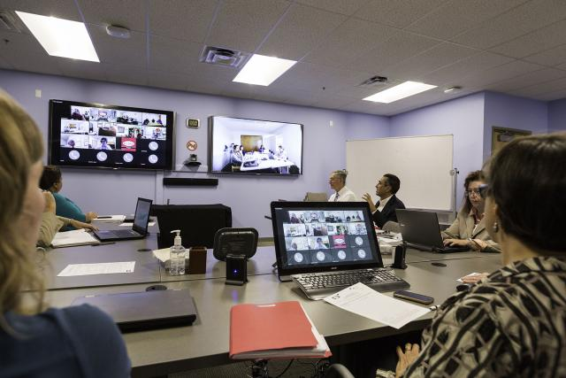
Background: Project ECHO
Teletraining platform for clinicians
  Video
  Develops knowledge + capacity in non-specialist clinicians
Popular
  Recommended by leading health organizations
  Previous efficacy shown with HIV
  Has connected 70,000+ clinicians in 37+ countries

Slide 17
Aim 1: Inform Implementation
Phase 1: PhotoVoice study with key populations and PLWH
  n=30-35 key populations/PLWH
Phase 2: Online focus group study with clinicians
  n=30-40 general practitioners + family medicine specialists
Phase 3: Pre-test intervention protocol
  n=5 general practitioners + family medicine specialists

Slide 18
Aim 1 : Online focus group study with clinicians
Goal: Gain insight into acceptability + feasibility issues
Participants: n=35 participants
  Years practicing: M(SD)=14.2(10.8) years, range=2-44 years
  Affiliation: 67.6% Private Sector, 32.4% Ministry of Health
  Gender: 58.8% men, 41.2% women
  Ethnicity: 47.1% Chinese, 26.5% Malay, 11.8% Indian, 14.7% Other
  Religion: 29.5% Muslim, 29.4% Buddhist, 11.8% Christian, 11.8% Hindu, 17.6% Other
Notes:
VAE RESTARTS
Our goal with our clinician focus groups was to gain some insight into acceptability + feasibility issues surrounding the intervention: i.e., whether participants thought they would like to do it, and what they thought would make it easier or harder to participate
We were able to run these last month - we had 35 clinicians complete 4 different online focus groups
Here are some of the characteristics of the sample
Decent range in terms of years practicing
Most were from private sector
Just over half were men
Almost have were Chinesse and over a quarter were malay
About a third Muslim and third Buddhist

Slide 19
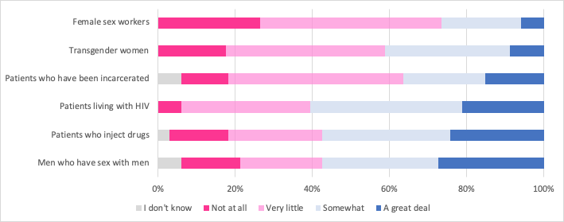
Aim 1: Online focus group study with clinicians
Contact: How much have you interacted with these types of patients?
Notes:
About 40% of these participants reported that they had very little or no interaction with most of the key population groups
A few more participants had interacted with patients who inject drugs, men who have sex with men, and patients living with HIV

Slide 20
Aim 1: Online focus group study with clinicians
Acceptability: What do you think about Project ECHO for HIV testing and prevention?
  Content: “ECHO is a good idea for HIV testing and prevention in primary care. Yes, I want to participate in this project to improve my knowledge and skill in HIV testing and prevention for my patient.”
  Format: “I think that is absolutely awesome idea. After the pandemic, I am very used to online webinar and prefer to just stay home without going to certain location to attend a course.”
  Duration / Content: “Looking at the planned intervention, I think twice a month meeting for one hour, for 9 months is rather too much than is necessary for just these topics. I don’t think I would have the time necessary to commit to such a long project, if it only relates to this very specific topic.”
Notes:
Turning towards the qualitative results
We found some indications that participants liked the idea of Project ECHO
Participants said that they’d want to participate in Project ECHO to improve their knowledge and skill in HIV prevention and testing
And others liked the idea of the webinar format, and said that they were used to this after the pandemic
We also had a few participants suggest that the duration of 9 months was too long
this suggests to us that we didn’t communicate about Project ECHO very well to our participants. There are topics that they learn about, but the goal is moreso to create a learning community wherein clinicians are creating a community wherein they can learn together, receive strong and sustained mentorship, AND apply their knowledge over the course of several months
Most Project ECHOs are 12 months, and so we’re already pitching a slightly shorter version of this program

Slide 21
Aim 1: Online focus group study with clinicians
Feasibility: What would make it harder for you to participate in Project ECHO?
  Timing / Other Priorities: “During working hours it is quite difficult to give full commitment to attend that 1 hour session because clinic is running, with unexpected schedules/meeting/tasks/referral.”
  Internet access: “Many of our colleagues in rural areas still have pretty bad internet access. Enough for googling but teleconferencing may be a challenge.”
Notes:
We asked participants what would make it harder for them to participate - what are barriers to feasibility of the program
They mentioned protecting their time for two hours a month might be challenging
And several participants mentioned that internet access in rural areas might be problematic

Slide 22

Example
How do doctors see you?
“Pandangan doktor terhadap saya,
Saya seorang yang active dan degil.”
“Doctor's view of me,
I am an active and stubborn person.”
Person who injects drugs

Slide 23
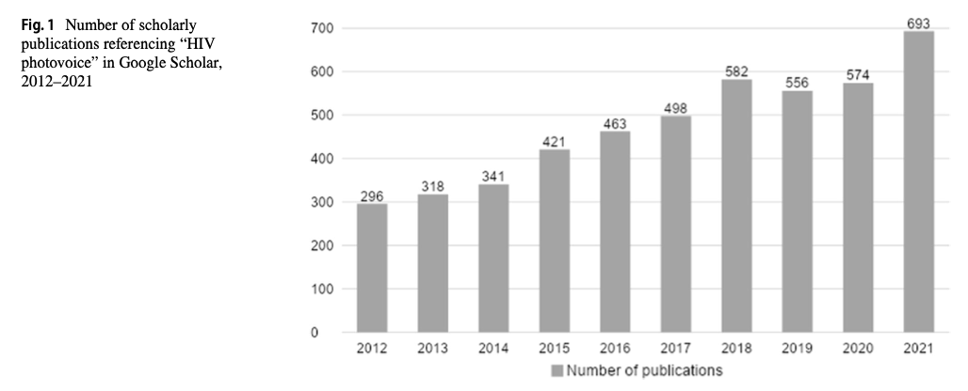

Slide 24
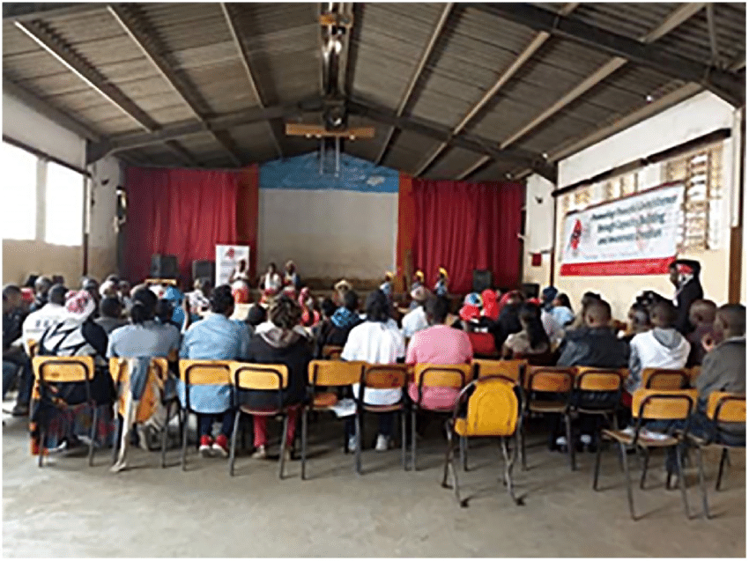
In Person, Synchronous: Traditional Methods¹
Hold in person workshops / trainings
  Photography skills
  Research methods
  Ethics
  Social power
Take photographs in communities
Review photographs + discuss
Hold public exhibits
Photovoice workshop in Nairobi, Kenya²
¹Wang & Burris (1997); ²Gibson et al. (2021)

Slide 25

Rationale for Online, Asynchronous Methods
Practical:
  Movement Control Order in Malaysia due to COVID-19
Opportunities:
  80% of people worldwide have smartphones (2022), with use increasing in LMICs¹
  Social media engagement increasing worldwide
Acceptability and Feasibility:
  Location / transportation barriers to in-person gatherings
  Strong cultural or structural stigma experienced by key populations
¹O’Dea (2022)

Slide 26
Website Development
Safety features
  HIPAA Compliant
  Participants were provided email addresses + logins
Structure
  Homepage
  Introduction
    To project
    To photography
  Photovoice prompts

Slide 27
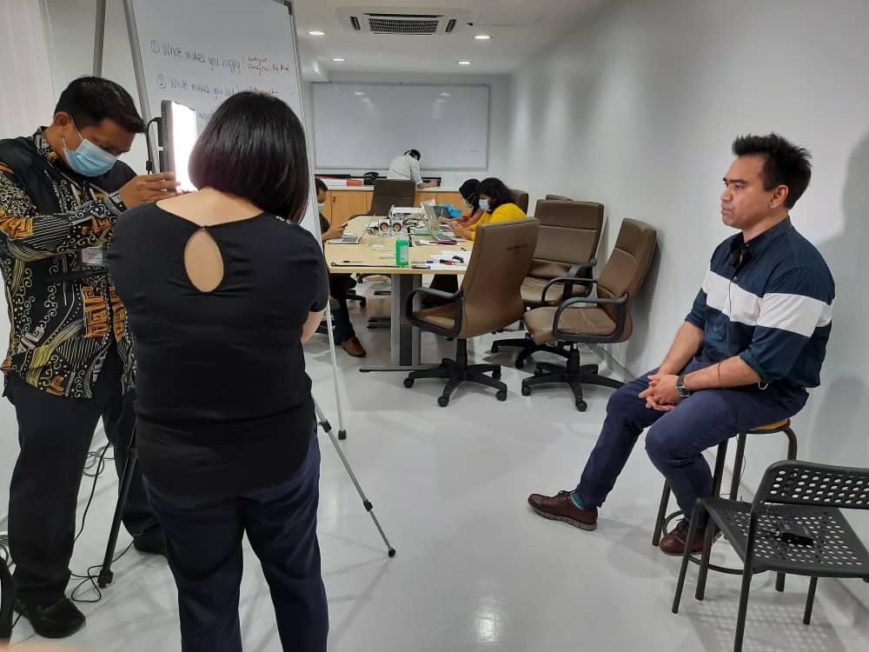
Videos
Introduced project and website
Taught photography skills
  Color
  Composition
Introduced each photovoice prompt
  What makes you happy?
  What makes you sad?
  What is important to you?
  What challenges do you face?
  How do doctors see you?
  What would you like doctors to know about you?

Slide 28

Welcome Video

Slide 29

Photography Instruction

Slide 30
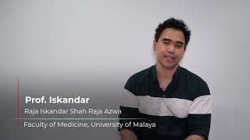
What challenges do you face?

Slide 31

Participant Recruitment and Engagement
Recruitment from local community-based organizations
Participants connected with study coordinator via WhatsApp call
  Screening
  Consent
  Introduction to website
Study coordinator monitored website progress and answered questions via text over course of week as participants completed project

Slide 32
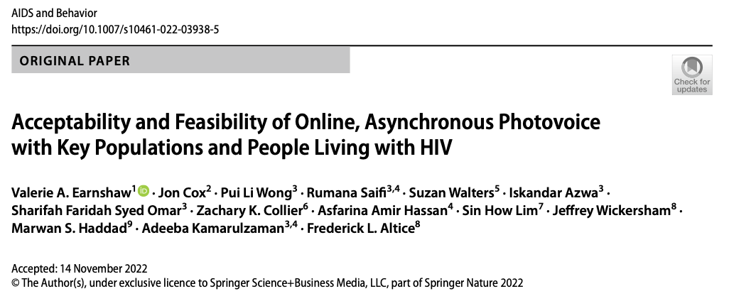
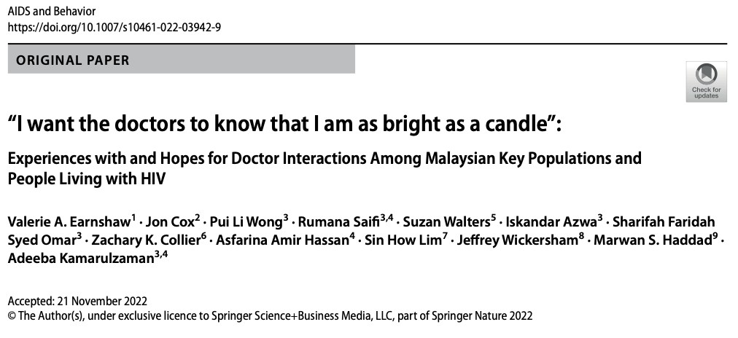
Results

Slide 33
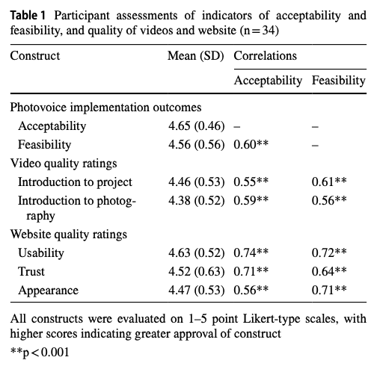
Results: Acceptability and Feasibility of Methods

Slide 34
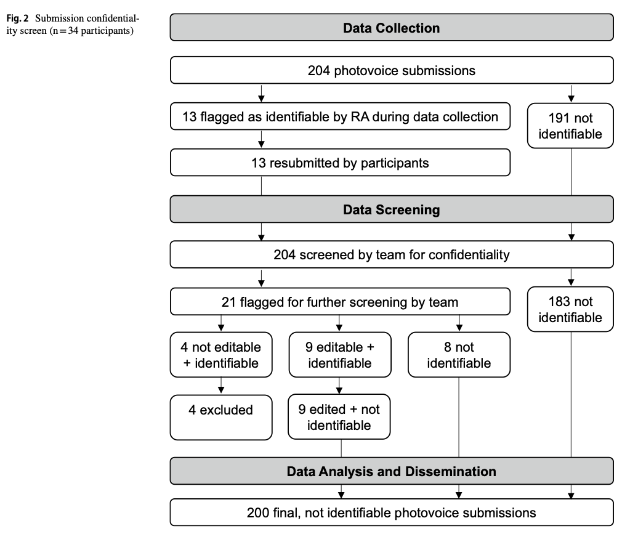
Results: Acceptability and Feasibility of Methods

Slide 35
Results: Acceptability and Feasibility of Methods
“I love it because it gives me the opportunity to convey my heart and words through pictures, in a unique way.”
“Unlike an ordinary survey, the photovoice allows participants to do something fun.”
“I do not have to fill in any details about myself to register. I feel comfortable and safe.”
“Photovoice projects entail the opportunity for empowering participants. Future research using photovoice should assess the influence it has on participants’ empowerment changes and how to sustain those individuals and social changes.”

Slide 36
Results: Stigma Experiences
Positive experiences
  Doctors want the best for patients (PWID)
  Kind and professional (TGW)
Stigmatizing experiences
  Misgendered and seen as sinful (TGW)
  Seen as small, misguided and incapable (MSM)
  Question whether doctors care (PLWH)
Respond by wearing a mask
  Afraid to open up, or be vulnerable (FSW)
  Sugarcoated exterior, hiding themselves (MSM, PLWH)

Slide 37

How do doctors see you?
“Even though I am a sex worker, the doctor I visit still treats me like other human beings even though I do activities that are outside the norms of other human beings and the doctor feels that I should be treated like other human beings.”
Female sex worker

Slide 38

How do doctors see you?
“I feel like doctors see me as not normal or one may called a freak. Ever went to a clinic to get myself tested so I can know my status. The doctors were shock and look at me weirdly.”
Man who has sex with men

Slide 39

What makes you sad?
“The mask that I have to wear when I approach new people or forced to wear by society. People expect me to wear a certain mask to blend in with the norm. It saddens me that I have to hide who am I even when I have been through a lot to take it off.”
Man who has sex with men

Slide 40
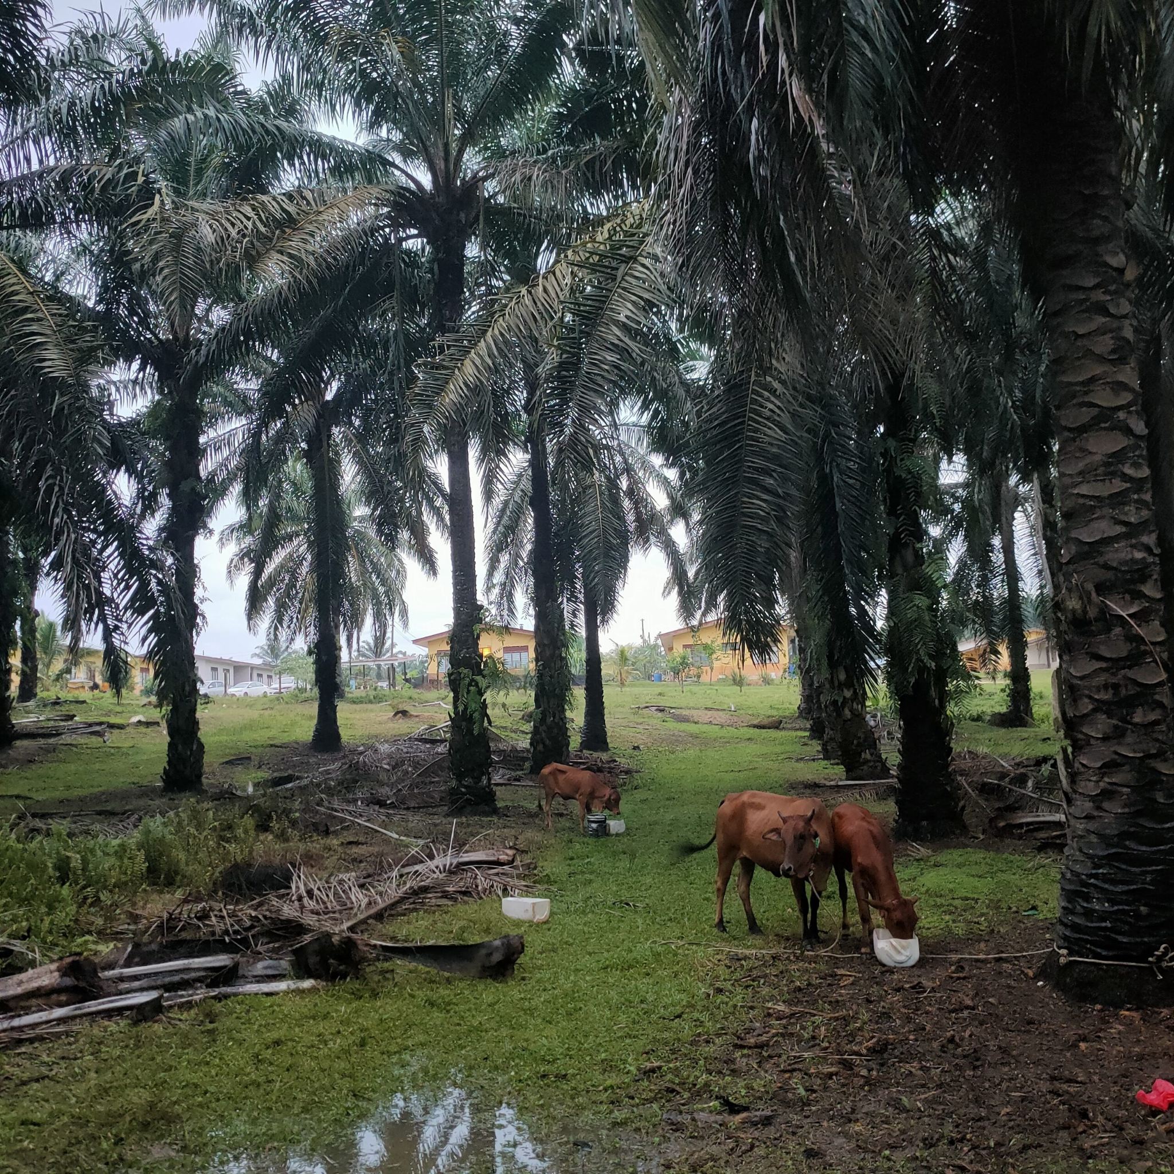
What do you want doctors to know about you?
“I just hope the doctors treat me as women and equally with other patients without any stigma or discrimination. I just want be healthy and peaceful like the nature in the picture.”
Transgender woman

Slide 41

What do you want doctors to know about you?
“Aku ingin doktor tahu mengenai aku yang aku ini kuat akan tetapi ada masanya aku jadi ketakutan bila aku menghadapi kengkangan daripada penyakit ini di mana aku perlukan sokongan ilmu perubatan dari segi fakta dan sokongan moral.”
“I want the doctor to know about me that I am strong but there are times when I get scared when I face the limitation of this disease where I need the support of medical knowledge in terms of facts and moral support.”
Person living with HIV

Slide 42

What do you want doctors to know about you?
“I want doctors to know that I want to be free. Free of being myself around them. To spread my wings and share my experiences with them. So they can help me reach the skies. But at the end of the day, I am still human, my wings may need tending when I make a mistake and I know I have good doctors I can trust that can treat me without clipping my wings in the process.”
Man who has sex with men

Slide 43
Dissemination
Videos
  Featured in our intervention to reduce HIV-related stigma among clinicians (example)
  Brief videos created for social media (example)
2 published manuscripts (link 1, link 2)
Posted to CERiA website (link)
World AIDS Day Exhibit
  Featured in CodeBlue article (link)

Slide 44
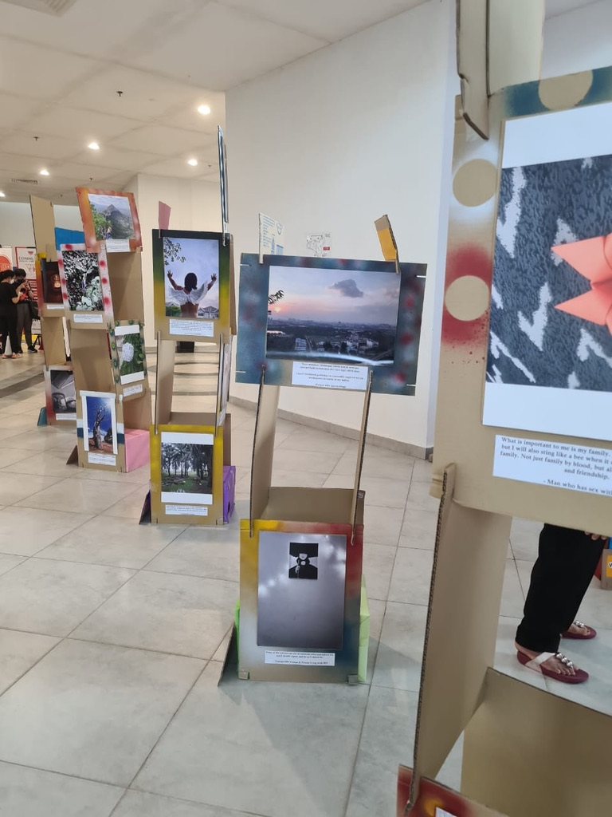
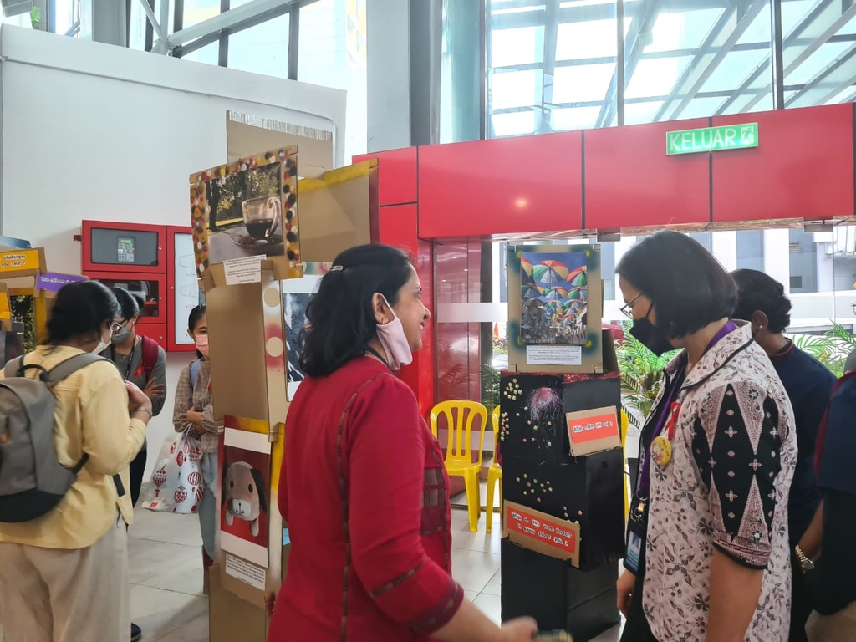
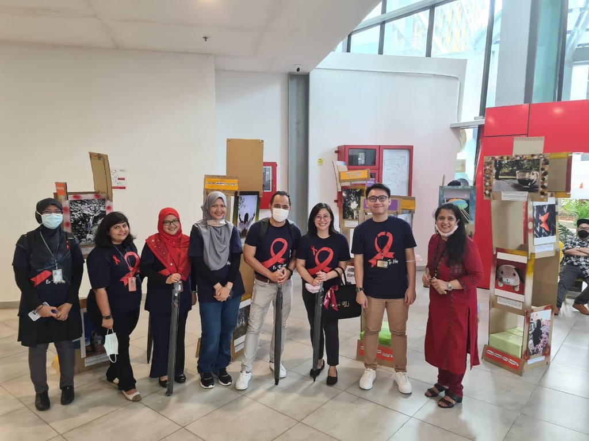
World AIDS Day 2022

Slide 45
Limitations and Next Steps
Participant engagement at analysis phase
  Leverage blogging for engagement and analysis?
Resources
  Website is costly - how to scale up?

