Slide 1



HIV AND AGING
Ageing with HIV: Opportunities for implementation science research in Malaysia
Reena Rajasuriar, MPharm, PhD
Department of Medicine, Faculty of Medicine;
Centre of Excellence for Research in AIDS (CERiA)
University of Malaya

Slide 2
Outline
HIV AND AGING
Setting the scene:
  Epidemiology of older PLWH (≥50 years)
Current gaps in HIV care → need to redefine HIV care models
Barriers to HIV/NCD care integration in UMMC
  Ongoing implementation studies
HIV care challenges in individuals acquiring HIV at older age
Notes:
Setting the scene describing the burden of older PLWH and what to expect in the coming decade
Share studies highlighting the gaps in care in PLWH --> why we need to redefine HIV care models
Summary of data from studies done to explore facilitators and barriers to integration of NCD care as part of HIV services in UMMC - introduce Mhint and NeuroScreen
HIV care challenges in older adults acquiring HIV

Slide 3
Epidemiology of PLWH ≥ 50 years
HIV AND AGING
Population pyramid of PLWH in Asia Pacific, 2022
Global (2022)
9.46M (24%) global population of PLWH ≥ 50 years
19% in Asia Pacific
Asia Pacific (2022)
27% of PLWH in the AP region are 50 years or older
1 in 3 females
1 in 4 males
~28%
Total = 2.43M
Total = 4.07M
Source: UNAIDS epidemiological estimates, 2023.
Notes:
27% of PLWH in AP region are 50 years or older.

Slide 4
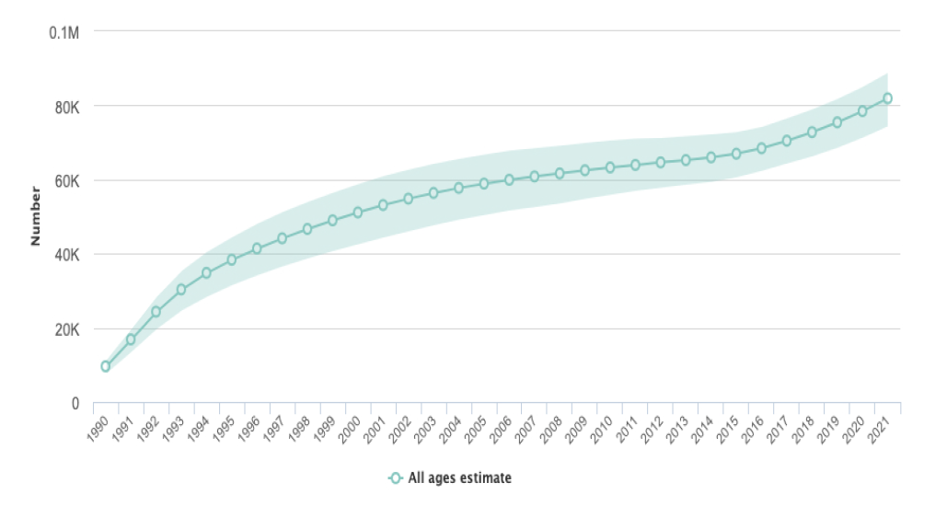
People living with HIV in Malaysia
HIV AND AGING
1990-2021
82 000
Proportion ≥ 50 years?
UMMC (2020):
1 in 3
≥ 50 years
Source: Prepared by www.aidsdatahub.org based on UNAIDS 2021 HIV Estimates
Notes:
And so as observed in other regions globally, the burden of older PLWH is growing fast. Why is this a concern if we have good and effective ART to maintain viral suppression?

Slide 5
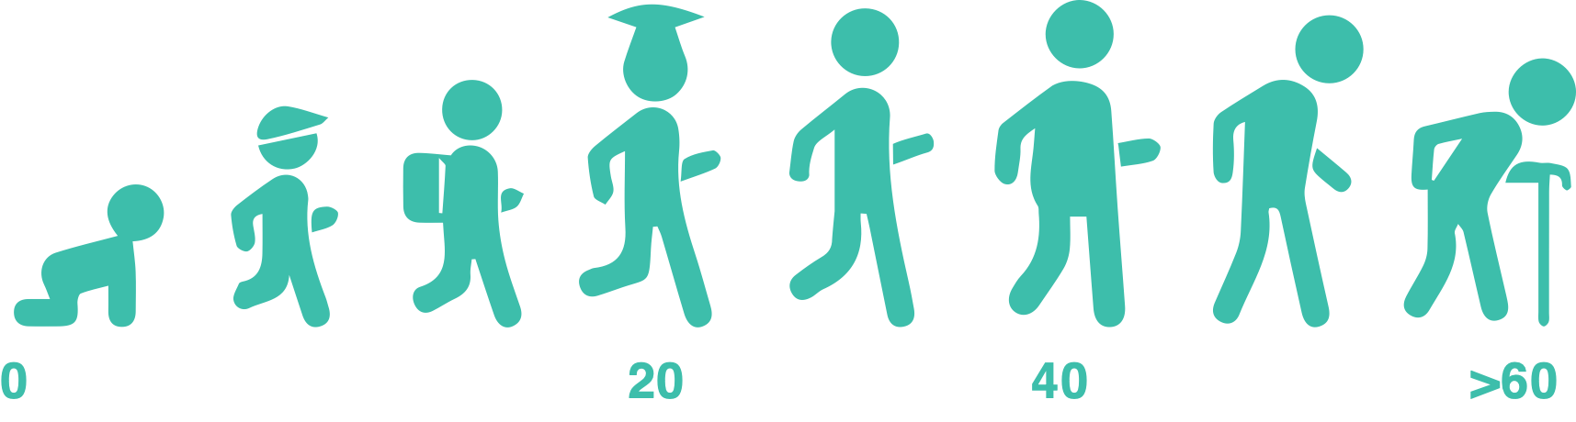

PLWH ≥ 50 years – heterogenous group
HIV AND AGING
Different experiences and challenges to remain in optimal health as they age
Growing old with HIV
Acquire HIV
at older age
Notes:
Their experiences living with the virus – major part of adult life vs NOT have much experience living with HIV
Each have different challenges to remain in optimal health as they age

Slide 6
Extended lifespan ≠ Healthspan
Healthspan
X
HIV pre-ART
HIV + ART
Age-related disease
Lifespan
Notes:
So why are we interested to study older PLWH as a group separate from the general HIV population?
ART has increased life-expectancy but this does not seem to have translated to an increased healthspan. Traditionally, healthspan has been defined as the period an individual spends free of disability.

Slide 7
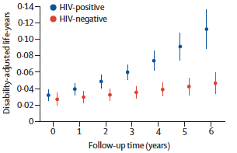
Evolution of disease burden in PLWH
AGEhIV Study Cohort: PLWH (n=596) and without (n=550) HIV; follow up period 6 years; median age at baseline = 50 years; median years living with HIV = 12 years; 95.8% on ART
Mean DALY increase: HIV+ 0.209/yr vs HIV- 0.019/yr, p=0.005
Difference in DALY driven by mortality from non-AIDS related malignancies and NCDs
Disability-adjusted life years (DALY)
DALY = years lost to disability + years lost to premature death
Verheij E Lancet HIV 2023.
Notes:
-investigators explored how having comorbidities impacted the health state of individuals by measuring disability-life adjusted years or DALY. This matrix takes into account the number of years lost due to disability associated with having comorbidities and as well as life lost due to premature death.
And as observed in the graph, PLWH experienced significantly higher rates of healthy life lost as they grew older compared to individuals without HIV. And this increased was mainly attributable to deaths from non-AIDS cancers and NCDs in PLWH.
And so although ART has significantly increased life extency, HIV is still associated with significant disability in later life.

Slide 8
Malaysian HIV & Aging Study
Age, sex, ethnicity
matched
Median age = 42 years;
73% male
HIV + (n=329)
UMMC
HIV – (n=290)
community-dwelling
Inclusion criteria:
Age ≥25 years
No reported acute illness at recruitment
- On stable cART (HIV RNA <50 copies/ml for at least 12 months)
Notes:
In Malaysia, we established a a clinic based to explore comorbidities and the burden of age associated condition in PLWH

Slide 9
Burden of geriatric conditions higher in PLWH vs HIV-ve
p<0.05
Adjusted for age, sex, ethnicity, education, employment, smoking, alcohol consumption
* p<0.05
(Rajasuriar R, AIDS 2017; Azdiah S AIDS 2018)
Notes:
We performed a series of assessments to profile chronic comorbidities and geriatric conditions in this relatively young cohort. We found that for all the 10 geriatric conditions we assessed the prevalence was numerically higher in the HIV-infected compared to uninfected controls.
The burden of these conditions was significantly higher in PLWH even after adjusting for socio-demographic factors and lifestyle.
This was the point we became aware of the extent of issues in our patients despite many them having well controlled HIV disease.
We then did some focused analysis on the trying to understand gaps in care for polypathology → ID clinicians are trained.

Slide 10
Audit of NCD management in HIV
1) New cases identified
2) Treatment prescribed (lifestyle/drug)
3) Achievement of target levels
(Local CPGs for individual comorbidities)
  Hypertension
  Dyslipidemia
  Diabetes mellitus
4) Mental health → screening and linkage to care
HIV + (n=329)
UMMC
MHIVA results assessment
Prospective follow-up
Assessment of treatment cascade
Timepoint
0
6-12 mo
18 months
Notes:
Prospective audit of study participants charts all of who received screening but management following screening was according to routine clinical practice.

Slide 11
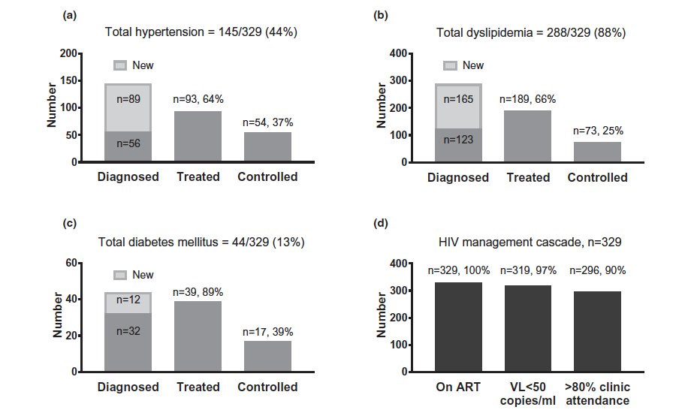
Optimizing treatment for comorbidities
(Chong ML, J Int AIDS Soc 2020)
Notes:
In this assessment we looked at how many new cases were picked up as a part of the study and among all with the condition, how many received treatment and how many achieved treatment targets after 18months of follow up.

Slide 12
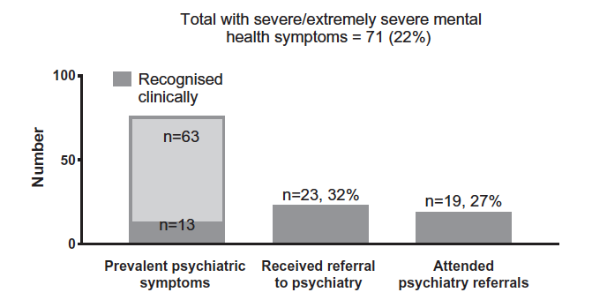
Optimizing treatment for mental health
(Chong ML, J Int AIDS Soc 2020)
Notes:
We assessed how many participants with severe to extremely severe MH conditions had a prior clinical diagnosis and how manywere picked up as a result of the study → screening for MH is not part of routine HIV care.
Referral to psychiatry unit was also poor following screening but among those who received screening, attendance of first clinic appointment was good.

Slide 13
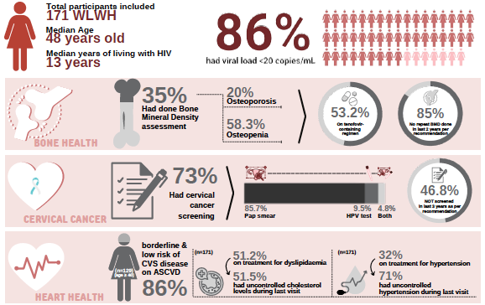

Optimizing HIV/NCD care for WLWH
(Kukreja A, Abstract #59, APACC 2022)

Slide 14
What we have learnt so far…
1. High burden of NCDs/age-associated conditions but we are not routinely screening for them in clinic.
2. Even when NCDs/age-associated conditions are diagnosed, care continuity is poor.
3. Need to actively engage with other specialties to optimally manage older PLWH.

Slide 15
Transitions in HIV care
Services needed
Models of care
HIV physician
Nutritionist
Parellel
Pharmacist
Occupational therapist
Coordinated
Geriatrician
Psychiatrist
Integrated
Nurses
Social worker

Slide 16





Consolidated Framework for Implementation Research (CFIR)
HIV/NCD care integration – pre-implementation
studies
[FGDs and IDIs with clinicians (ID, psychiatrists, geriatrics, neurologists, rehab medicine), nurses, admin staff, and PLWH in UMMC]
Mental health & Substance use
Cognitive impairment
Mental health & wellness clinic for WLWH
Cognitive rehabilitation therapy
Notes:
FGDs and IDIs to assess integration of screening and LTC encompassing mental health, substance use and cognitive impairment among HCP and admin/supportive staff at different levels. FGD and interview guides were developed based on the CFIR framework which is a determinant framework to help understand barriers and facilitators to an intervention.

Slide 17
HIV/NCD care integration: barriers
[FGDs and IDIs with clinicians (ID, psychiatrists, geriatrics, neurologists, rehab medicine), nurses, admin staff, and PLWH in UMMC for integration of screening for cognitive issues, mental health and substance use]
Inner setting | Individual | Implementation Process | Intervention
Lack of quiet space in clinic Complex hospital processes Lack of trained staff High staff turnover- care continuity Complex IT infrastructure | Poor awareness on the need to screen Lack of staff motivation Staff confidence/ competence Mixed awareness of non-HIV/ ageing issues Stigma | Poor ongoing training Lack of algorithms to guide screening and management practices Sustainability of the program –resources needed from other specialities Lack of clear communication Communication of screening results Timing – not at initial diagnosis | Executable in multiple languages Lack of validated tools Executed by non-specialists Time consuming – waiting time Convenient linkage to care – best ID clinic Cost
Notes:
FGDs and IDIs to assess integration of various screening and LTC encompassing mental health, substance use, cognitive impairment and general NCDs among HCP and admin/supportive staff at different levels. FGD and interview guides were developed based on the CFIR framework which is a determinant framework to help understand barriers and facilitators to an intervention.

Slide 18
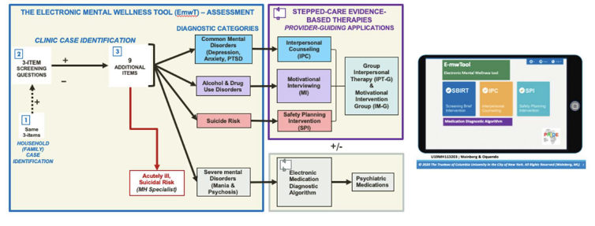


On-going implementation studies on HIV/Aging in UMMC
Validation and implementation of a brief electronic screening tool (e-mwTool) for stepped-care management of mental health and substance use disorders in PLWH [Chong ML]

Slide 19







Implementation phase : Mixed method effectiveness-implementation study (type 2)
Mental health screening
Pre-Implementation
Implementation
Post-Implementation
Identify patient and provider-level facilitator and barriers to the implementation of MH screening and linkage to care interventions in HIV clinical setting
Develop ‘optimal’ MH screening and linkage to care intervention
Staff training for implementation
Implement mental health screening in ID clinic
Implement mental health linkage to care to psychologist and psychiatrist through stepped care model
Assess implementation and effectiveness:
Implementation outcomes (fidelity, acceptability feasibility, sustainability)
Service level outcome (coverage)
Patient level outcome (ART adherence, CD4, HIV RNA, Quality of life)

Slide 20

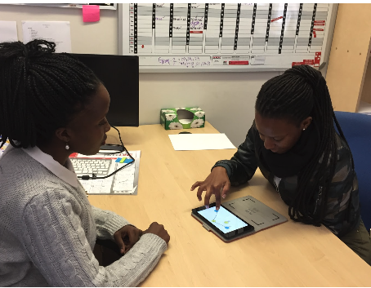

On-going pre-implementation studies on HIV/Aging in UMMC
Explore the acceptability, appropriateness and feasibility of using NeuroScreen, a validated tablet-based app to screen for HAND among PLWH and health care providers [Wong PL]
Designed to be executed by all levels of staff including community health workers
Used online and offline
Data synced and stored in the cloud
Suitable for low literacy settings
Automated (timing, scoring and reporting)
Tests for learning, memory, working memory, information processing speed, executive function and motor speed
Notes:
Language and cultural adaptation of the tool in local languages, develop local norms to be able to generate NCI cut-off and facilitate its use for research and clinical care.

Slide 21
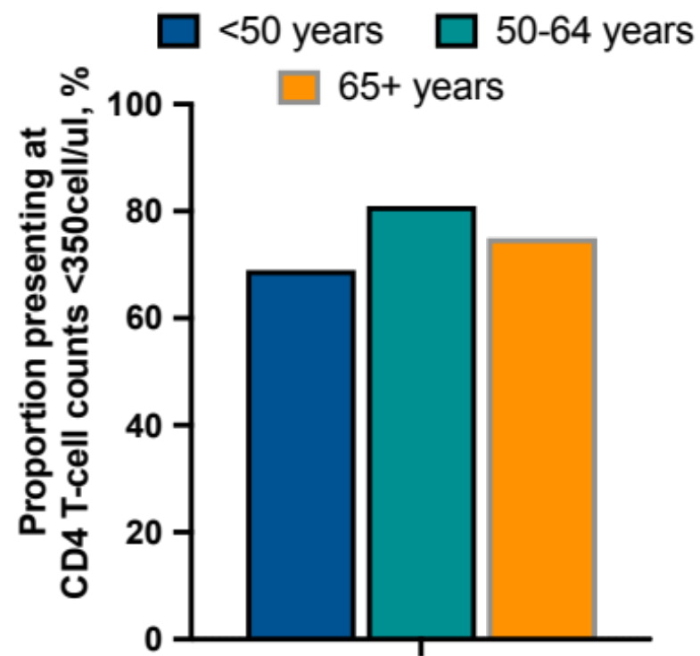
Acquiring HIV in later life
Estimates of new HIV infection in PLWH ≥50 years in Europe, Canada and the US ranged from 17-26%, with gradual annual increase.
Asia: China (60-70%) and Malaysia (7%).
Asia Pacific (IeDEA sites):
≥ 50 yrs: 16%
M: 16%
F: 15%
(Justice A., Lancet HIV 2022)

Slide 22
CD4 T-cell counts at presentation in young vs old in the Asia-Pacific
CD4 at presentation for HIV care
CD4 at ART initiation
18-49 years
18-49 years
≥50 years
≥50 years
(Justice A., Lancet HIV 2022)
Notes:
These graphs indicate the trend in CD4 counts at presentation to care (on the left) and at ART initiation (on the right) among PLWH in the IeDEA –AP cohort over a period of almost 2 decades. Analyses was stratified by age with the black line representing counts in younger individuals while the red line in those over 50 years.
CD4 counts at presentation and ART initiation were low in both groups in the initial period but this trend has shown improvement in the younger individuals in the last decade but not in older individuals. Whats concerning is the obvious widening of CD4 gap among the two age groups in recent years.

Slide 23
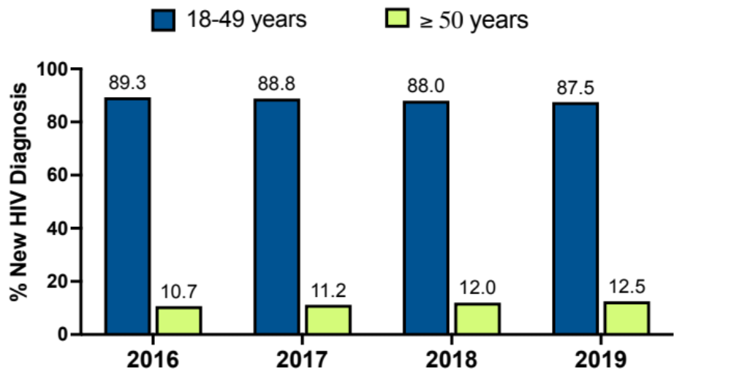
New HIV infection 2016-2019, (N=594) →11.5% in older adults
New HIV diagnosis at UMMC (2016-2019)
Data extraction
Medical, laboratory and pharmacy records
National death registry
Joinpoint Regression Analysis
Annual percent change (APC)
PLWH ≥ 50 yrs: +5.5%* (95 CI: 3.8–7.2)
PLWH<50 yrs: -0.7%* (95%CI: 0.5-0.9)
*Indicates APC is significantly different from zero at the α=0.05 level.
(Hoiey W., JAIDS 2023)
Notes:
We recently conducted an analysis of all new HIV diagnosis seen in our ID unit in UMMC between 2016 to 2019 (pre-pandemic) to examine the trends of new HIV infections in older individuals, their demographic and transmission characteristic as well as HIV outcomes.
Medical, pharmacy refill and laboratory records for viral load and CD4 counts were reviewed in all participants until their last follow up in 2020 and participant who were lost to follow up or had their care transferred were traced to the national death registry to determine their status, cause and date of death.
Out of a total of 594 new cases seeing at the unit, 11.5% were over the age of 50 years. There was only a slight increase in yearly frequency of new infections among older individuals.

Slide 24
Demographic and transmission risk characteristics
Patient characteristics | 18-49 years(n=526) | >50 years (n=68)
Male, n(%) | 468 (89.0%) | 57 (84.0%)
Ethnicity, n (%)
- Malay | 181 (39.4%) | 16 (24.2%)
- Chinese | 204 (44.4%) | 28 (42.4%)
- Indians | 63 (13.5%) | 20 (30.3%)
Highest Education, n (%)
- Primary/less | 32 (6.1%) | 10 (14.7%)
- Secondary | 80 (15.2%) | 18 (26.5%)
- Tertiary | 130 (24.7%) | 11 (16.2%)
Mode of transmission, n (%)
- Homosexual | 290 (55.1%) | 18 (26.5%)
- Heterosexual | 138 (26.2%) | 25 (36.8%)
- Not stated | 73 (13.9%) | 22 (32.4%)
Full-time employed, n (%) | 368 (70.0%) | 25 (36.8%)
Married, n (%) | 113 (21.5%) | 40 (58.8%)
(Hoiey W., JAIDS 2023)
Notes:
When comparing demographic and transmission risk characteristics in the two groups of newly diagnosed, there was an over representation of Indians on the older age group and fewer reporting tertiary level education.
The HIV transmission mode differed in both age groups with more in the older groups having acquired the virus by heterosexual contact. Also notable was that a third of individuals in this age group did not disclose their risk category. Older individuals were also more likely to be married and less likely to be in fulltime employment.

Slide 25
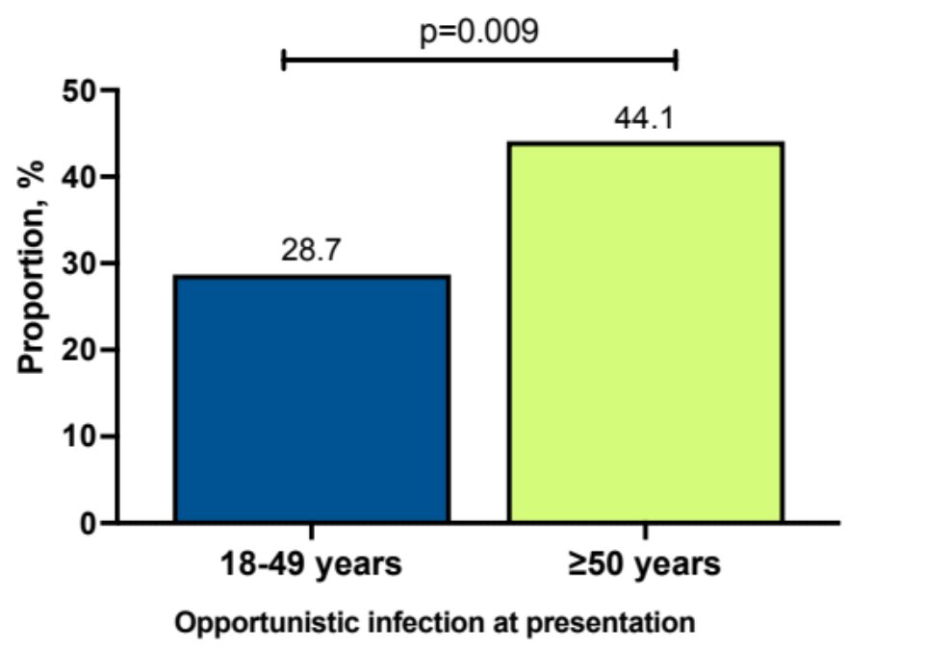
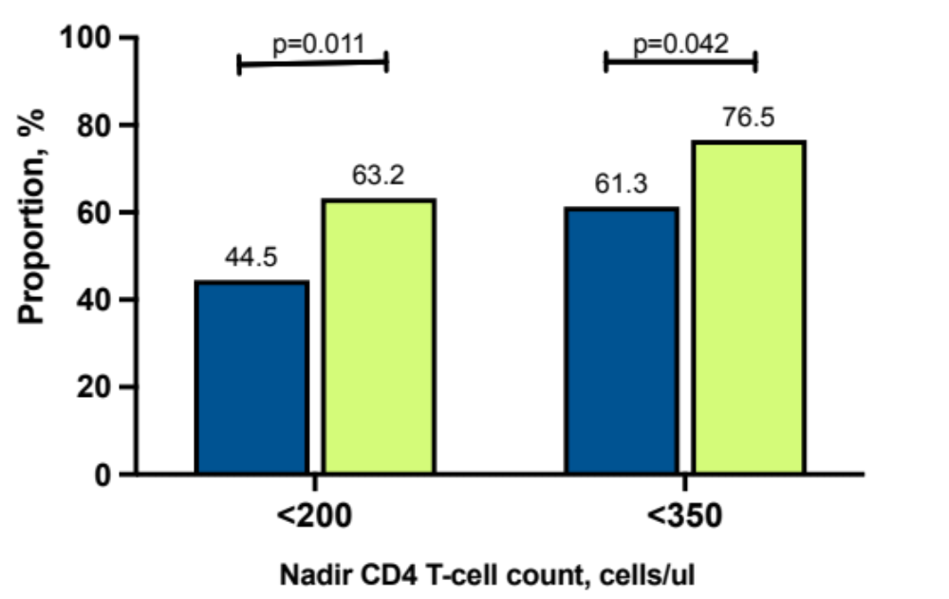
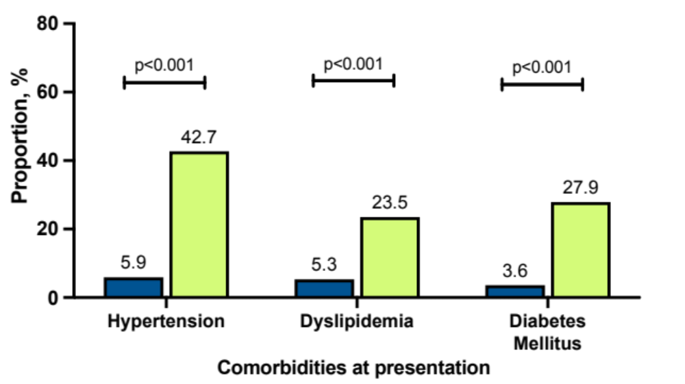
PLWH ≥50s present with more advance HIV disease
 | 18-19 years | >50 years
Time from diagnosis to presentation, days | 4.0 (0.0-28.0) | 3.5 (0.0-19.5)
(Hoiey W., JAIDS 2023)
Notes:
Similar to the IeDEA data, we also found that late presentation was significantly more common among the older individuals with new HIV diagnosis. Its important to note here that a late presentation also means an increased opportunity for HIV transmission in a group who are mostly married and likely to have inconsistent condom use due to age associated erectile dysfunction or their partners being beyond child-bearing age.
Not surprising, the frequency of opportunistic infections were significantly higher in the older group as was the numbers presenting with comoribidities of hypertension, dyslipidemia and diabetes

Slide 26
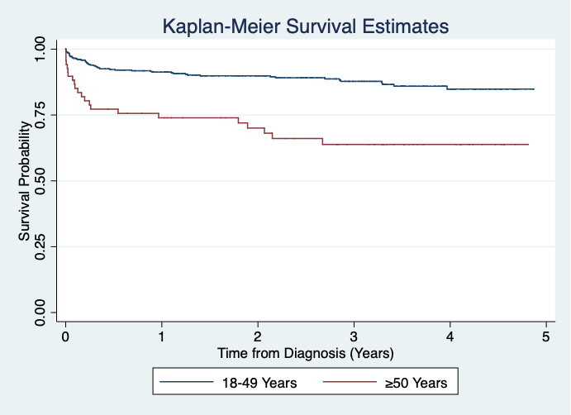
Higher mortality in individuals ≥50 years
18-49 years
74.7%
Died within one year after HIV diagnosis.
within 1 year of diagnosis
≥50 years
90.7%
of the total deaths cases related to HIV/AIDS
aHR: 2.40 (95% CI: 1.23-4.67), p=0.010
*adjusted for sex, educational level, marital status, mode of HIV transmission, OI at presentation, late diagnosis and initiation of ART and multimorbidity at diagnosis.
aHR= 2.22 (95% CI: 1.20 – 4.08)*
Log-rank p=0.011
(Hoiey W., JAIDS 2023)
Notes:
What was most concerning was that in Kaplan-meier analysis adjusting for sex, ethnicity and nadir CD4 counts, older individuals still had twice the risk of dying after presentation to care compared to those diagnosed at younger ages. The biggest difference in survival is seen in the initial days and weeks after presentation to care. These data indicate that events leading up to or at the peri-diagnosis period are probably most important in understanding the different mortality risks in both age groups.
More studies are needed to understand the issues and challenges of getting tested and engaged in care for older individuals.

Slide 27
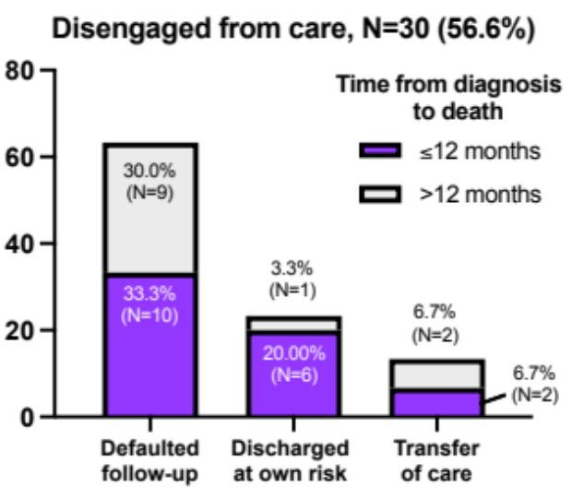
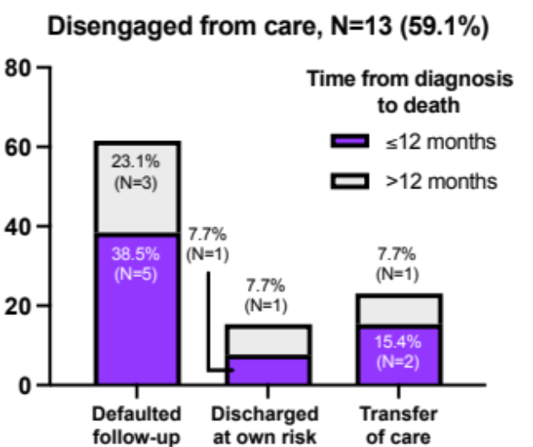
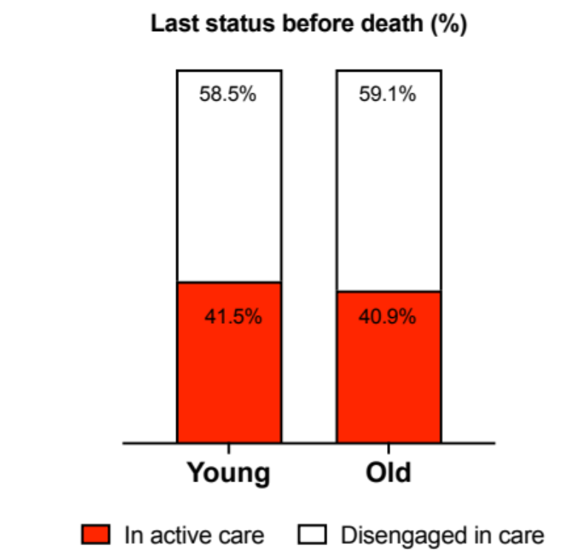
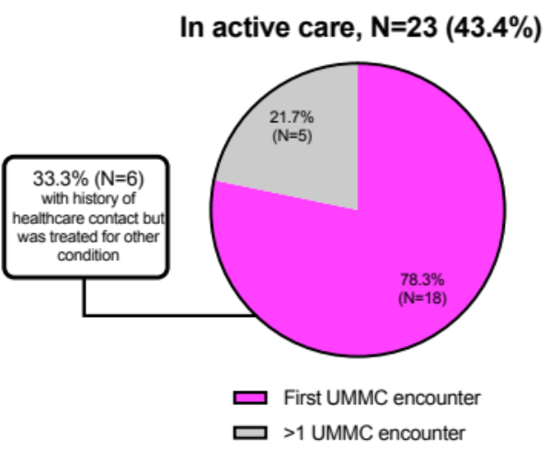
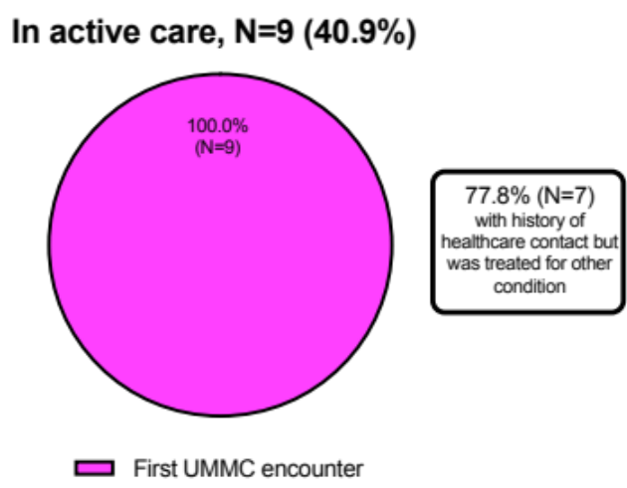
Circumstances of care engagement prior to death
(Hoiey W., submitted)

Slide 28
Summary
There is a growing burden of older PLWH in Malaysia and this number will continue to grow
Clear gaps in management of NCD and age-associated issues
Some common barriers to integration of HIV/NCD care – addressed simultaneously
High mortality rates among older adults newly diagnosed with HIV – missed opportunities for earlier diagnosis

Slide 29
Implementation science questions for older adults with HIV
  Can we enhance the role community health workers to strengthen HIV care models for older PLWH
  Can we implement fixed drug combination ART to reduce polypharmacy among older patients with HIV?
  Can we use mHealth to improve ART initiation among older people with HIV?
  Can we develop an implementation approach to ensure that older adults with HIV receive all recommended vaccine?

