Slide 1
Optimizing Coaching (Facilitation) in Implementation Research
Lynn Madden, PhD, MPA
Assistant Professor, Yale University School of Medicine
CEO, APT Foundation, Inc.
UNIVERSITI MALAYA & YALE UNIVERSITY
MIST SUMMER BOOTCAMP 2023
MAKING IMPLEMENTATION SCIENCE AVAILALE AND APPROACHABLE TO RESOURCE-LIMITED SETTINGS
JULY 17-19, 2023

Slide 2
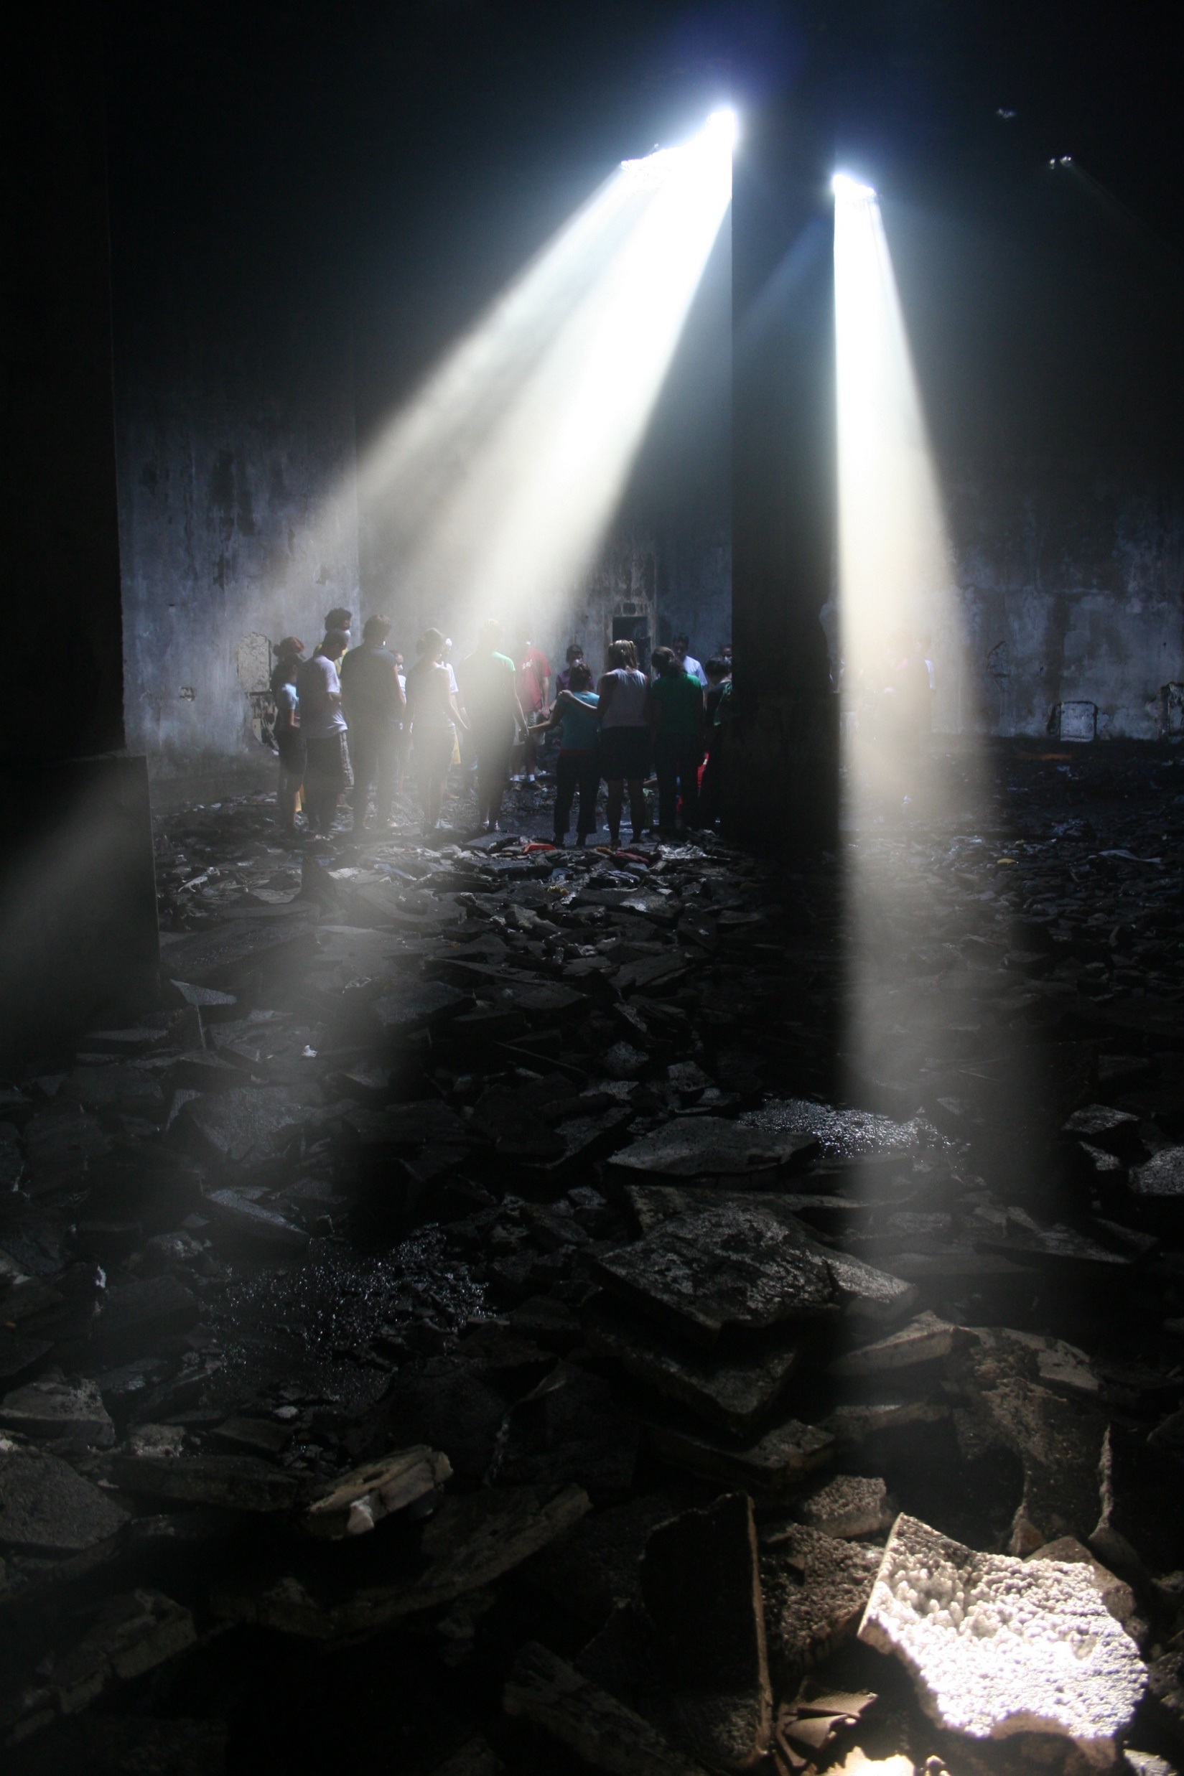
We cannot change
the way the world is,
but by opening ourselves
to the world as it is,
we may find that
gentleness, decency and bravery are available—
not only to us but
to all human beings.
Chögyam Trungpa, Buddhist teacher

Slide 3
Who showed up as ‘you’ this morning?
rate yourself on a Scale of 1 to 5
1 = barely here 5 = best day ever
How present and undistracted am I?
How open and curious do I feel?
How brave do I feel—to inquire, take risks?
How much do I feel able to contribute to others?
How willing am I to support their learning as well as my own?

Slide 4

The Know-Do Gap
What we know!
What we do!
Yesterday
Today
Tomorrow

Slide 5
Implementation Science: The Key To Successful Implementation is Facilitation
IMPLEMENTATION TEAM
YES
No
Effective
80%, 3 Yrs
14%, 17 Yrs
INTERVENTION
Effective use of Implementation Science & Practice
Letting it Happen Helping it Happen
Facilitation
Fixsen, Blase, Timbers, & Wolf, 2001
Balas & Boren, 2000
Notes:
It takes an estimated average of 17 years for only 14% of new scientific discoveries to enter day-to-day clinical practice (Balas & Boren, 2000)
Balas EA, Boren SA. Yearbook of Medical Informatics: Managing Clinical Knowledge for Health Care Improvement. Stuttgart, Germany: Schattauer Verlagsgesellschaft mbH; 2000.
With the use of competent Implementation Teams, over 80% of the implementation sites were sustained for 6 years or more (up from 30%) and the time for them to achieve Certification was reduced to 3.6 years.
Fixsen, D. L., Blase, K. A., Timbers, G. D., & Wolf, M. M. (2001). In search of program implementation: 792 replications of the Teaching-Family Model. In G. A. Bernfeld, D. P. Farrington & A. W. Leschied (Eds.), Offender rehabilitation in practice: Implementing and evaluating effective programs (pp. 149-166). London: Wiley.
Balas & Boren, 2000

Slide 6
Coaching as a key element of implementation
Coaching or Facilitation is cited as the most important or among the most important tools for successful implementation. Coaching can take many forms, but is most commonly organized (initially) as external support.
Role - Implementation Goals are Expected, Supported and Rewarded by coaching

Slide 7
Your thoughts
When you think about coaching – what comes to mind?

Slide 8
Co-production of Knowledge
Creation of knowledge, information or data through a shared research process that involves different levels and backgrounds of people.

Slide 9
Key concept - Co-production of knowledge by coaches/teams and other stakeholders
Principles of Knowledge
Context based
Pluralistic
Goal orientated
Interact
Albert Norstrom, et al. (2020) “Principles for knowledge co-production in sustainability research.” Nature Sustainability
Four elements of working with co-production approach
Equality
Diversity
Accessibility
Reciprocity

Slide 10
NIATx Learning Collaboratives
Which elements of improvement collaboratives are most effective? A cluster-randomized trial
David H Gustafson, et al. (2013) Addiction
201 organizations across 5 US States. Conclusions: Coaching and the combination of collaborative components were about equally effective in achieving study aims, but coaching was substantially more cost-effective.

Slide 11
A 2019 systematic review of successful facilitation strategies included the following attributes: “goal-setting, assessing progress and outcomes, and providing tools and resources.”
Change Facilitation Strategies Used in the Implementation of Innovations in Healthcare Practice: A Systematic Review. Lydia Moussa, 2019. Journal of Change Management.

Slide 12
NIATx Coaching for Implementation
Opening the Black Box of Organizational coaching for implementation. Fledderman K, Jacobson N, Horst J, Madden LM, Haram E, Molfenter T. BMC Health Serv Res. 2023 Feb

Slide 13
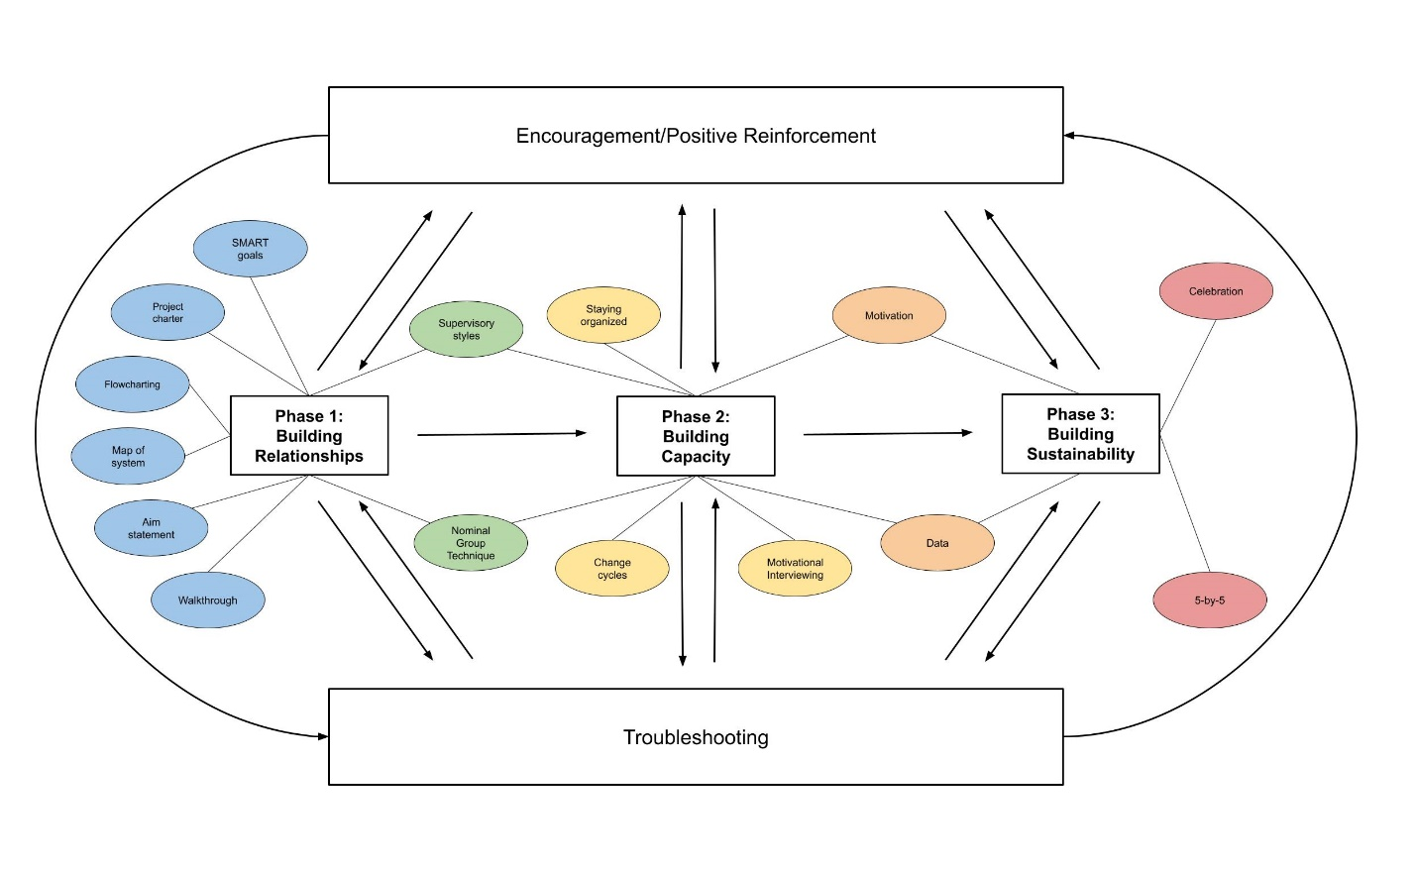
The NIATx Coaching Model

Slide 14
Building Relationships
Introduce yourself. Think about LOCATION. Encourage introduction of others.
Explain and use tools – pass on the knowledge and be willing to hear more.
Assist/remind change team planning. Be kind but consistent. Use positive frames.

Slide 15
Building Capacity
Staying organized – use a project worksheet
Making sure/encouraging change team to meet
Reflecting/translating results
Functioning as an advisor
Reminding teams about tools
Passing on ‘credit’ and ‘recognition’
Practicing/encouraging lateral and vertical communication

Slide 16
Building Sustainability
Celebrating and communicating success/milestones achieved (5 x 5)
Ongoing processes for feedback – data evaluation, sharing and planning for course corrections
Always remember to understand and involve the customer!

Slide 17
How does coaching relate to implementation?
Expected
Supported
Rewarded

Slide 18
Appreciative inquiry
Appreciative Inquiry is an asset-based approach to dialogue and engagement that can be utilized by communities, organizations, and teams. It builds on the idea that we can best improve human/organizational systems by a focus on what is going well and a shared vision of a positive future versus cataloguing deficits.

Slide 19
Practicing Appreciative Inquiry or positive framing
A simple way that to practice Appreciative Inquiry is to employ 3 key approaches:
Practice asking positive questions.
Find and share positive stories of when you, other people, the organization is its best.
Practice playing different roles and inspiring others to become champions of positive questions.

Slide 20
A relationship building technique: Asking questions
What is going well for you?
What could be going better?
What it is really like to be you?

Slide 21
The power of Why?
Simply asking people why? How? What do you think? can be excellent conversation starters.
Use approaches such at Nominal Group Technique to ultimately capture the ‘learnings’ of the conversation.

Slide 22
Building Capacity
Staying on track - schedule regular meetings
Capturing progress – use a form – eventually turn it over to someone on the team
creating positive momentum – try not to become ‘stuck’ in the idea that ‘this is how it is’

Slide 23
Rapid-cycle Testing
Start by asking three questions:
  What are we trying to accomplish?
  How will we know a change is an improvement?
  What changes can we test?
  Model for Improvement
  Langley, Nolan, Nolan, Norman, & Provost. The Improvement Guide San Francisco, Jossey-Bass Publishers, 1996
Notes:
Standard slide – please do not modify.
These are the basic questions to ask at the beginning of any Change Project.
Examples of Answers:
Reduce waiting times from 30 days to less than 10 days.
By measuring the number of days until the next available appointment.
Identify possible changes: this is a good time to refer back to problems identified by the CEO or the walk-through.

Slide 24

Conducting a Rapid Cycle Change Exercise
PDSA cycles
  Plan the change
  Do the plan
  Study the results
  Act on the new knowledge
Rapid cycle changes
  Changes should be doable in 2 -4 weeks

Slide 25
Change Cycles
PDSA - Sustain
Changes That Result in Improvement
A
P
DATA
S
D
D
S
P
A
A
S
P
D
A
P
Rapid cycle changes
  should be do-able in 2 -4 weeks !!!!!
S
D
Hunches Theories Ideas

Slide 26
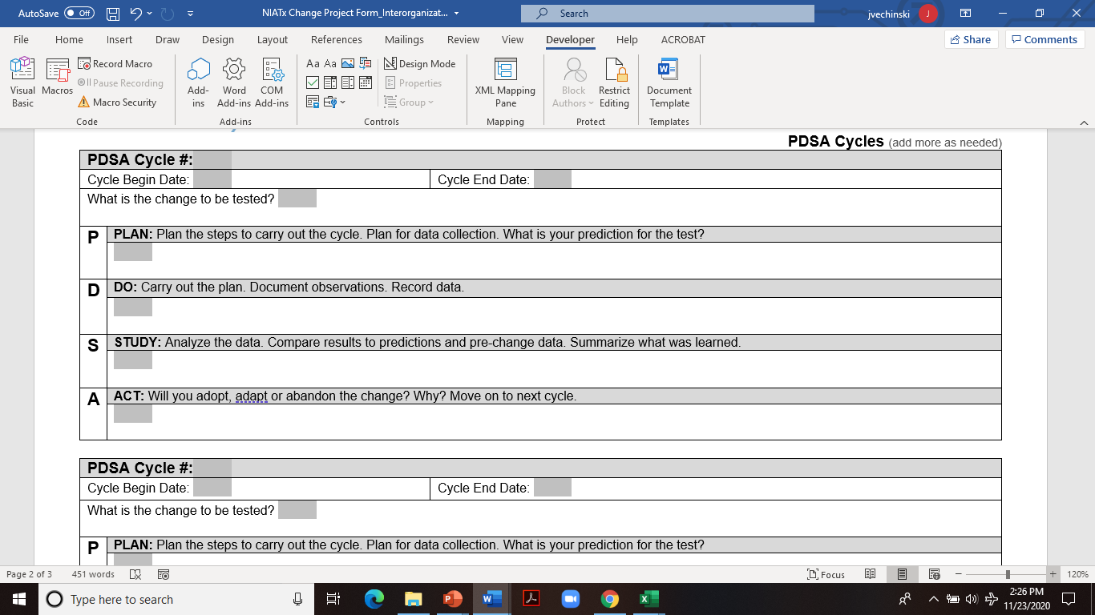
Notes:
FOR BREAK OUT SESSION:
Presenter: NIATx Coach (Each coach will be provided this presentation so that they have the slides to walk through)

Slide 27
Promoting Sustainability
Story telling (5 x 5s) 5 slides in 5 minutes. Slides are titled Plan, Do, Study, Act, Lessons Learned
Communicating progress – the elevator speech
Building process changes into policies, procedures and job descriptions

Slide 28
Leading Change Teams
Establish direction with a clear aim
Create a sense of urgency
Provide accountability
Involve the right staff
Communicate, communicate, communicate
Engage senior leaders
Motivate and inspire
Commit to empowerment
Create a process for short term wins
Notes:
Standard slide – please do not modify.
Describe the role of the Change Leader by picking 3-4 of these points to talk about in detail. Expand with examples from your personal experience, if possible.

Slide 29
Starting a Change Project
Set the AIM and select a change team – name a change leader, an executive sponsor, and data person.
Conduct a walk-through.
Collect baseline data. (Nominal Group Technique, Flowcharting, local data)
Review baseline data and walk-through.
Suggest a process change that might move toward the desired aim.

