Slide 1
Find, Save & Read Literature
in the Health Sciences
Kayla Del Biondo, Simbonis Librarian for Public Health
Cushing/Whitney Medical Library at Yale University
Malaysian Implementation Science Training Bootcamp | July 2023

Slide 2

Agenda
Overview of learning outcomes
Introductions
Key definitions
FIND relevant literature
  Search strategies
  Scholarly vs. grey literature
  Where to search
Q&A
Image by Max Pixel is licensed with CC0 (public domain).

Slide 3
Learning outcomes
Participants will be able to explain the difference between scholarly and grey literature.
Participants will be able to construct a concept table of search terms for a particular research question.
Participants will be able to search for literature using a subscription database available through the Universiti Malaya Library, as well as an open source (free) database.

Slide 4


Kayla Del Biondo, guest lecturer
Simbonis Librarian for Public Health
Cushing/Whitney Medical Library at
Yale University
kayla.delbiondo@yale.edu
Zanaria Saupi Udin
Acting Senior Deputy Chief Librarian
Liaison librarian for Faculty of Medicine
Universiti Malaya Library
xana@um.edu.my

Slide 5
NOT on the agenda, but still important
How to search for datasets
How to conduct a systematic review
  Universiti Malaya (UM) Medicine Library Guide: Systematic Reviews

Slide 6
Fundamentals of Reviewing Literature
Make decisions about which documents to review
Read and understand what the authors describe in those documents
Evaluate the ideas, research methods, and results of each publication
Write a synthesis that includes both the content and the critical analysis of these materials
(Garrard, 2014)

Slide 7
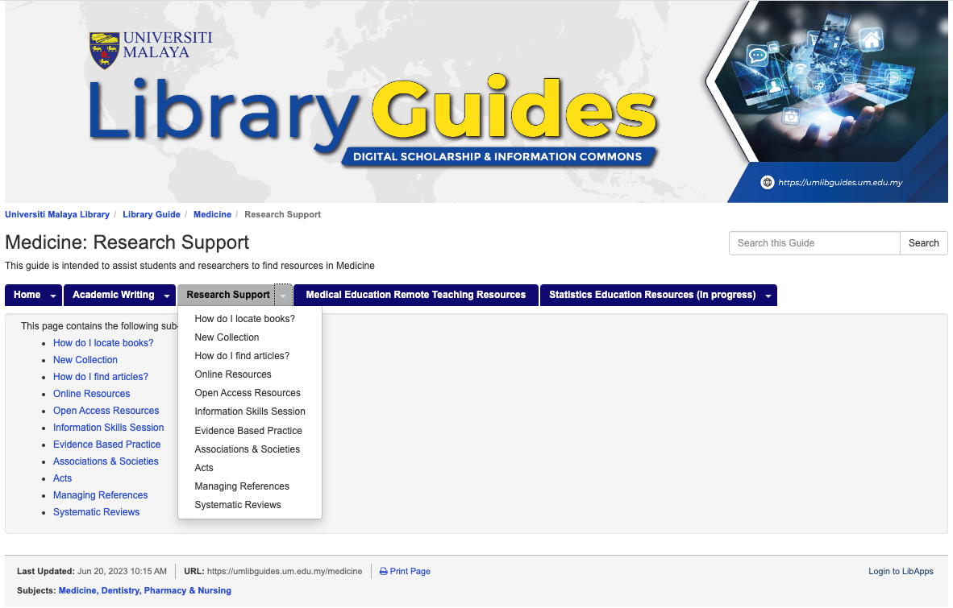
Medicine Library Guide: Research Support

Slide 8
Implementation science & information needs
Perhaps you’d like to…
Find literature in order to better understand a population/local context, an evidence-based intervention (EBI), or a known barrier/gap to community deployment of an EBI
Locate an evidence-based policy or guideline
Read about an implementation research method/framework
  for example, reach, effectiveness, adoption, implementation, maintenance (RE-AIM)
Learn about a key component of an implementation study
  Stakeholder engagement
  Community based participatory research

Slide 9
Developing an Implementation Research Proposal
Helpful sources for formulating IR questions:
Programme progress, annual or evaluation reports from monitoring and evaluation activities.
Medical, health and social science literature, meta-analyses, and literature reviews.
Scientific meetings and conferences.
New ideas from previous research or formative qualitative studies (e.g., interviews).
Funding agencies’ annual reports.
Questions asked by programme staff and students.
Local documents – project progress reports, theses, dissertations, seminar proceedings.
Annual review or dissemination meetings.
Geographic information systems (GIS) data that identify geographic location and distribution of problems.
(WHO & UNICEF 2014)

Slide 10
Types of Reviews
Review types...
Narrative review
Systematic review
Scoping review
State-of-the-art review
How they differ...
Different degrees of comprehensiveness in searching
May or may not include a formal quality assessment
Timeline and team size matters
Qualitative vs. quantitative analysis

Slide 11
The Realist Review
A literature review that seeks to answer the question…
What works for whom under what circumstances?
Not an X causes Y theory of thinking, but rather C-O-M, context-outcome-mechanism
The goal is to produce a product useful to a policymaker in responding to a time-sensitive situation with limited resources
RRs recognize that interventions are embedded in social systems
(Pawson et al., 2005; Sutton et al., 2019)

Slide 12
FIND
Step #1

Slide 13
Scholarly vs. Grey Literature
Scholarly literature - written by highly-qualified researchers and have a thorough publication process, which usually involves peer-review
  an article on a single study or a review paper on the same topic
Grey literature - information produced on all levels of government, academics, business and industry in electronic and print formats not controlled by commercial publishing, i.e. where publishing is not the primary activity of the producing body
  guidelines and policies
(Evaluating Sources: Where to Begin; GreyNet International)

Slide 14
Articulate a specific research question.
Use PIO, PICO, PEO, or PCC as a framework.
Population
Intervention/Exposure/Concept
[Comparison, if using ‘PICO’]
Outcome or context

Slide 15
Research Question:
What preconception care interventions exist for people living with HIV (PLHIV) in low-resource settings?

Slide 16
Create a concept table of search terms
 | Keywords (database will look for these keywords in the field you specify– for example, title/abstract or all fields)
Population | PLHIV
Concept | preconception care
Context | low-resource settings
Note: The context or outcome may not always be a part of your search, but rather, the lens for how you will read and interpret the literature on your population + concept

Slide 17
PLHIV
preconception care
low-resource settings

Slide 18
Search with subject headings
Subject headings differ by database!
 | Keywords | MeSH* (database is looking for papers that have been assigned to this category)
Population | PLHIV HIV “human immunodeficiency virus”
Concept | preconception fertility | preconception care
Context | “low resource” “low income”
*MeSH = Medical Subject Headings used in PubMed databases

Slide 19
Preparing to combine concepts
Your search will be more exhaustive if you search with as many relevant keywords and subject headings (SHs) as possible
 | Keywords | MeSH*
Population | combine all terms of the same row (keywords & SHs) with OR and place in parentheses
Concept
Context
combine concepts with ‘AND’

Slide 20
Put it all together
For this example, choose ‘title/abstract’ or ‘MeSH Terms’ as the search field in PubMed and build the search bit by bit, or type it out like so
(PLHIV[title/abstract] OR HIV[title/abstract] OR “human immunodeficiency virus”[title/abstract]) AND
(preconception[title/abstract] OR fertility[title/abstract] OR preconception care[MeSH Terms]) AND
(“low resource”[title/abstract] OR “low income”[title/abstract])
In many databases…
“quotation marks” are for exact phrases
truncation* is for searching a term that may have alternate endings
(parentheses) are for grouping like terms of the same concept
Boolean operators such as AND/OR/NOT combine concepts in a search string

Slide 21
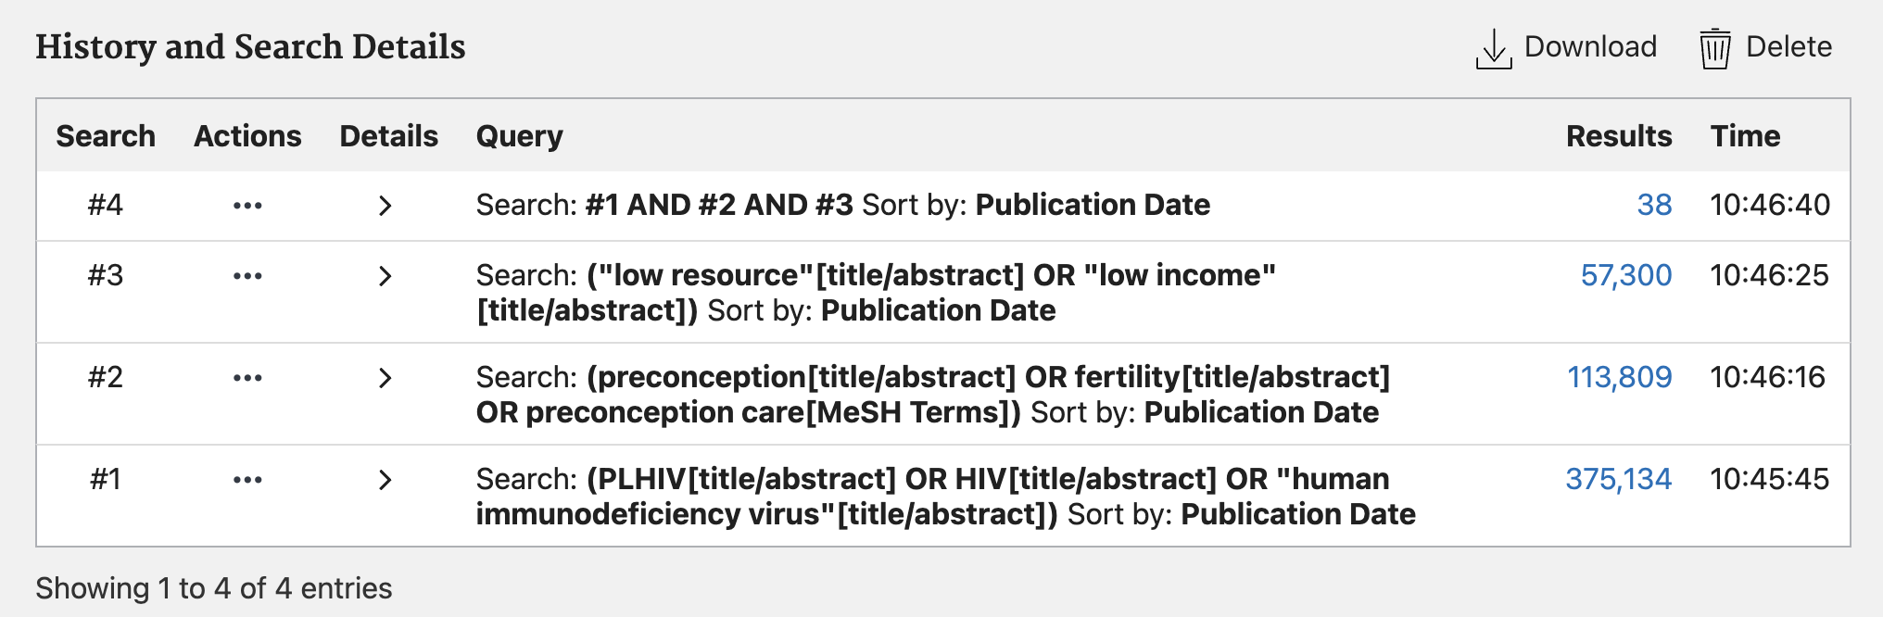

Slide 22
Search techniques: before the search
Building blocks - divide research Q into parts/concepts → PIO (population, intervention, outcome)
  individual search lines for each concept which you can combine and experiment with (see previous slide)
  you might consider using searching different fields (title/abstract vs. title vs. all fields) for different lines
Simple strategy (AKA quick-and-dirty or easy searching) - select a database, divide a research Q into parts/concepts (similar to the way you approach the building blocks method), but compose a simple query using your terms for each concept linked by AND/OR
  all in one line!
  modify search as needed based on results
(Marchionini, G, 1995).

Slide 23
Revise and repeat.

Slide 24
Precision & recall
(Quality vs. Quantity)

Slide 25
Search techniques: during/after the search
Pearl growing - begin with a specific document that is known to be relevant and use the characteristics of that document to grow a set of related documents
  Scopus database - related documents feature
Citation chaining - find a relevant, well-written article and mine its reference list
  Web of Science database - citation network feature
(Marchionini, G, 1995).

Slide 26
Your turn!
Fill in search terms for a research question you have in mind
 | Keywords (in ti/ab of papers)
Population
Concept
Context

Slide 27
Create an account
in your favorite databases and save your search history.

Slide 28
Run a search in more than one platform.
Databases differ by coverage (subjects/disciplines, time period, language(s), etc.) and searching capabilities (filters available, subject headings or not, save/export options, etc.).

Slide 29
Keep a written search log.

Slide 30
Try your best to access the full text
full text = the entire article
Universiti of Malaya subscriptions
  A-Z databases
    Medicine, dentistry, pharmacy & nursing subcategory

Slide 31
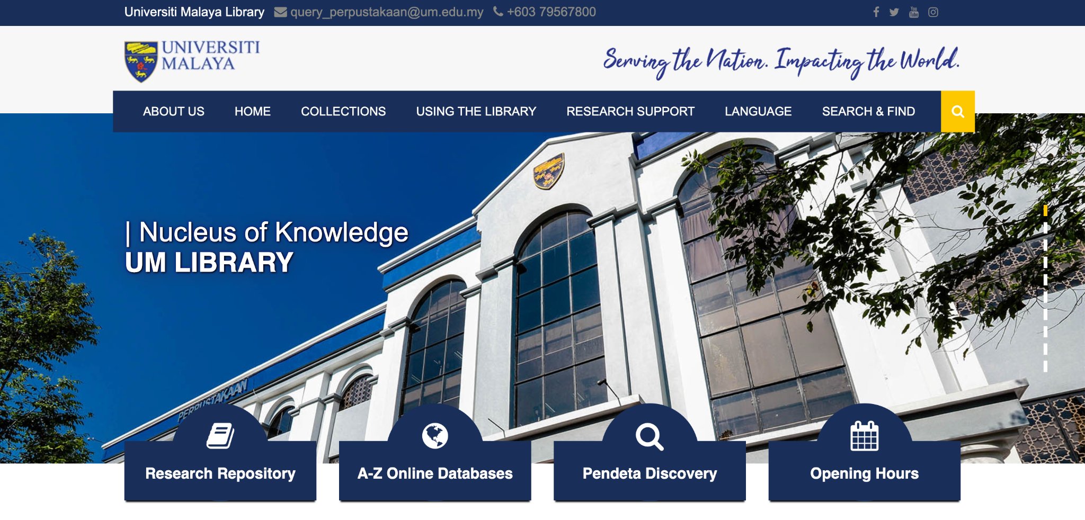
Universiti of Malaya Library databases A-Z

Slide 32
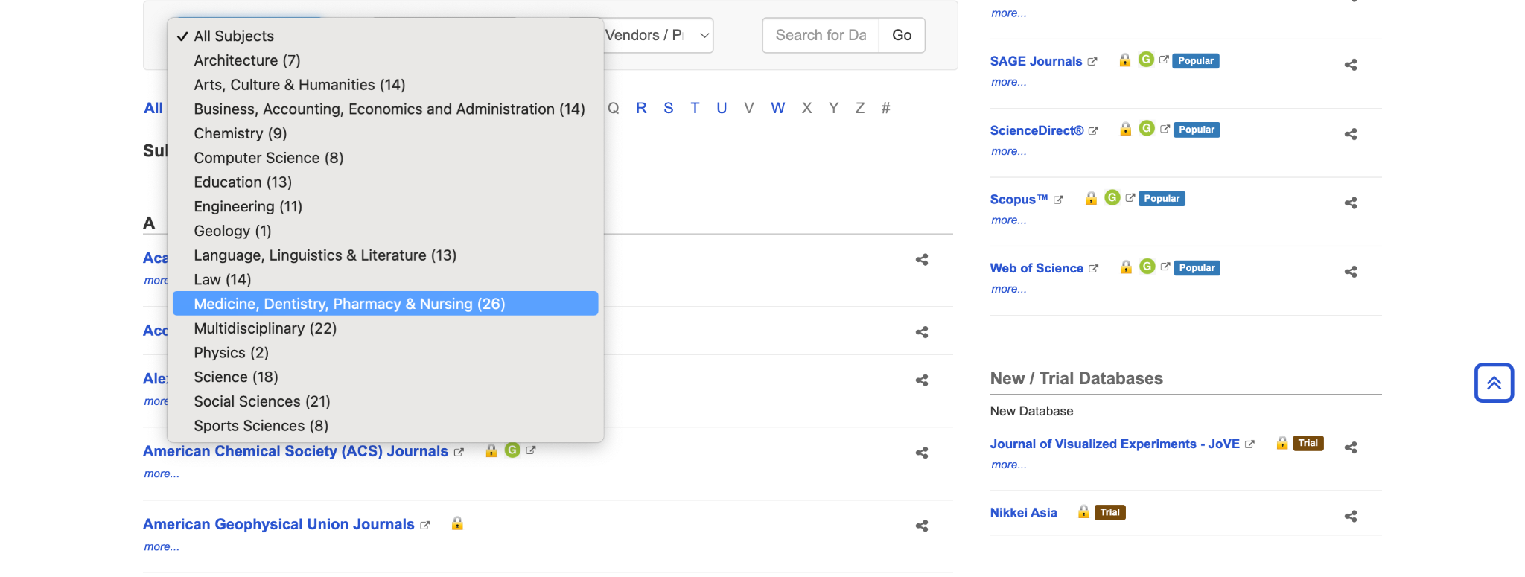
All subjects or a particular subject

Slide 33
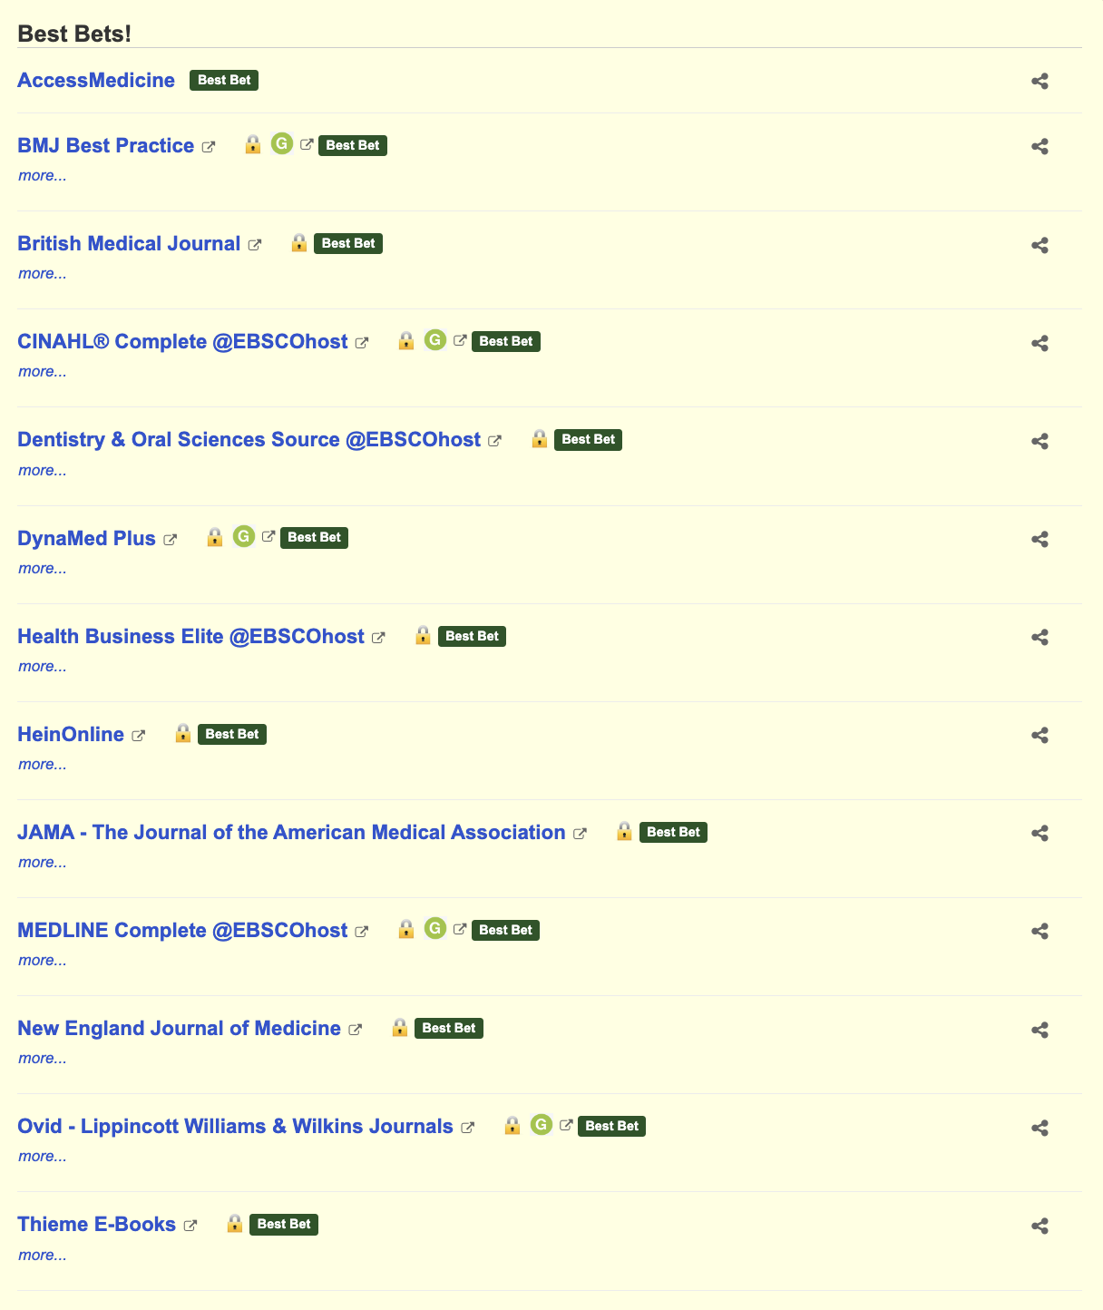
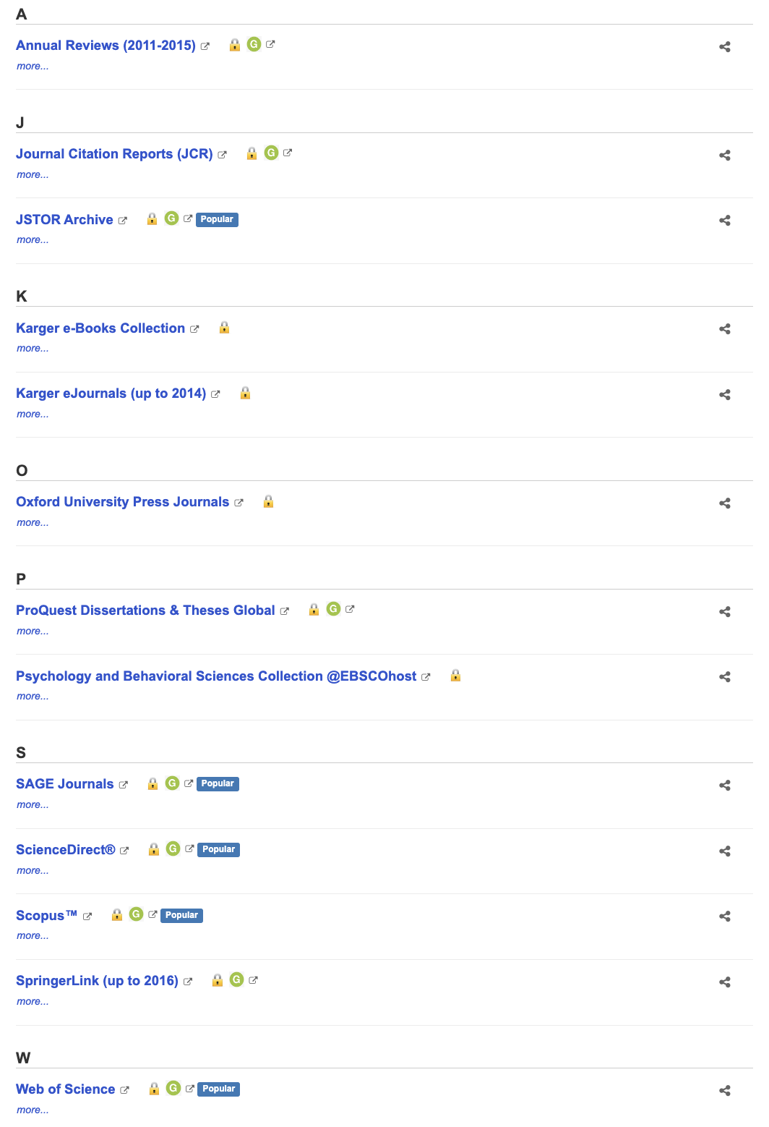
Databases for medicine, dentistry, pharmacy & nursing

Slide 34
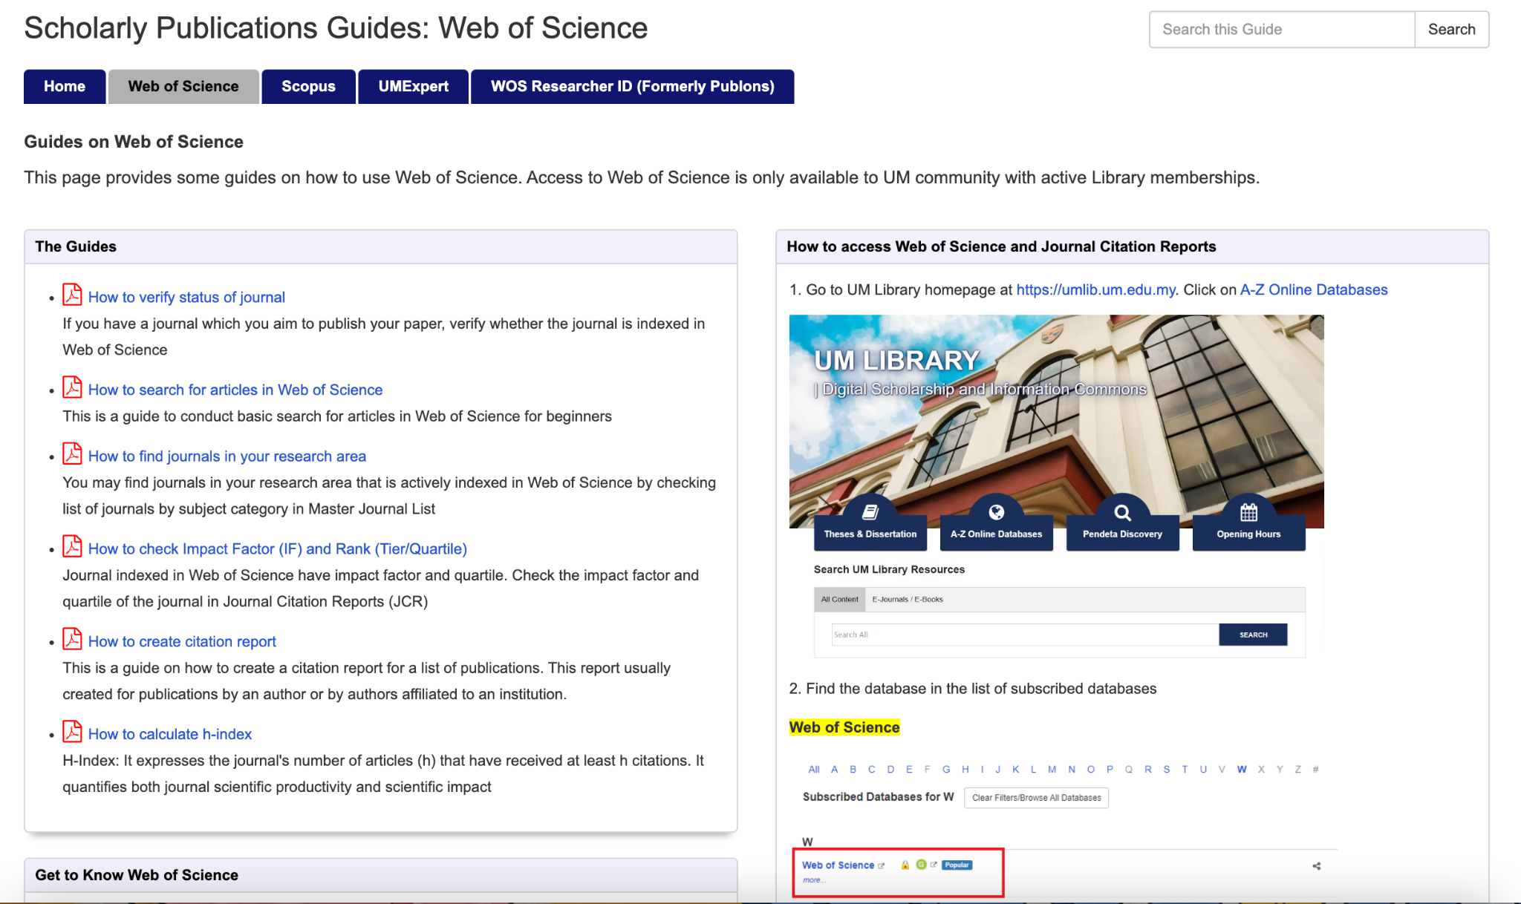
Practice searching in Web of Science
Refer to the UM Web of Science Library Guide for guidance
Note: this database does not contain SHs!

Slide 35
Practice searching in PubMed
Create a myNCBI account
Use the ‘free full text’ filter
Learn more about automatic term mapping
  PubMed attempts to translate your keyword search terms to MeSH terms where applicable, but only if you search at the all fields level and your terms are not enclosed in “quotation marks”
Or look up MeSH terms in the MeSH database before searching
Remember: a narrative literature review does not require an exhaustive search, so you can stick with just keywords if you prefer

Slide 36
Access the full text: continued
In databases, such as Web of Science
  Button for ‘full text at publisher’ (availability will depend on library journal subscriptions)
  Button for ‘Look up full text at Google Scholar’ (this option will only work if the article is available for free, otherwise known as ‘open access’)
PubMedCentral (PMC) is the open access (OA) repository of PubMed articles
Other OA pathways
  OA Button
  UnPaywall
  Preprint servers
  Email the author(s)

Slide 37

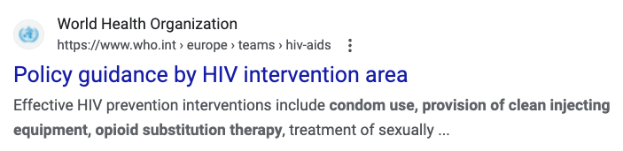
How do I find grey literature?
Ask Yourself…
Who are the experts/leaders on this topic?
  Community/state/national/global levels
  What professional associations exist?
Tip: try a Google search or an advanced Google search

Slide 38
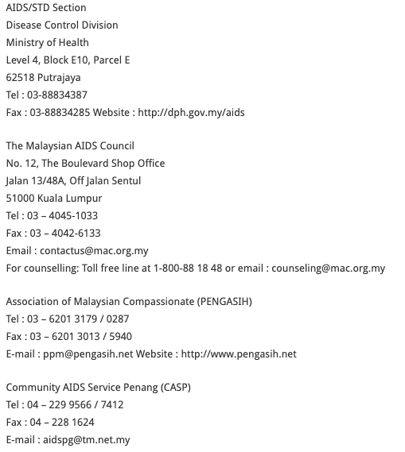
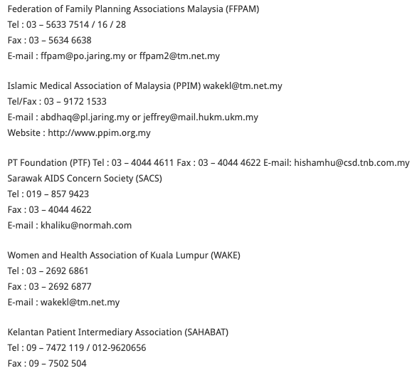
Groups listed on the Malaysian Ministry of Health website - HIV/AIDS subpage

Slide 39
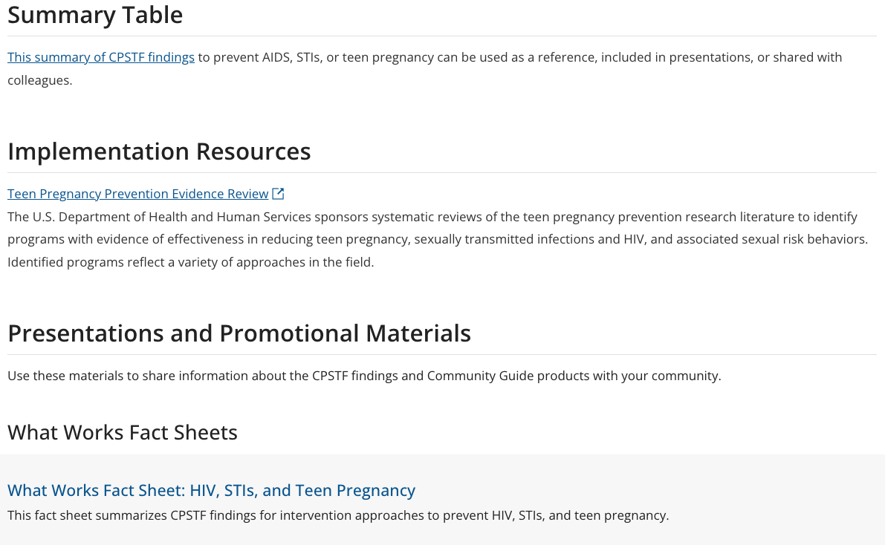
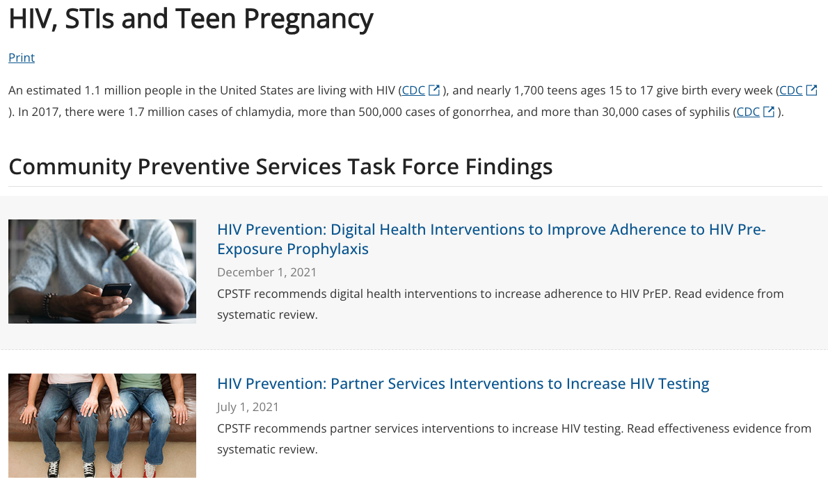
The Community Guide

Slide 40

Alliance for Health Policy and Systems Research

Slide 41
Parting advice
Determine your information need(s)
Search on more than one platform
  for scholarly literature: begin by searching keywords pertaining to your research question in health science databases
  for grey literature: begin by brainstorming who you think the creators of the information might be (leaders in this area, community organizations, etc.)
Meet with a librarian to discuss your information needs and literature searching plans
Save sources to a citation manager
Take thoughtful notes on what you read, so that you are prepared to write, meet with stakeholders, etc.

Slide 42
Kayla Del Biondo
kayla.delbiondo@yale.edu
Questions?

Slide 43
References
Evaluating Sources: Where to Begin. Purdue University Online Writing Lab. Retrieved January 24, 2022 from
https://owl.purdue.edu/owl/research_and_citation/conducting_research/evaluating_sources_of_information/where_to_begin.html
Garrard, J. (2014). Health sciences literature review made easy : the matrix method (4th ed.). Jones & Bartlett Learning.
GreyNet International. GreyNet International, Grey Literature Network Service. (n.d.). Retrieved January 24, 2022, from http://www.greynet.org/
Marchionini, G. (1995). Information seeking in electronic environments. In (pp. xi, 224 p. :). Cambridge ;: Cambridge University Press.
Pawson, R., Greenhalgh, T., Harvey, G., & Walshe, K. (2005). Realist review-a new method of systematic review designed for complex policy
interventions. Journal of health services research & policy, 10(1_suppl), 21-34.
Sutton, A., Clowes, M., Preston, L., & Booth, A. (2019). Meeting the review family: exploring review types and associated information retrieval
requirements. Health Information & Libraries Journal, 36(3), 202–222. https://doi-org.yale.idm.oclc.org/10.1111/hir.12276
World Health Organization, & UNICEF. (2014). Implementation research toolkit (Second Edition). World Health Organization. https://adphealth.org/irtoolkit/

