Slide 1

Implementation science and Young Men who have sex with Men (YMSM)
Iskandar Azwa
Infectious Diseases Unit, Faculty of Medicine
Centre Of Excellence For Research in AIDS
Universiti Malaya

Slide 2
Outline of my talk
Definition of YMSM
Global and Regional Epidemiology of HIV in YMSM
Implementation science considerations for HIV prevention in YMSM with case examples

Slide 3
Definitions
UNAIDS
Young person: aged 15-24 years
Adolescents: aged 10-19 years
US CDC
Youth/young person: age 13-24
Spans the developmental periods of adolescence to emerging adulthood
Adolescence
Period of life from puberty to maturity
Definitions used for the Global AIDS Response Progress Reporting indicators.
For programmatic purposes, UNAIDS also uses the following definitions: adolescents, 10–19 years; youth, 15–24 years; young people, 10–24 years

Slide 4
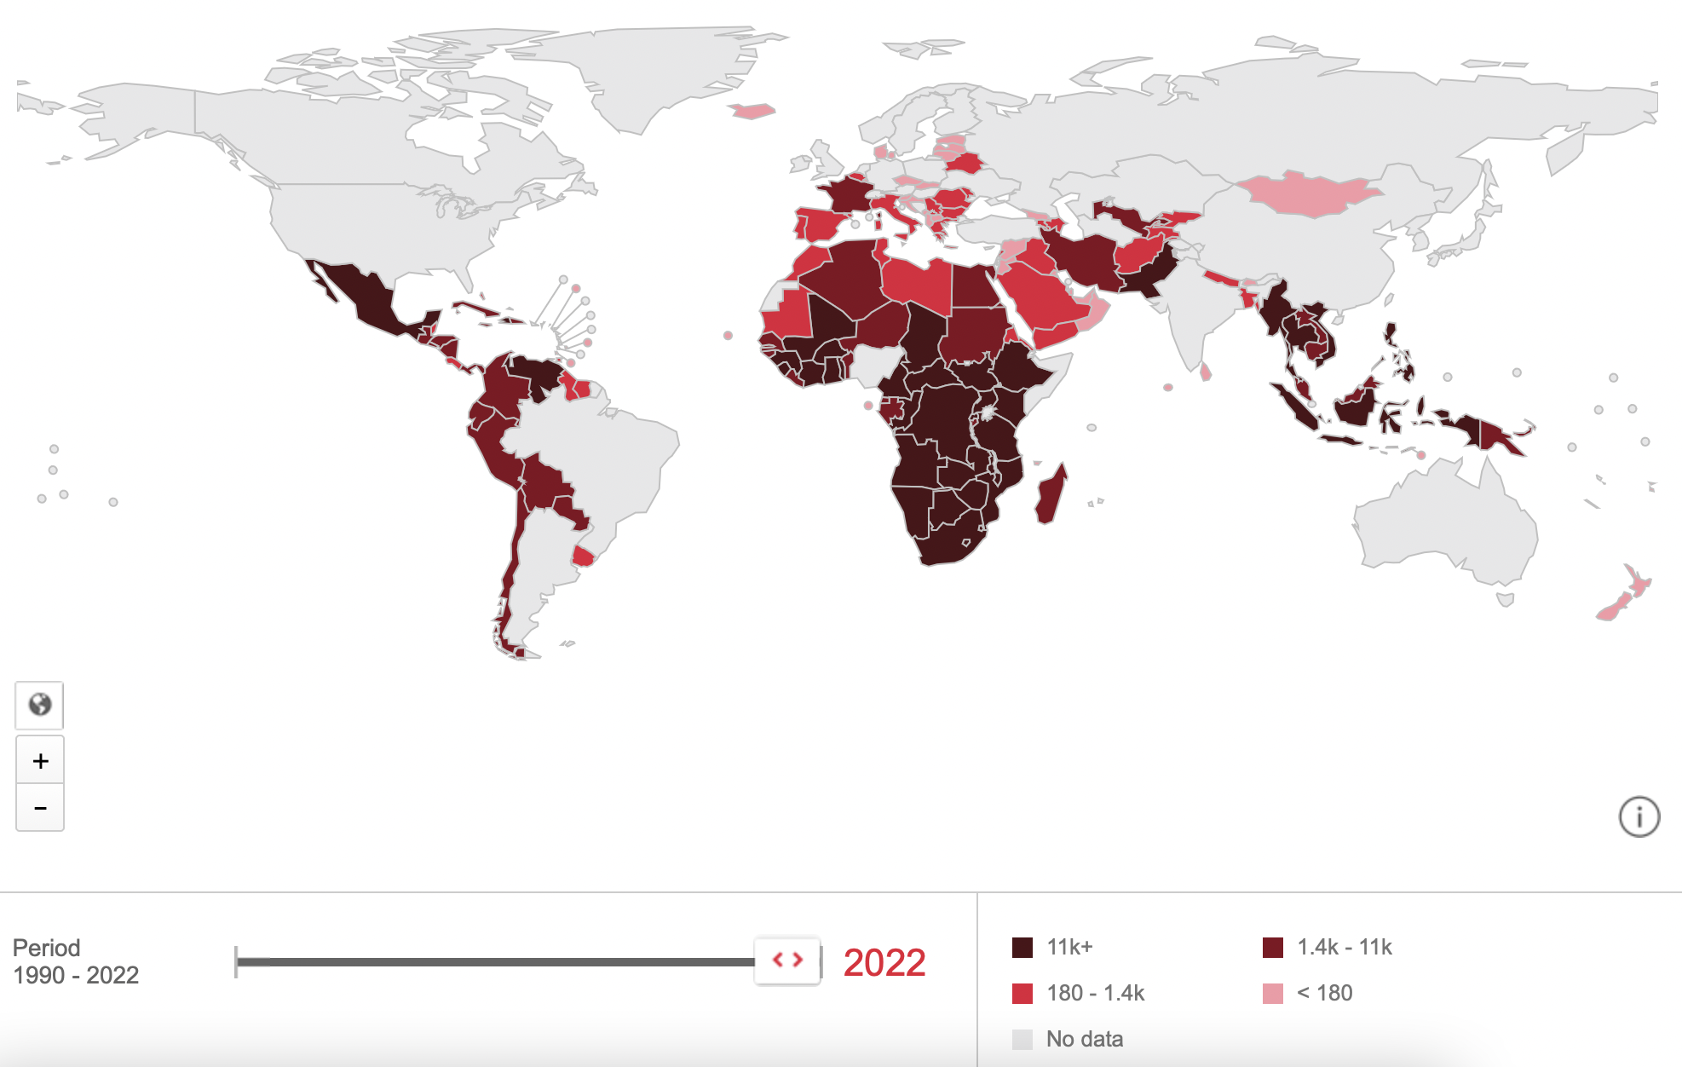



Young People Living with HIV (15-24) is a global issue (2022)
In 2022
30% incident infections were in
the youth (15-24)
https://aidsinfo.unaids.org

Slide 5
HIV prevalance among young key populations
From Global AIDS Monitoring countries that submitted a Global AIDS Monitoring report between 2016 and 2020 (n = number of countries)
Among:
YMSM: 6% (n=67)
Young transgender people: 11% (n=5)
Young people who inject drugs: 5% (n=23)
Young sex workers: 4% (n=58)
Young prisoners: 1% (n=31)

Slide 6
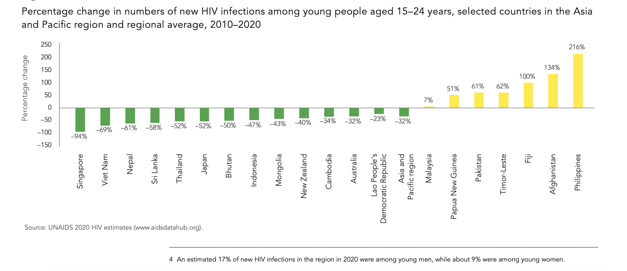
New HIV infections among young people declined by 32% between 2010 and 2020 in the AP. HIV epidemics are growing in some countries, however, with up to half of new infections among young people from key populations
Notes:
Across the region, new HIV infections among young people declined by 32% between 2010 and 2020. This trend is encouraging, but it is not strong enough to end the region’s AIDS epidemic by 2030, and it is offset by steep rises in new infections in several countries. New HIV infections among young people increased in seven countries in the region between 2010 and 2020: Afghanistan, Fiji, Malaysia, Pakistan, Papua New Guinea, the Philippines and Timor-Leste

Slide 7
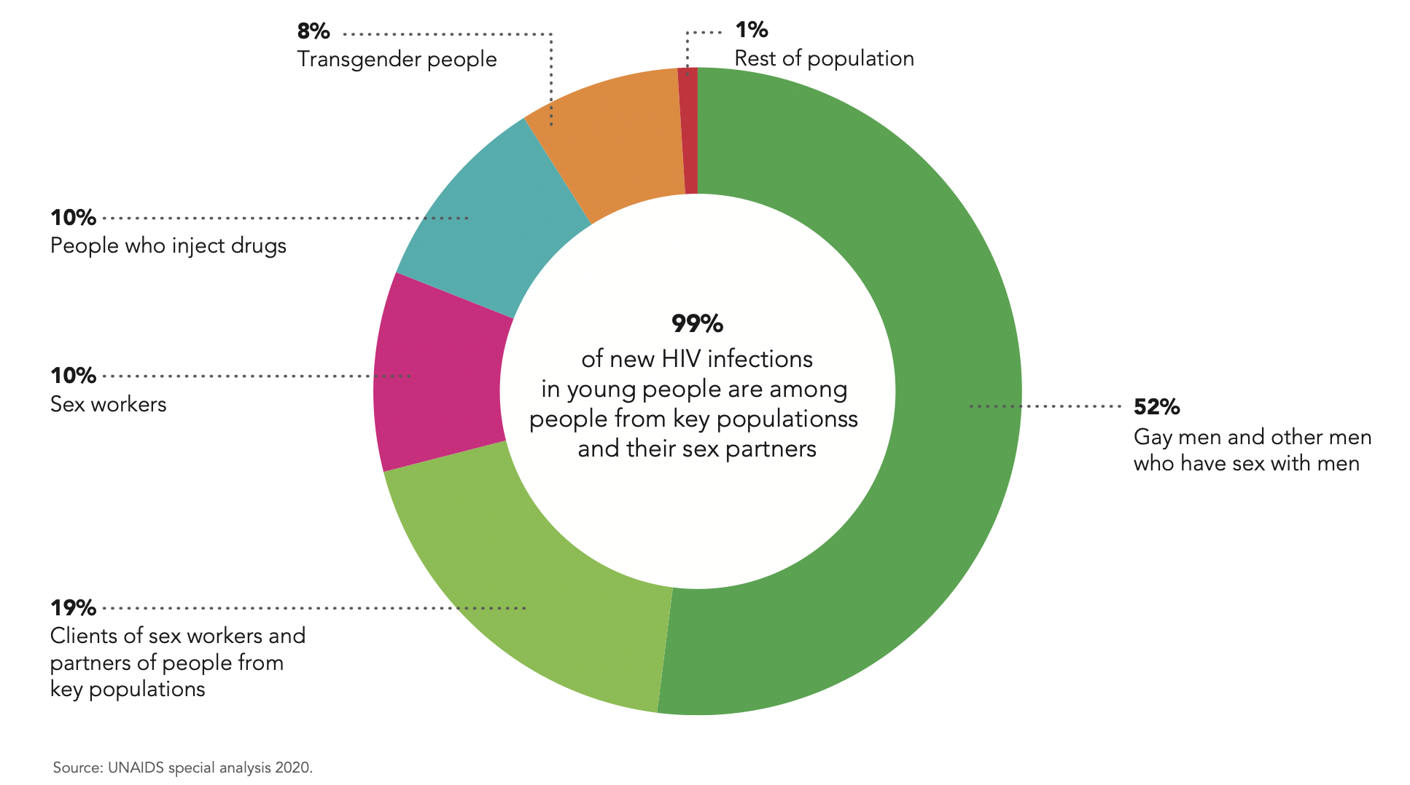
Almost all new HIV infections among young people in the Asia Pacific are in young people from key populations and their sexual partners
Figure: Distribution of new HIV infections among young people in the Asia Pacific by key population, 2020
Notes:
In the region overall, more than half of new HIV infections (52%) in young people in 2020 were among gay men and other men who have sex with men, while people who inject drugs, female sex workers and transgender people together accounted for almost 30% of new infections

Slide 8
Key implementation considerations for HIV prevention programmes for young MSM

Slide 9
1. Understanding the target population and identifying the barriers and facilitators
  Young MSM often face distinct social, cultural and environmental factors that influence their HIV risk and prevention needs
  Comprehensive understanding and adapting intervention programmes to align with the unique characteristics, specific needs and preferences and contexts of YMSM e.g. sexual behaviours, social networks, and barriers and facilitators to accessing HIV prevention services
  Interventions should be age-appropriate, culturally sensitive, acknowledge diversity and consider factors such as language, religion and community norms

Slide 10
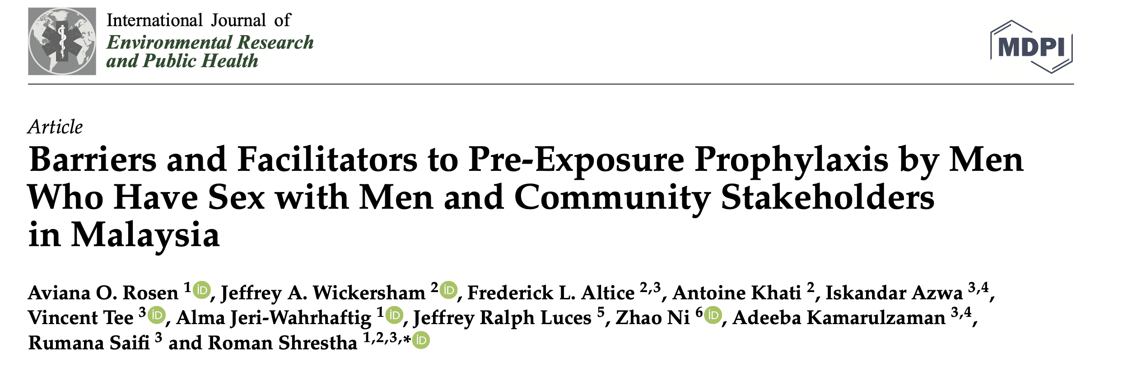
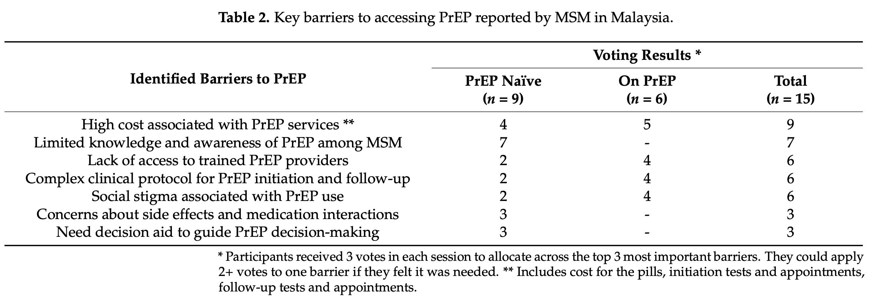
BARRIERS TO PREP USE
Greatest barrier was high cost associated
with PrEP services (9 votes), followed by
limited knowledge and awareness of PrEP
Differential voting bet PrEP naïve and PrEP
using MSM
FACILTATORS OF PREP USE
Govt subsidy to reduce costs of PrEP services
Simplification of service delivery e.g. same day
PrEP, minimized clinic visits
Need for additional trained PrEP providers
Increase no of serviced delivery models
(telehealth, pharmacy-led, key-population-led)
Use of alternative regimens eg on-demand PrEP
Positive framing of PrEP
Int J Environ Res Public Health. 2023
Notes:
Nominal Group Technique & 6 FG sessions
3 among MSM (n=16), 3 among commubity stakeholders
(n=20)

Slide 11
2.Optimizing Youth engagement
Meaningful engagement of YMSM in the planning, design and throughout the implementation process is crucial
YMSM must have equal voice and shared power within the research process, and they must be more involved and engaged than merely as members of a community advisory board.
Ensures the highest likelihood of uptake and sustainability of interventions

Slide 12

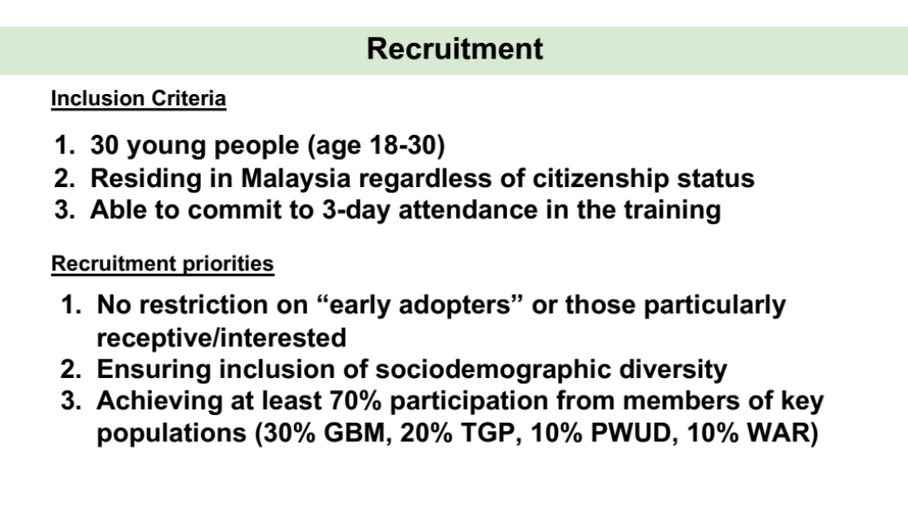
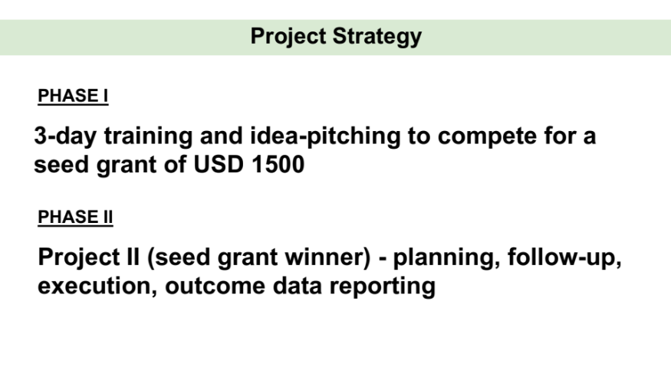

Slide 13
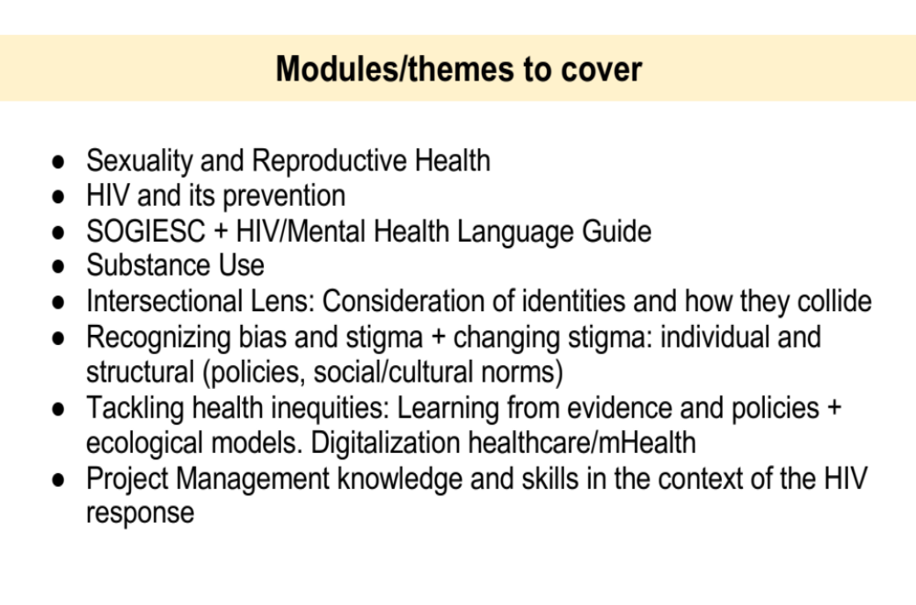
Aim 1: Pilot We Ask the Y among young Malaysians and evaluate its acceptability, feasibility, and preliminary impact on HIV -related knowledge and engagement in HIV testing and prevention
Aim 2: Exploring the perception, hopes, and experiences of young key populations on deconstructing geopolitical and socioeconomic barriers to HIV prevention
Aim 3: Guide young people to create nimble, people-powered HIV programs using design thinking, gather portfolios on youth-centric HIV programs portfolios, and incentivize the most-promising initiative birthed from the training to its fruition.

Slide 14
3.Addressing structural barriers
Health care access
  Accessible: community-based decentralized services, easy and safe for young MSM to reach
  Acceptable: Services at times convenient to young MSM so they don’t need to take time off from work or classes, reduced waiting times
  Affordable: Low cost/free of charge
  Integration of services within other services eg youth health services
  Peer support groups, trained counsellors and case managers can help young MSM navigate health systems

Slide 15


The Safe Clinic
Community based integrated sexual health clinic
THE TARGET GROUPS
Young people
Female Sex Workers (FSW)
Clients of Female Sex Workers
Transgenders
Men who have sex with men (MSM)
Refugees
HIV positive patients
THE CLIENTS
1536 clients June 2010 to November 2012
72% MSM (25% < age 24), 16% heterosexuals
(50% - clients of FSW), 10% transgenders, 2% sex workers
152 HIV positive patients under regular follow up
(60% foreigners) with 90% retention rate
95% HIV testing acceptance rate

Slide 16
Lessons Learnt
Important to understand the local context and the preferences of the target population
Community engagement is essential and should shape services provided by the clinic
Most important aspect of service valued by clients was provision of a safe and non-judgemental space
Monitor and evaluate your services and outcomes
A social enterprise clinic model is more sustainable than one reliant on commercial social responsibility funds
Identify key population friendly clinics from existing pool of primary care clinics who have an interest in sexual health & HIV
Different key populations have different needs and specialized clinics addressing the needs of a particular key population are better than a “One size clinic fits all” model
Integration of services!!!

Slide 17

3.PRORITIZE HIV SELF TESTING!!!
JOMTEST: Web-based HIV self testing (ST) study in Malaysia
(Nov 2020 – Oct 2021) (N=1077)
21,661 unique visitors
1077 provided online consent ,completed baseline survey and returned test results
77.3% MSM
46% from KL & Selangor
7% positivity rate
45% 20-24 yo
49% 1st time testers
29% cited “Being too afraid to test in person” as main reason for seeking online ST

Slide 18
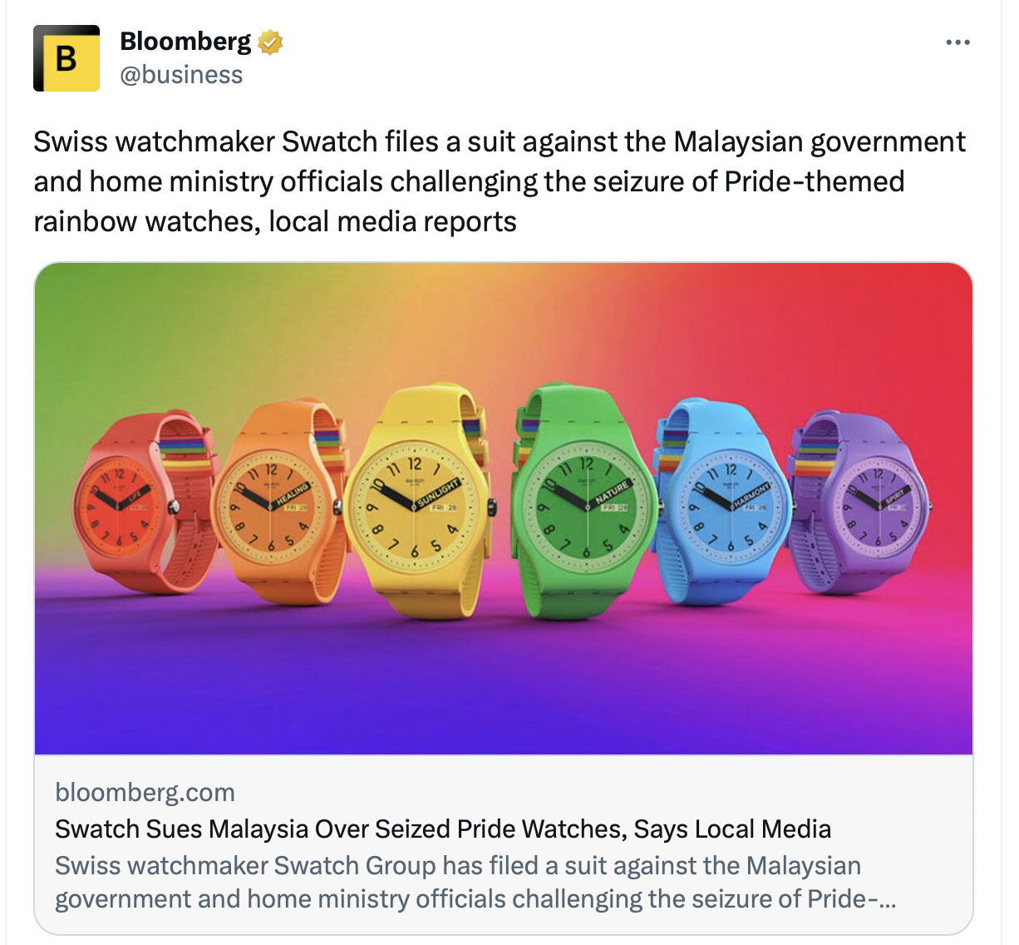
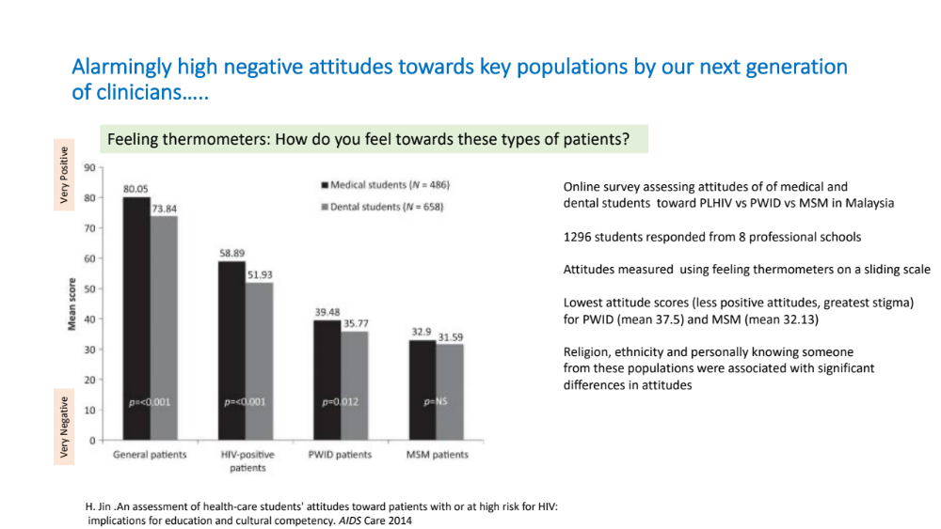
Stigma & discrimination

Slide 19
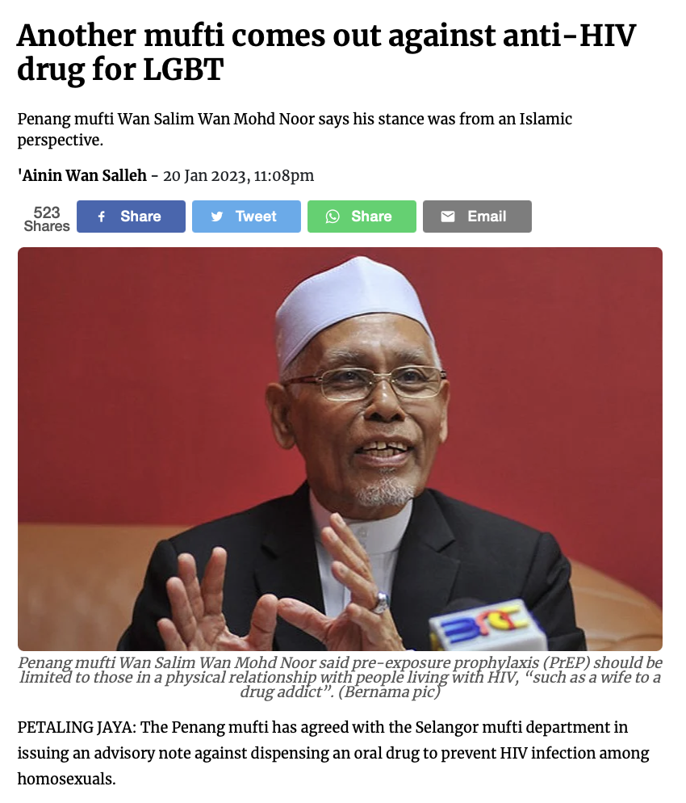
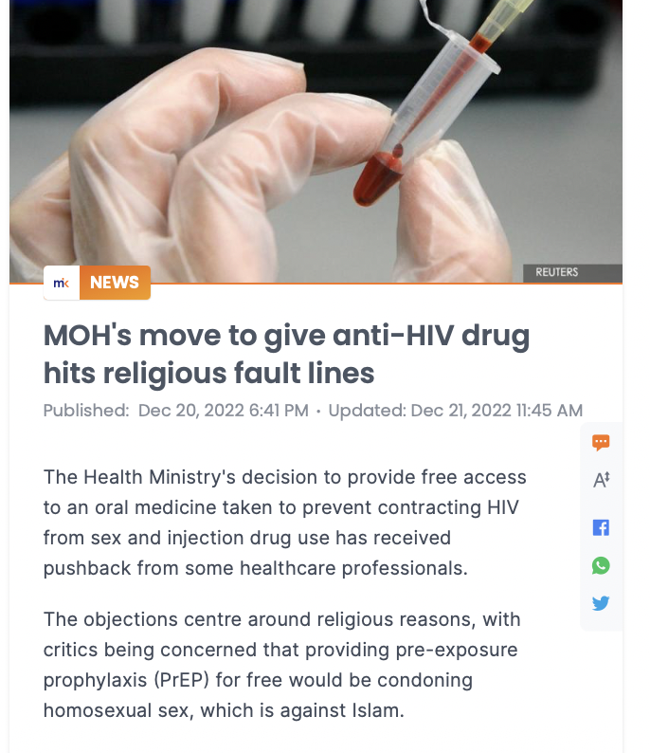
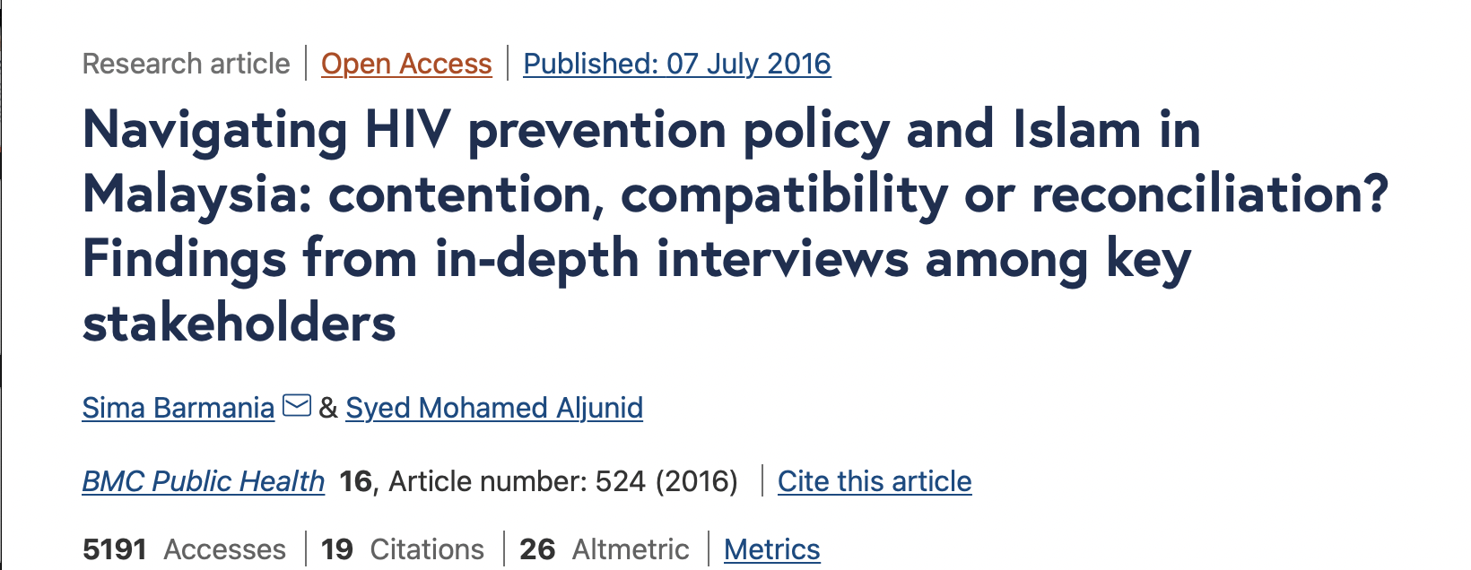

PrEP stigma remains at an all time high
Examples from Malaysia

Slide 20
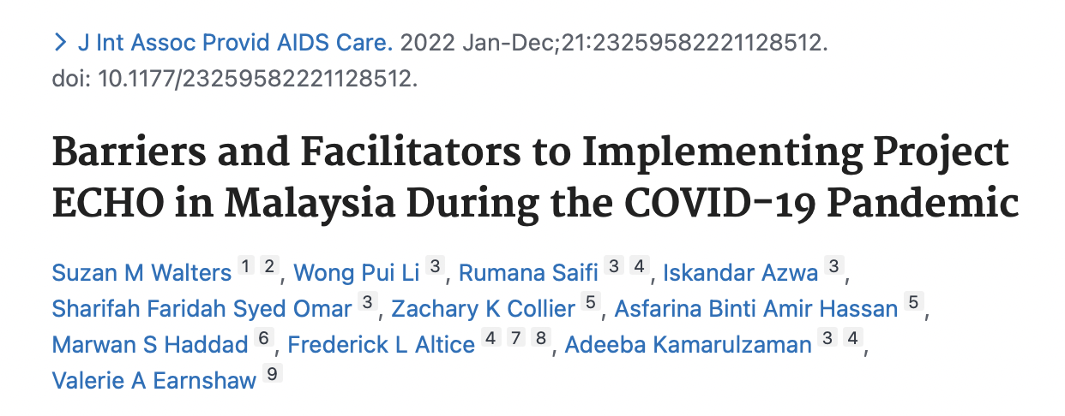
Asynchronous online focus groups
34 clinicians, 47% general practitioners,
15% family medicine specialists
KEY BARRIERS TO ENGAGEMENT
Conflicting priorities and lack of protected time
Technological issues- internet connection and
accessibility to stable internet – more pronounced in
rural settings
KEY FACILITATORS TO ENGAGEMENT
1. Tele-mentoring & access to speciality information
from experts
2. Need for dedicated work time
3. Access to asynchronized flexible sessions
that can be accessed anytime
4. Stronger internet connection and user friendly
platform that can be used on mobile devices
5. Incentives for participating
Notes:
Project ECHO (Extension for Community Healthcare Outcomes)
Potential solution for overcoming barriers to key populations accessing HIV prevention, care and treatment
Tele-education strategy that uses collaborative learning and democratized specialty training for non-specialists via
technology (eg, videoconferencing) to enable healthcare providers in community settings to learn from and
collaborate with specialists at academic “hubs”
Project ECHO® is an expert-guided practice model wherein healthcare providers in the community retain care responsibility,
operating with increasing independence as their skills and self-efficacy grow.
Paritcipants – family medicine specialists and GPs who played key roles in HIV prevention and testing effeorts
Used asynchronous online focus groups

Slide 21
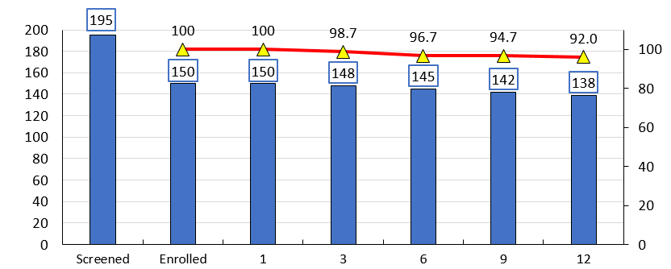
Retention
14 HIV infected
23 Declined
8 Clinical
2 Lost
3 Lost
3 Dropout
5 Dropout
1 Returned
Retention rate
Number of men
Number of men
Retention rate (%)
Months of follow-up
PrEP Demonstration project 2019 (150 MSM)

Slide 22
Lessons learnt and recommendations from My PrEP demonstration project (1)
Messaging of “safer sex” in the era of PrEP needs to change to reduce stigma
  It is likely that with the perceived HIV protection offered by PrEP, rates of condomless sex are likely to increase over time.
  The messaging of "safe sex" in the era of PrEP needs to evolve so that patients are not shamed or stigmatized by HCWs/policy makers for not using condoms if they feel adequately protected from HIV by adhering to PrEP
  PrEP use needs to be re-framed as a positive and responsible option to remain HIV negative and that potential PrEP users are seen as taking control of their sexual health
Chemsex users should be a priority population for PrEP
  40% of participants used substances in the sexualized context (engaged in chemsex), mostly crystal meth with increasing use of GHB over time
  Despite this, chemsex use did not appear to impact on overall PrEP adherence
PrEP is an opportunity for STI control and prevention
  There was a high prevalence of baseline STIs which preceded the initiation of PrEP, most of which were asymptomatic, re-enforcing that we are reaching those at higher risk of HIV/STIs and emphasizing the importance of regular screening of extra-genital STIs and syphilis within MSM irrespective of symptoms

Slide 23
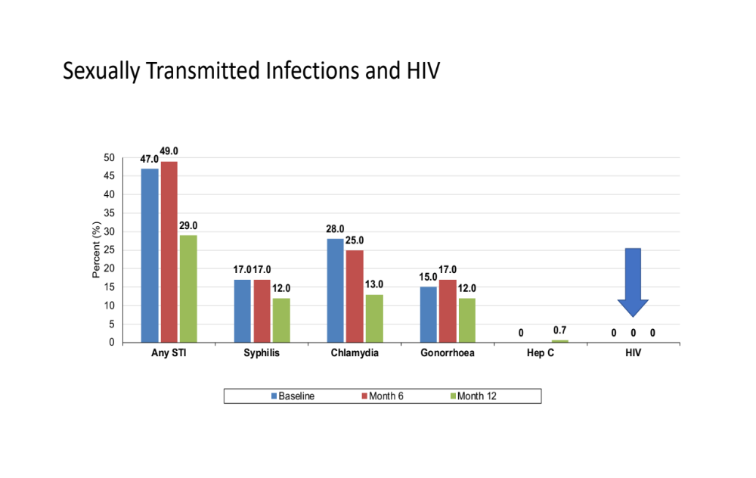
Summary
A sample of 150 MSM was successfully enrolled at three different PrEP service delivery sites in Klang Valley
Men were in majority Chinese, young, well educated, employed and at very high risk for HIV infection
Project retention and drug adherence were high (>90%), exceeding international standards
Only minor changes in sexual risk behaviors were observed
Some self-reported medical conditions following PrEP initiation seem to be elevated compared to one would expect in every-day life
Decreases in kidney function below the eGFR threshold (<60) were associated with use of creatine supplements
There were high rate of asymptomatic STIs at baseline, which preceded the initiation of PrEP
NO HIV SEROCONVERSIONS
18 MONTHS INTO THE STUDY!!
Chemsex (aHR 1.46 (95% CI 1.03- 2.08) (p=0.036) and receptive AI (aHR 1.55 (95% CI 1.04- 2.30) (p=0.03)
were significant predictors of STI positivity on multivariate analyses

Slide 24


Lessons Learnt (2)
The preferred and most accessible sites for accessing PrEP (if all other factors were equivalent) was either the private clinic or the community based clinic.
  HIV treatment clinics offering PrEP in the hospital setting may be early adopters in providing PrEP but in the long term, PrEP provision is best delivered in key population clinics or private clinics which are already being accessed by key populations.
  Task shifting to trained nurses or empowered members of key populations should be considered as part of de-medicalization of PrEP service delivery models.

Slide 25
4.Mobilizing family and parental support
  Access of young people to sexual and reproductive health services are often restricted by laws and policies requiring consent of parents in order for legal minors to undergo testing or treatment
  Age of consent laws and policies can significantly impact adolescent MSM’s access to HIV prevention interventions including HIV testing and access to PrEP
  Parental consent is a particular concern for MSM under the age of 18 who may fear disclosing their sexual behaviours or orientation to their parents
  Primary consideration should be given to the best interest of the young person in the design and delivery of all programmes and services for young MSM in accordance with the UN Convention on the Rights of the Child (CRC) & other relevant international treaties
  Interventions that include parents should be included
  Majority of MSM studies start their sample at age 18
  Ethics and policy research is needed to address challenges associated with enrollment of YMSM

Slide 26
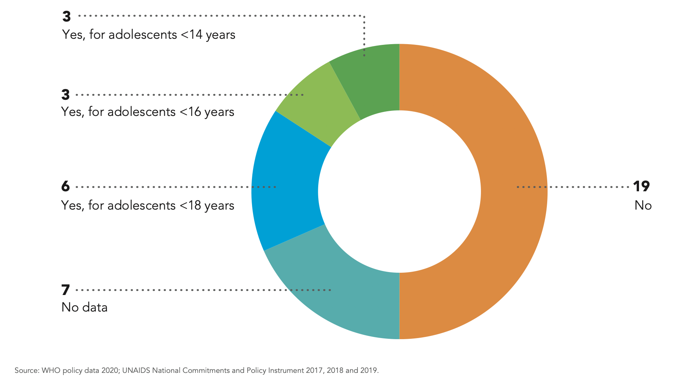
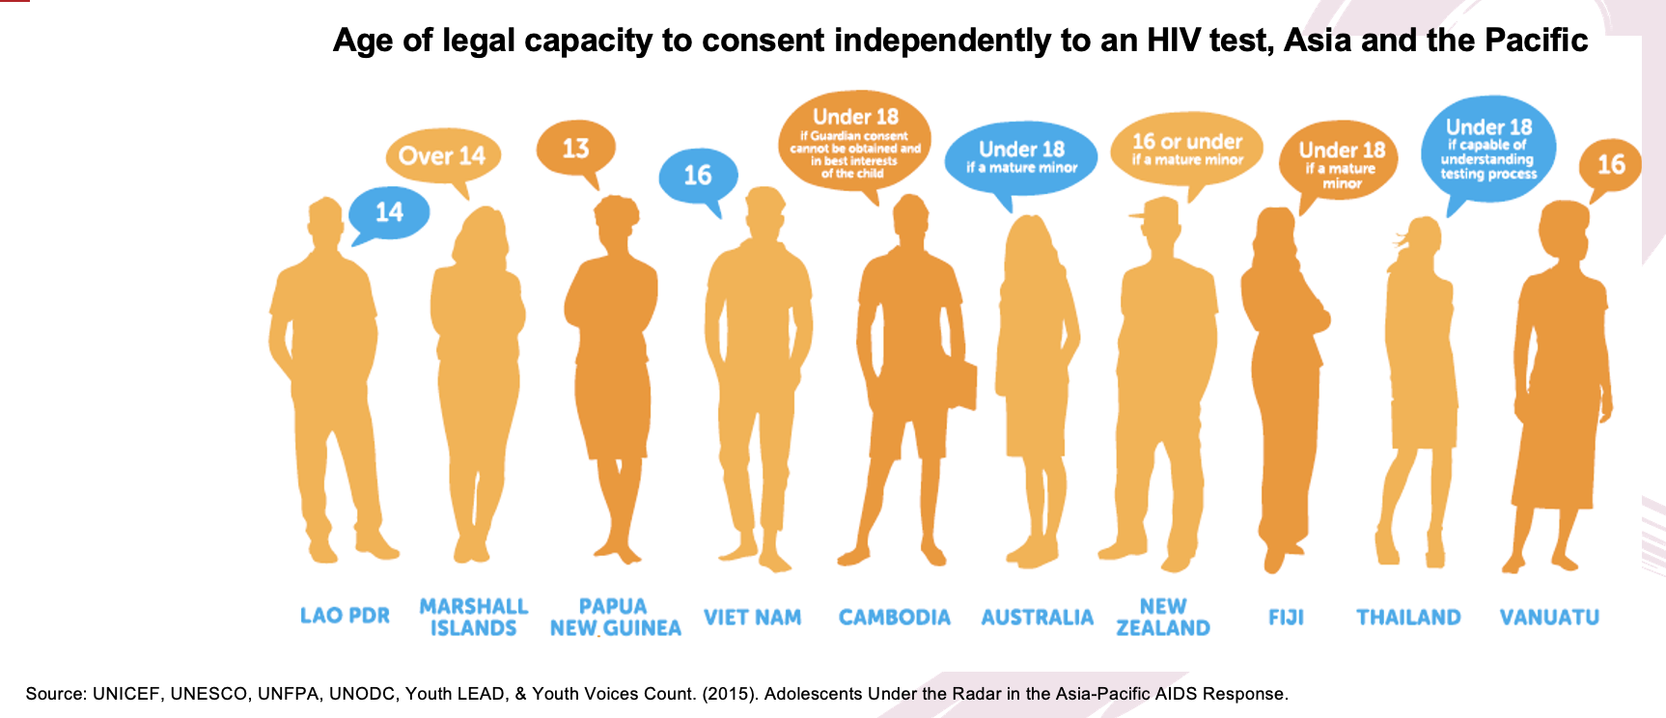
Independent access to HIV testing and related services for young people in the Asia Pacific
No of countries in the Asia Pacific with age of consent laws & regulations for adolescents to access HIV treatment

Slide 27
5. Use of digital technologies and interventions
YMSM are often early adopters of technology, making digital interventions a priority for HIV prevention efforts
  Eg acceptability of Mobile health (mHealth) or internet- based electronic (eHealth innovations) & Social media platforms to reach and engage YMSM in HIV prevention
In Malaysia, the use of mobile technology over the past decades has grown markedly, particularly among MSM, with a mobile phone penetration rate of 97.5% and an internet penetration rate of 71.1%

Slide 28
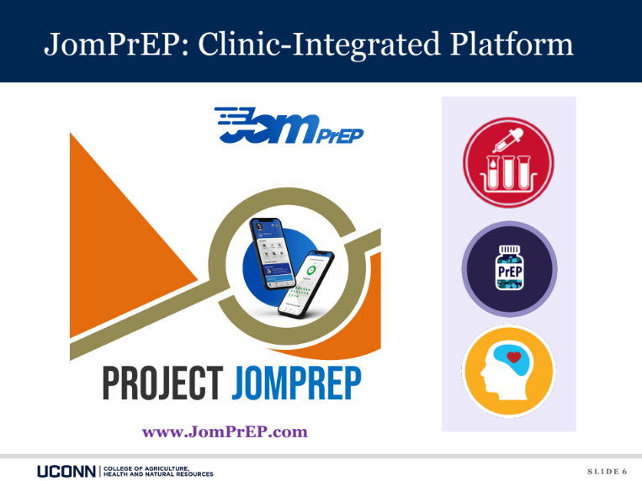
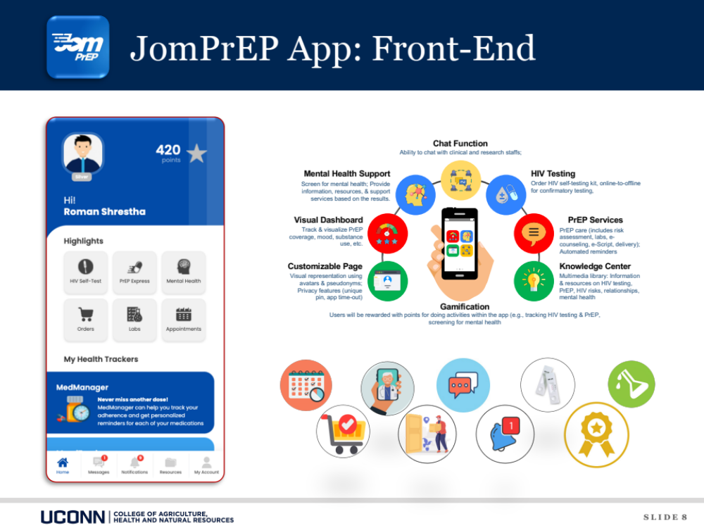
Evaluation of a clinic integrated smartphone app to improve HIV prevention cascade among MSM in Malaysia
Notes:
It includes several on-demand features, including scheduling and managing appointments in person or through e-consultation, communicating with the clinical team (ie, chat), home-based testing, accessing test results, ordering health products, discrete door-to-door delivery, timely notifications, a points-based reward system for completing activities within the app, and a multimedia resource center.

Slide 29
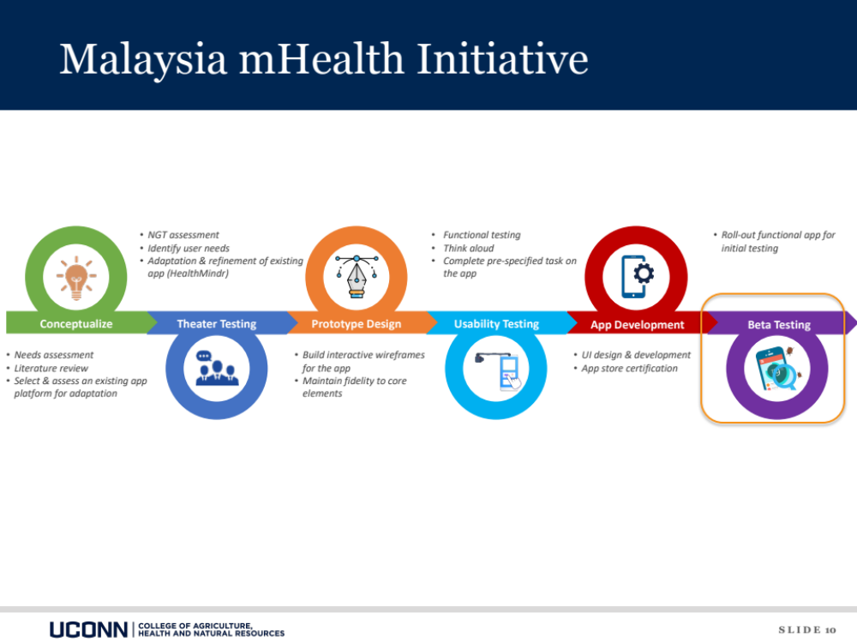
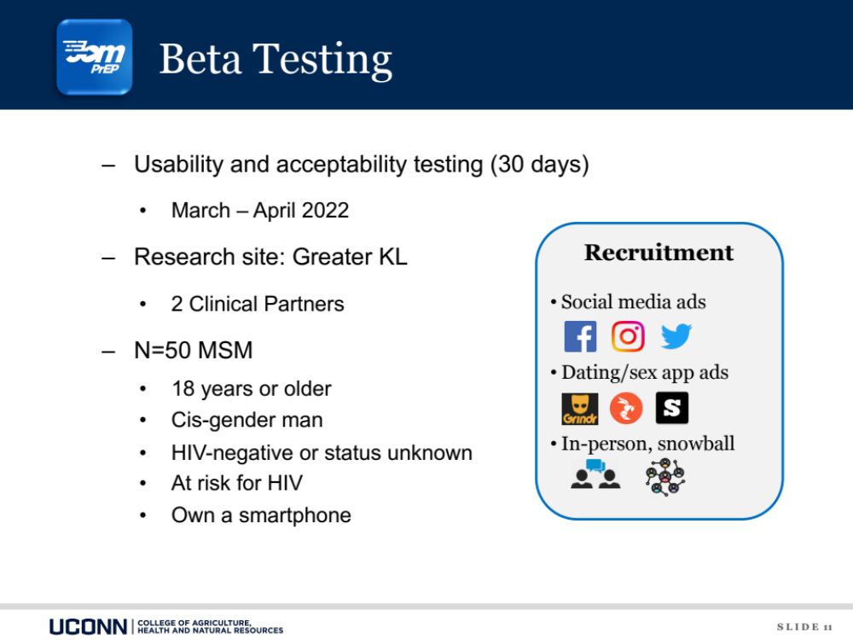
Notes:
Methods: In total, 50 PrEP-naive MSM without HIV in Greater Kuala Lumpur, Malaysia, were recruited between March and April 2022. Participants used JomPrEP for a month and completed a postuse survey. The usability of the app and its features were assessed using self-report and objective measures (eg, app analytics, clinic dashboard). Acceptability was evaluated using the System Usability Scale (SUS).

Slide 30
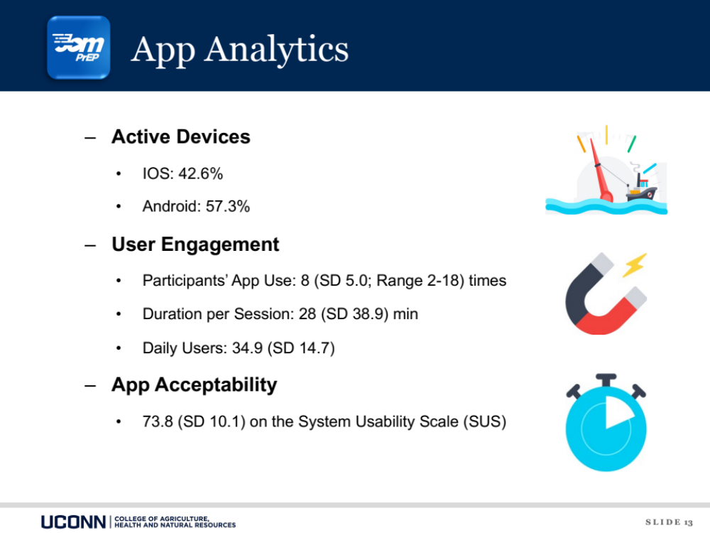
Notes:
During the beta-testing phase, 29/50 (58%) participants were Android users, while the remainder (21/50, 42%) were iOS users. Usability measures by participants included app use, with an average of 8 (SD 5.0, range 2-18) unique visits over 30 days, with an average duration of 28 (SD 38.9) minutes per session. The app had a mean of 34.9 (SD 14.7) daily users
During the beta-testing phase, 29/50 (58%) participants were Android users, while the remainder (21/50, 42%) were iOS users. Usability measures by participants included app use, with an average of 8 (SD 5.0, range 2-18) unique visits over 30 days, with an average duration of 28 (SD 38.9) minutes per session. The app had a mean of 34.9 (SD 14.7) daily users
The mean acceptability score was 73.8 (SD 10.1) on the SUS, well above the minimum criteria (≥50) set for the acceptability of the app with all participants reporting acceptability scores of >50.

Slide 31
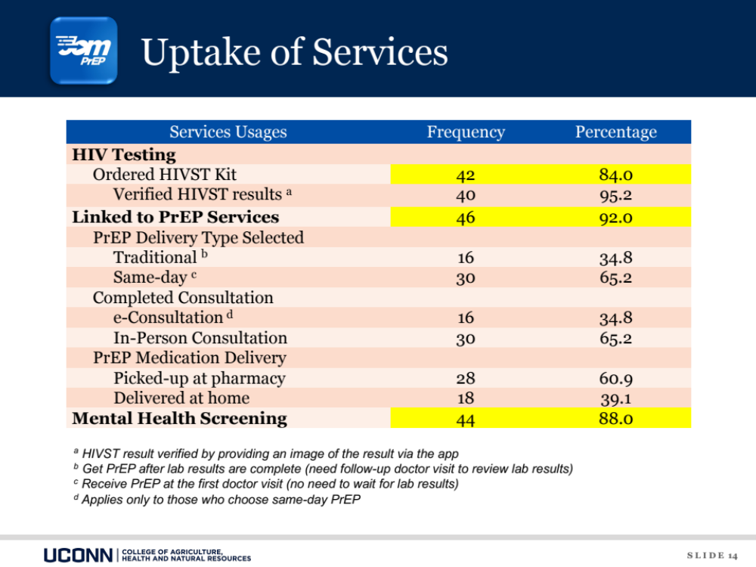
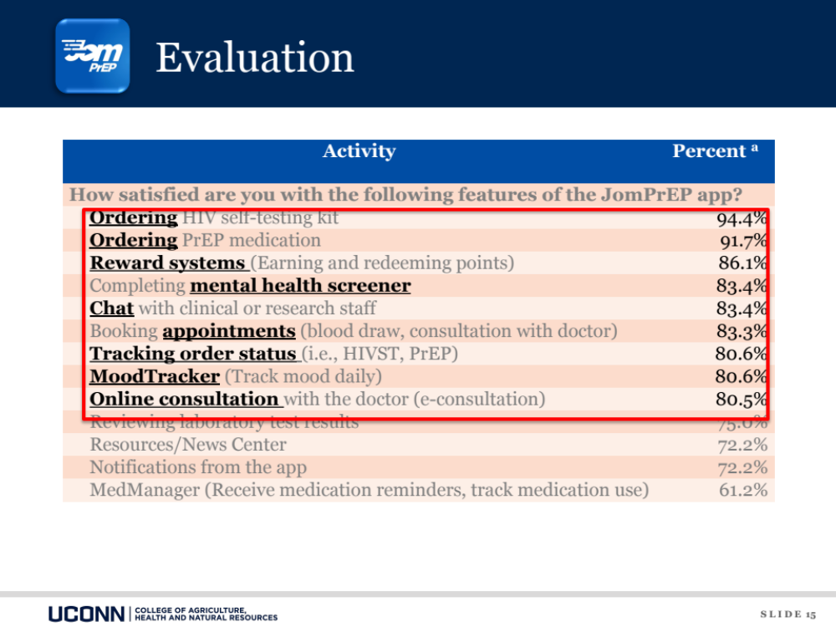
Notes:
During the 30-day beta-testing phase of JomPrEP, 42/50 (84%) participants ordered an HIVST kit using the app. Almost all (46/50, 92%) participants used the app to get on PrEP. Specifically, 30/46 (65%) participants chose same-day PrEP versus traditional PrEP, and the majority of them picked up the PrEP medication at the pharmacy (28/46, 61%). Additionally, 44/50 (88%) participants used the online assessment tool to screen for depression, and 39/44 (89%) of them met the criteria for moderate-to-severe depressive symptoms [37] and were provided with a referral letter
Almost all participants reported that they were satisfied with JomPrEP (46/50, 92%) and that the app was useful in addressing their HIV prevention needs (49/50, 98%); see Table 4.

Slide 32
Thank You

