Slide 1





Implementation Science for HIV Testing among Young Men who have sex with Men (YMSM)
Howie Lim, PhD
Dept of Social & Preventive Medicine,
Centre of Excellence for Research in AIDS (CERiA),
Faculty of Medicine, University of Malaya

Slide 2
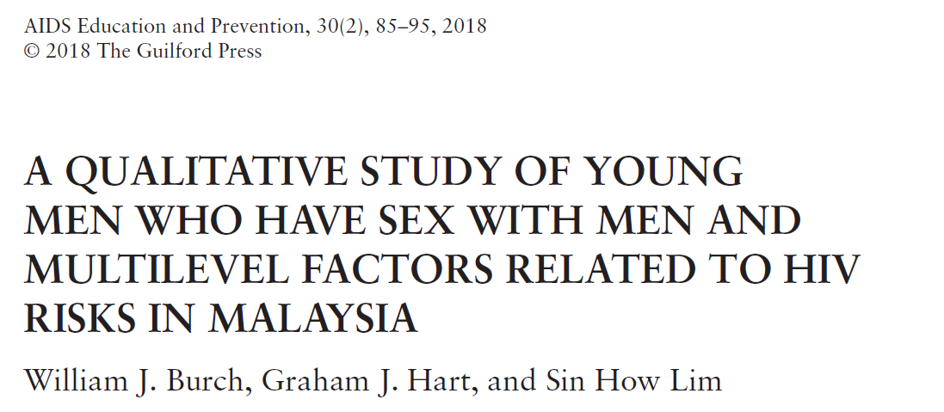

Slide 3
Semi-structured interviews
Local service providers (n=4) and YMSM aged 18-25 (n=20)
With the aid of PT Foundation and KLASS
Study was advertised through NGO websites, email list and gay social media such as Grindr, Jack’d.
Interviews were recorded, transcribed, coded and analyzed using Atlas.ti
Code were then grouped into a smaller number of code families that constituted emerging themes.
Most of the YMSM recruited were university students

Slide 4
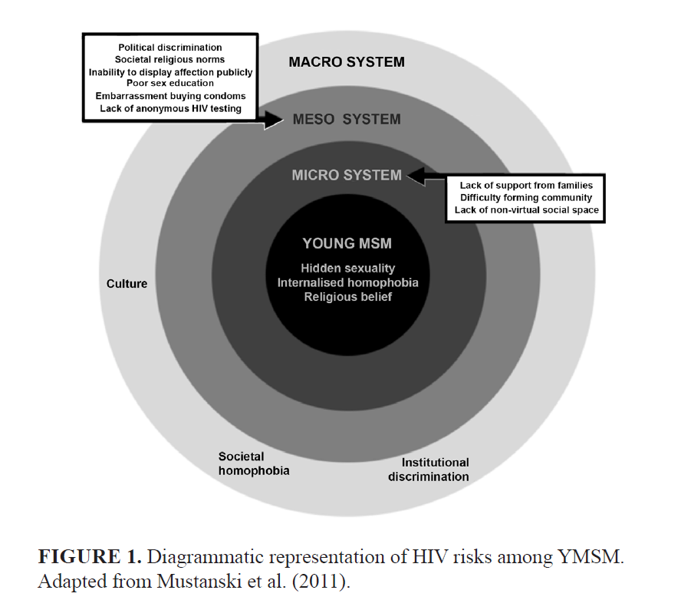
A modified social-ecological model
Notes:
HIV risk among YMSM is mediated by a range of social, cultural, political, and economic factors
operating at multiple levels, from individuals (i.e., knowledge of HIV and condoms) up to the level of society (i.e., national laws governing same-sex relationships). A modified social-ecological model that incorporates these multilevel factors into a single comprehensive model was used as the conceptual framework for the study (see Figure 1).

Slide 5
THEME#1, PERVASIVE STIGMA AGAINST YMSM DUE TO SOCIETAL HOMOPHOBIA
“It’s still like a taboo, you can’t talk about that openly unless you’re brave enough to do so . . . you just can’t tell anyone that you’re gay.” —YMSM, 21years old, university student, ethnicity not obtained

Slide 6
They [the Ministry of Education] have a guideline [to identify gay pupils] . . . if they like to go to the gym, they may possibly be gay. If they’re wearing V-neck then they are gay! [laughs] . . . they will encourage counselors and teachers to try to identify who are the students who are gay, then identify them and send them to this camp or workshop to convert them [to heterosexuality].—Local service provider

Slide 7
THEME#2, “DON’T ASK, DON’T TELL” WITH FAMILY AND FRIENDS
Negativity towards same-sex relationships from close family members was reported by many YMSM, putting mental stress on participants who wanted to live up to their families’ expectations:
“My mum told me once, “What happened [sic] if you live alone [and] there’s no children to take care of you when you’re old.” . . . sometimes the parents worries [sic] a lot. That’s what creates pressure on people.—YMSM, 22 years old, university student, Chinese

Slide 8
THEME #3:POOR MENTAL HEALTH AS A RESULT OF A STIGMATIZED IDENTITY
One LSP participant reflected on his own experience working with YMSM that the lack of acceptance by their families causes low self-esteem and poor mental health, leading to risky behavior:
“Family is most important . . . they have to be accepted and loved . . . . [If] you don’t get those feelings, you create a lot of dysfunctional coping mechanism. Including taking drugs, having risky behaviours . . . why should they consider an open monogamous and accepted relationship?—Local service provider

Slide 9
THEME#4:RELIGIOUS BELIEFS ON HOMOSEXUALITY
Religion, predominantly Islam and its place with Malaysian society, was regularly mentioned as a factor influencing attitudes towards same-sex relationships. Participants who were religious, mainly Christian and Muslim, expressed internalized homophobia and significant angst as they attempted to reconcile their religious background with their sexuality:
“I have friends who are gay in East Malaysia…he’s a very faithful Christian…he’s struggling with his own [sexual] identity . . . religious teachings [sic] doesn’t recognize gay, is condemning gay. Gay is a sin. So it’s for me that self-stigmatisations [sic] . . . . they don’t want to accept their own identity.—YMSM, 19 years old, university student, ethnicity not obtained

Slide 10
THEME#5: LACK OF PHYSICAL SOCIAL SPACE FOR YMSM AND DIFFICULTY FINDING FRIENDS FOR SOCIAL SUPPORT
For almost all the interviewees, gay dating mobile phone apps were overwhelmingly the medium of choice to find new partners.
Gay dating apps were mainly used for finding sexual partners:
“Apps is only purely for sex, that’s all. I don’t believe that’s for friends.”—MSM, 25 years old, university student, Chinese
“I find it almost impossible, personally . . . to make friends on the apps, because I feel everybody goes on that just to hook up. So far, probably I’ve successfully made one or two friends from the apps.”—YMSM, 24 years old, university graduate, ethnicity not obtained

Slide 11
THEME #6:LACK OF COMPREHENSIVE SEX EDUCATION AND KNOWLEDGE ON HIV/AIDS
“We were taught of venereal diseases, but the way it was taught, I think, it was portrayed in a very negative manner. Like it’s not something you want to have . . . definitely like a negative aura to HIV/AIDS and just a sexual STDs and STIs.”—YMSM, 18 years old, university student

Slide 12
THEME #7:CONCERN ABOUT DISCRIMINATION BY GOVERNMENT CLINICS
“I heard a few stories about people who are lectured by the doctors to not be gay . . . Told them off . . . [said] not have sex and “Do you realise what you’re doing is wrong? I’m not going be surprised that it’s going be positive today.” I mean, those are the things that happen here in government hospitals here in Malaysia.”—MSM, 19 years old, university student, Malay
Notes:
Participants reported that the most important reason avoiding government clinics was the lack of confidentiality.
HIV diagnosis made in a government health center will be reported to the Ministry of Health to be avoided at all costs.

Slide 13
Special issues for YMSM
Illegal
Stigma
Lack of support (family, community, etc)
Online/virtual space for meeting
HIV prevention is not targeted towards MSM
Lack of comprehensive sexual health education
Health care discrimination (perceived, enacted)
Concern of confidentiality with HIV testing

Slide 14
Snapshot of HIV in Malaysia (2021)
81,942
67,822
2,760
Estimated people living with HIV
Total number of people living with HIV
Reported new HIV infections
Source: Global AIDS Monitoring 2022: Country Progress Report – Malaysia by Ministry of Health Malaysia.

Slide 15

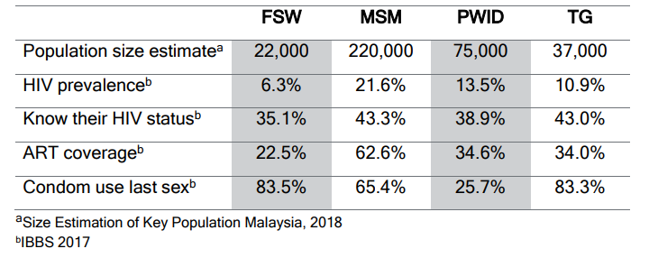
HIV situation among key populations in Malaysia

Slide 16

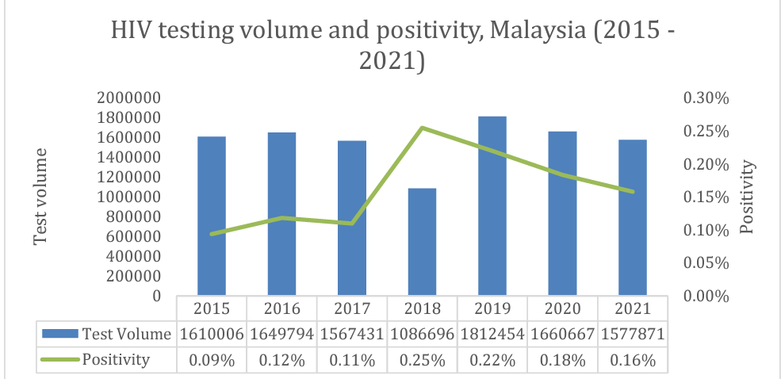
As many as 1.5 million test are performed in 2021, with positivity rate of 0.16%. These data were derived of facility based testing.
Notes:
.

Slide 17
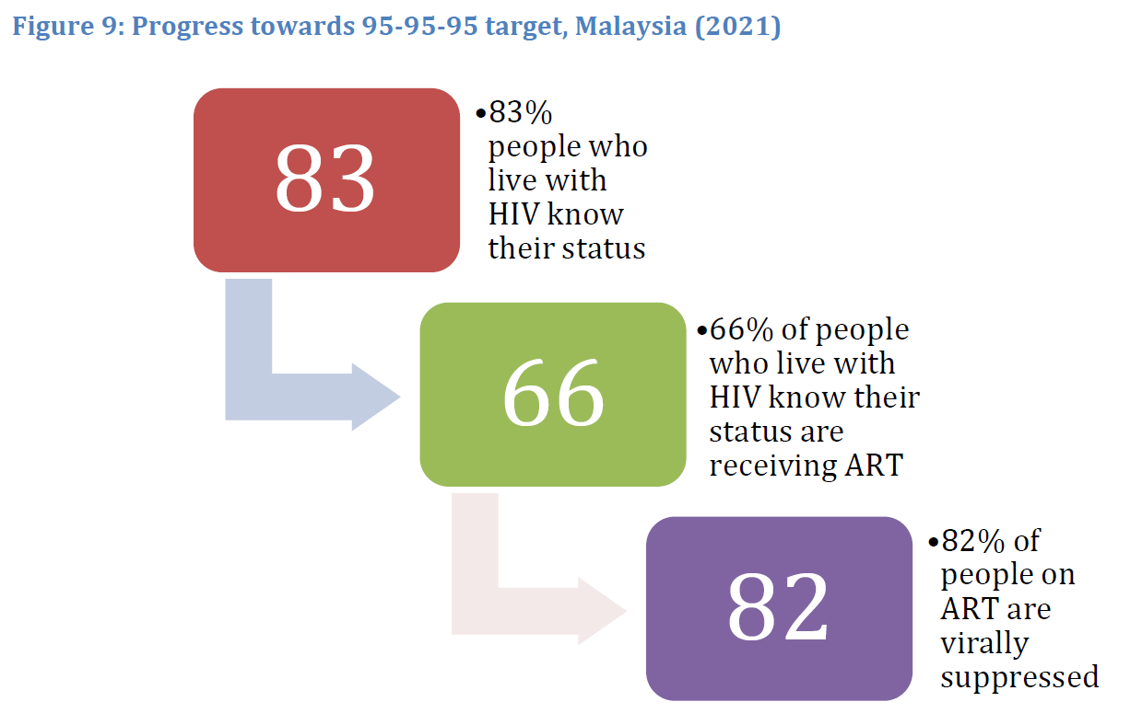
We do not have HIV cascade for each key population
Source: Global AIDS Monitoring 2022: Country Progress Report – Malaysia by Ministry of Health Malaysia.

Slide 18
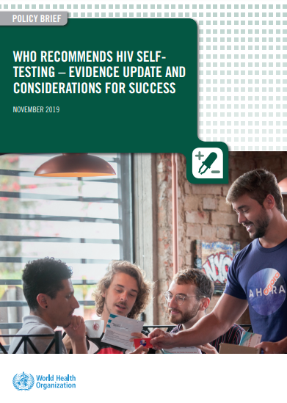
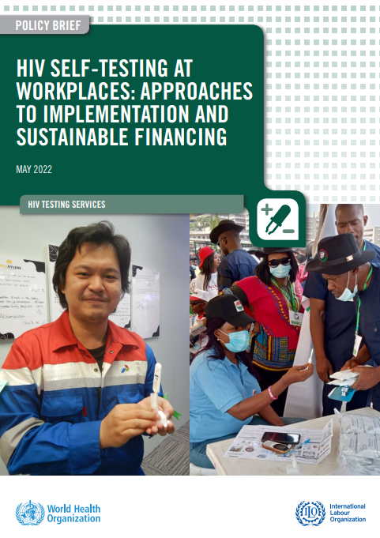
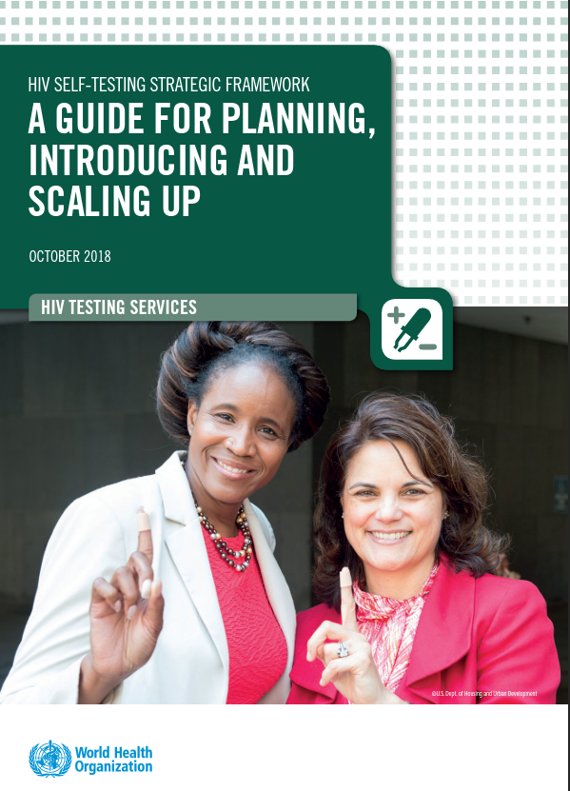
Introduction – HIV Self-testing

Slide 19
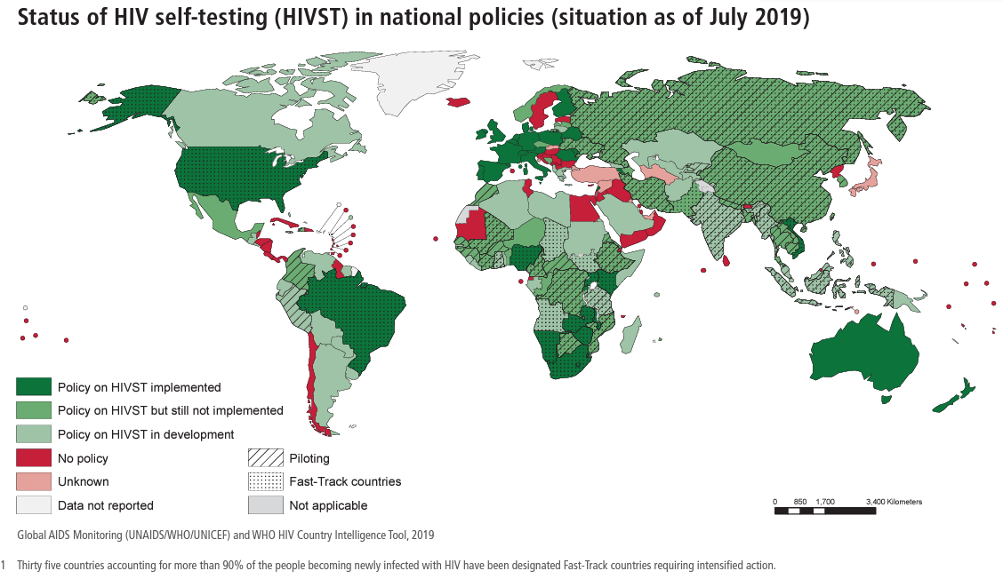

Slide 20
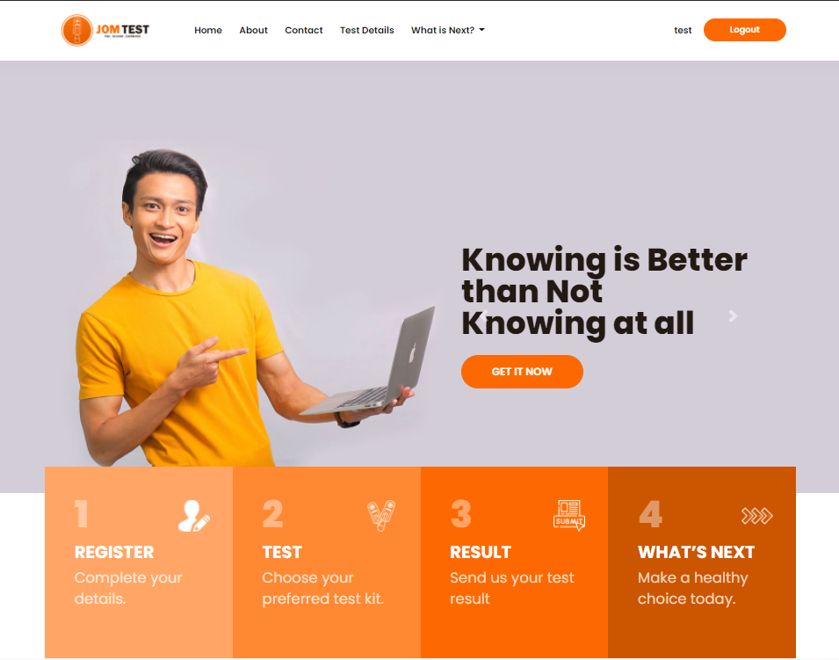
HIV Self-testing in Malaysia
Jomtest by Malaysian AIDS council and CERIA UM, are the pioneer and sole implementor of HIVST initiative in Malaysia.
Introduced and piloted in November 2020.

Slide 21
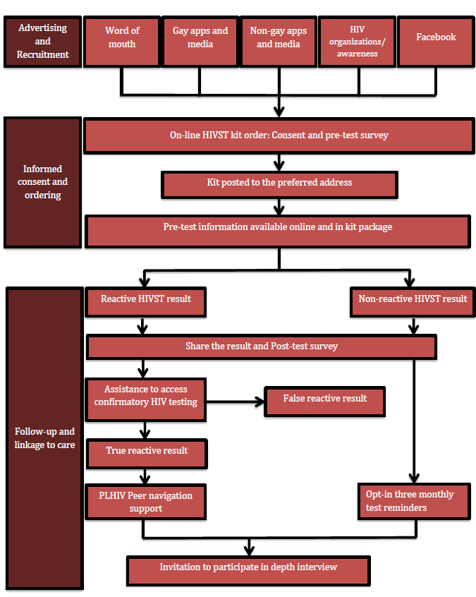

Slide 22
JOM TEST WEBSITE

Slide 23
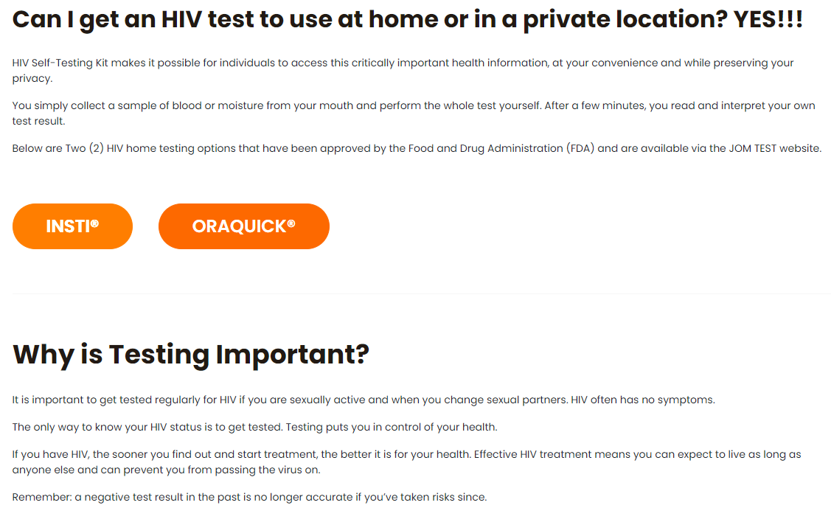
www.jom-test.com

Slide 24
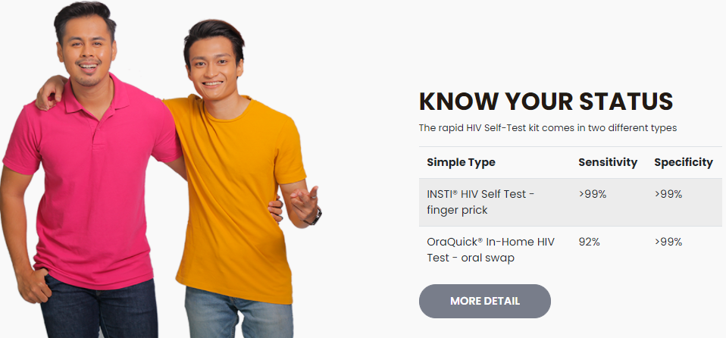
List of test kits available
www.jom-test.com

Slide 25
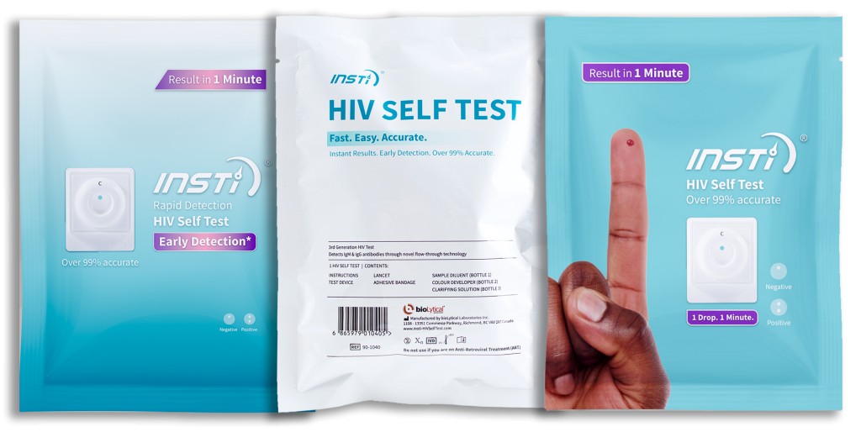
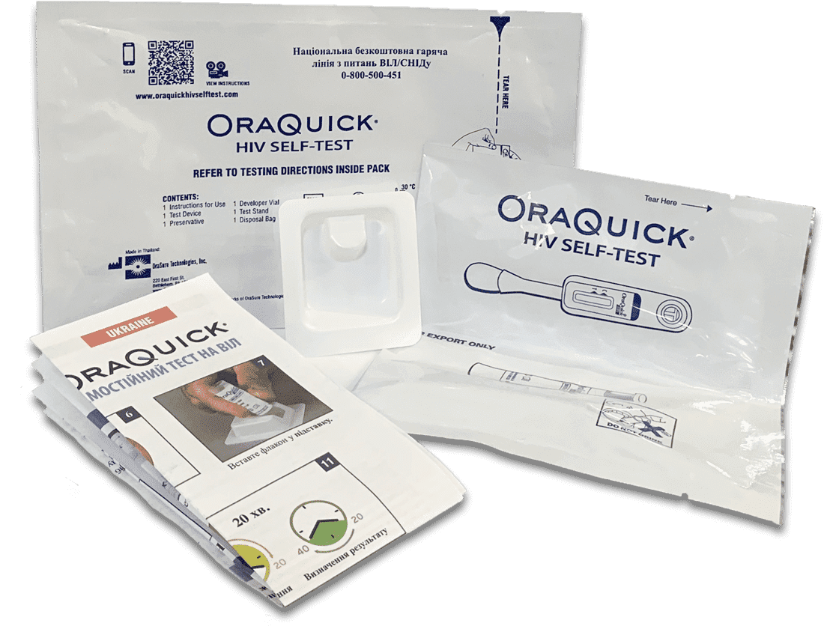
HIVST Kit
This intervention revolves around self-administered rapid test kit using either saliva or blood to detect the presence of HIV antibodies.
HIVST allows the participants to interpret their own result in their own privacy and have total autonomy in the process without being affected by the stigma surrounding HIV.
Source: www.jomtest.com

Slide 26

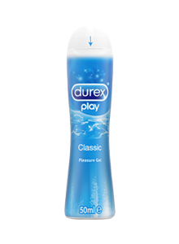
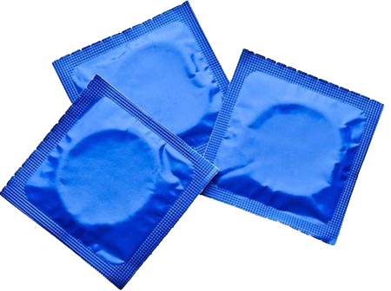
WHAT DO CLIENTS GET?
OR

Slide 27
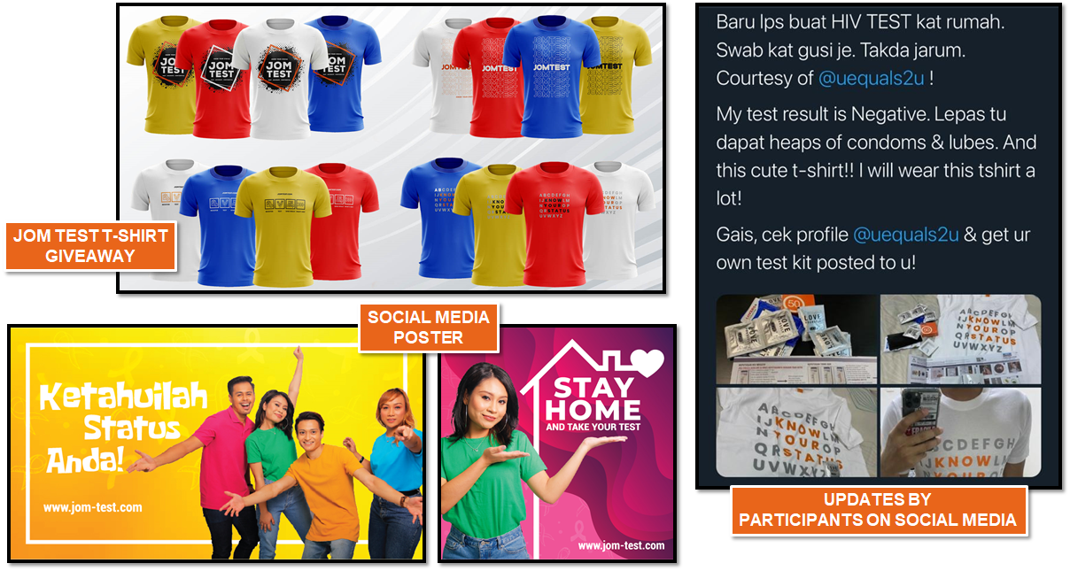
JOM TEST PROGRAM PROMOTION

Slide 28




MOTTO PROGRAM JOM TEST
EASY
FAST
CONFIDENTIAL

Slide 29
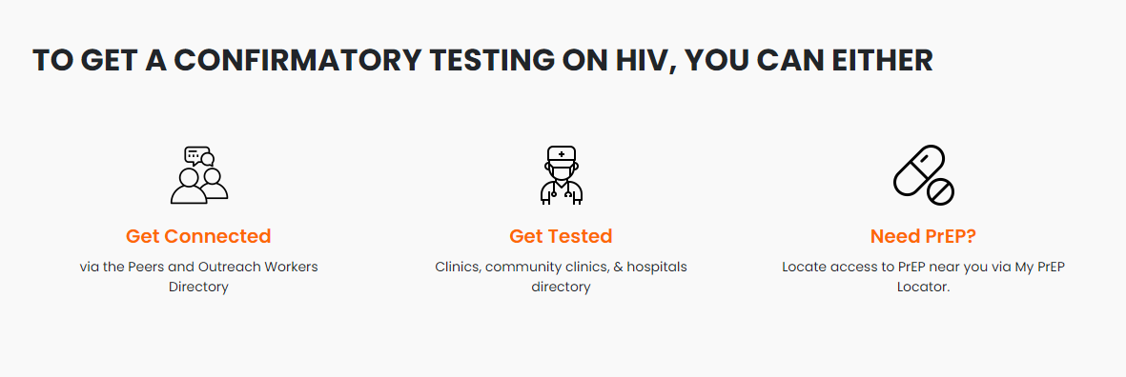
Community friendly & STI clinics and hospitals
Directory of all active Outreach workers & Peers
Direct link to MyPrEP Locator Website
www.jom-test.com

Slide 30
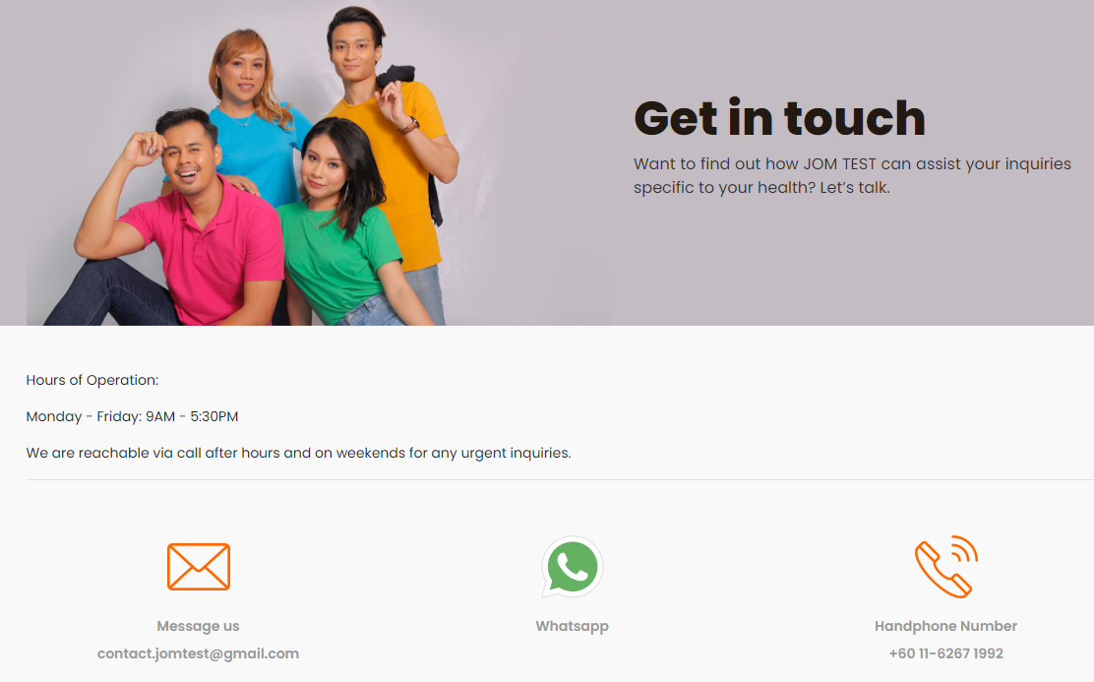
www.jom-test.com

Slide 31
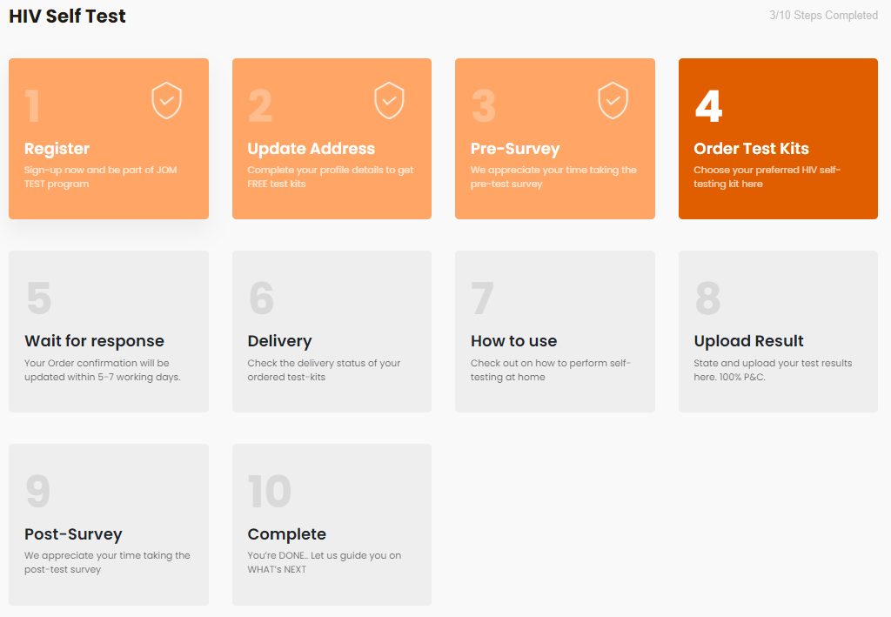
PARTICIPANT’S DASHBOARD

Slide 32
JOMTEST Program Progress (Nov 2020 – Oct 2021)
Website launched on 16 Sep 2020
Recruitment started on 6 Nov 2020
Recruitment ended on 31 Oct 2020
No. of unique visitors: 21,661
100%
88.1%
4.5%
7.0%
42.6%
88.5%
94.4%

Slide 33

Distribution of Participants by State (N=1,077)

Slide 34
Distribution of Participants by Key Population (N=1,077)
9.0%
9.3%
0.3%
1.1%

Slide 35
Distribution of Test Results by Key Population (N=1,077)

Slide 36

Distribution of Participants by Age (N=1,077)

Slide 37
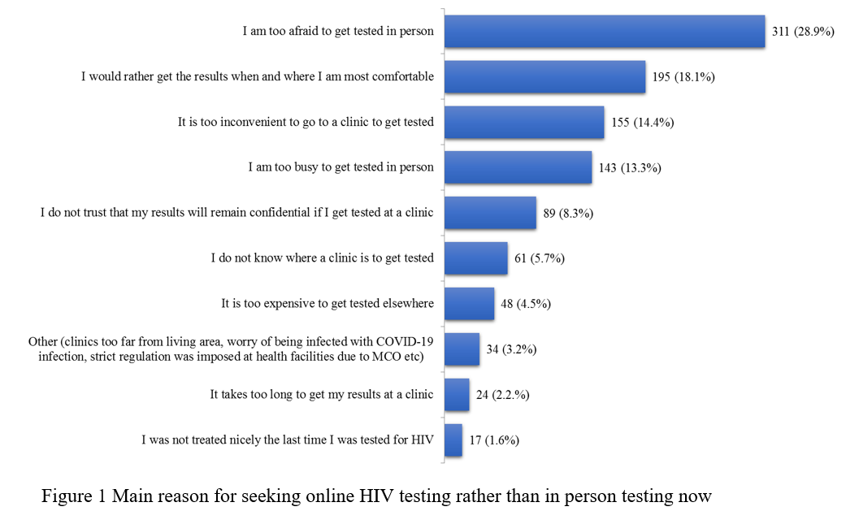

Slide 38
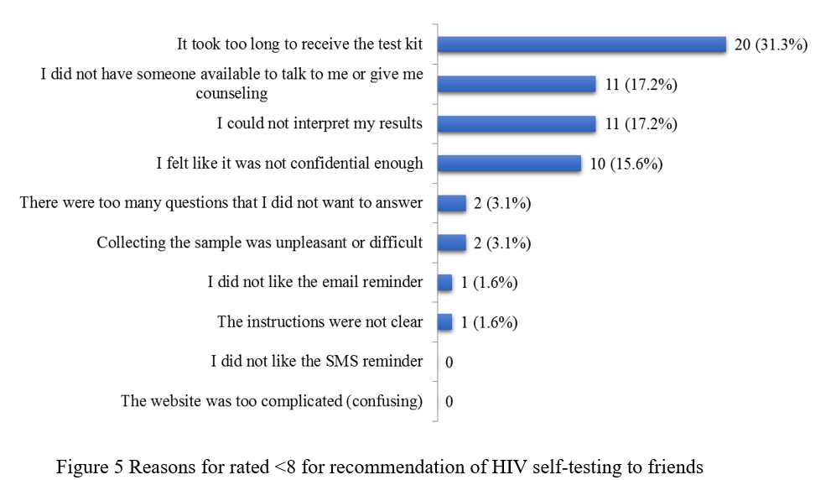

Slide 39
Total MSM size population estimate: 220,000
Gap #1
No. of unique visitors: 21,661
100%
88.1%
42.6%
94.4%

Slide 40
Total MSM size population estimate: 220,000
No. of unique visitors: 21,661
Gap #2
100%
88.1%
42.6%
94.4%

Slide 41
Total MSM size population estimate: 220,000
No. of unique visitors: 21,661
100%
88.1%
42.6%
94.4%

Slide 42
Some updates after the pilot study ~May 2023

Slide 43
Process | 2021 |  | 2022
 | Mean | Sd | Mean | Sd
Average time from registration to ordering (mins) | 22.3 | 2.1 | 29.4 | 2.7
Average time to delivery arrival (days) | 5.34 | 0.76 | 19.8 | 3.4
Average back-end man hours needed for 100 clients (hours) (Includes packaging, support services) | 27.6 hours |  | 29.1 hours
Average back-end man hours needed for 100 clients for enquiries and support services | 11.3 hours |  | 21.1 days
Number of participants perform repeated testing | 9 |  | 7

Slide 44
Result from previous acceptability study and end-user feedback
Implementation Gaps
Information
Dissemination
User
experience
Infrastructure

Slide 45
User experience
Extensive signing up process
Prone to technical error due to complex user interface
Long waiting duration for test kits
Lack of versatility in service provided
Difficulty in obtaining support in terms of technical errors

Slide 46
Infrastructure
Only up to 2 orders per client
No automation in services
No other support services included
Only available in English language
Only basic registration services available with no follow up services, referral system and information

Slide 47
Information dissemination
Only single channel of dissemination-> Social media, sharing with other Malaysian AIDS council initiatives.
No partner NGO involvement

Slide 48
IS 1: Integration of HIV preventive initiatives into a single platform
New added services
STI information and referral system
Access to Chemsex online intervention
Mental health assessment and support
Addiction assessment and support
Psycho-social services
Regular testing for HIVST as per WHO guidelines
Condom and lubricant delivery
Access to partner organisation and support
Automated referral to CHW or Health clinics if indicated.
Existing service
HIV self test kit and delivery – 2 times max
HIV prevention information
Treatment directory
HIV support directory

Slide 49
IS 2: Streamlining processes and improving interface for end user
Upgraded system
Available in English and Bahasa Malaysia. ( Mandarin and Tamil interface is currently under planning)
Registration process has only 2 questions
Risk group questionnaire is adhoc (separated) not compulsory – will guide for the other services.
Concise webpage with minimalistic design. (designed to be suited for mobile app, however mobile app is still under planning)
Real time delivery update.
Information is fed to user based on the result of questionnaire on an automated pre-design criteria.
Existing system
Only available in English.
Registration process has 18 questions survey in 3 steps.
Has links for services that are not available.

Slide 50
IS3: Creating an automated platform system to deliver multiple services without impacting resources.
Current system
No automation – require backend officers to engage constantly.
Upgraded system
Automation embedded for:
  Delivery of the HIVST kits
  Linkage and access to other necessary HIV prevention initiatives/ support services.
  Referral in positive cases to nearest CHW or KK
  Re-delivery of new kit if result is invalid
  Reminder for regular testing if negative HIVST
  Psycho-social support (virtual or referral to psychiatrist ) if fulfil pre-determined criteria –with consent

Slide 51
IS4: Increasing mode of service delivery to improve engagement and information dissemination
Upgraded system (add –ons)
3 service delivery method
  Online
  Via NGOs/ POs
  Peer to peer engagement
All HIV/AIDS NGO and POs will be given training of the programme together with referral code.
Organisation that are sub-recipients of Malaysian AIDS council grants will be given targets for the program. (based on referral codes and promotional activities during key population engagement)
Existing system
Online available through online application.
No partnership with other organisation.
Information only available through social media

Slide 52
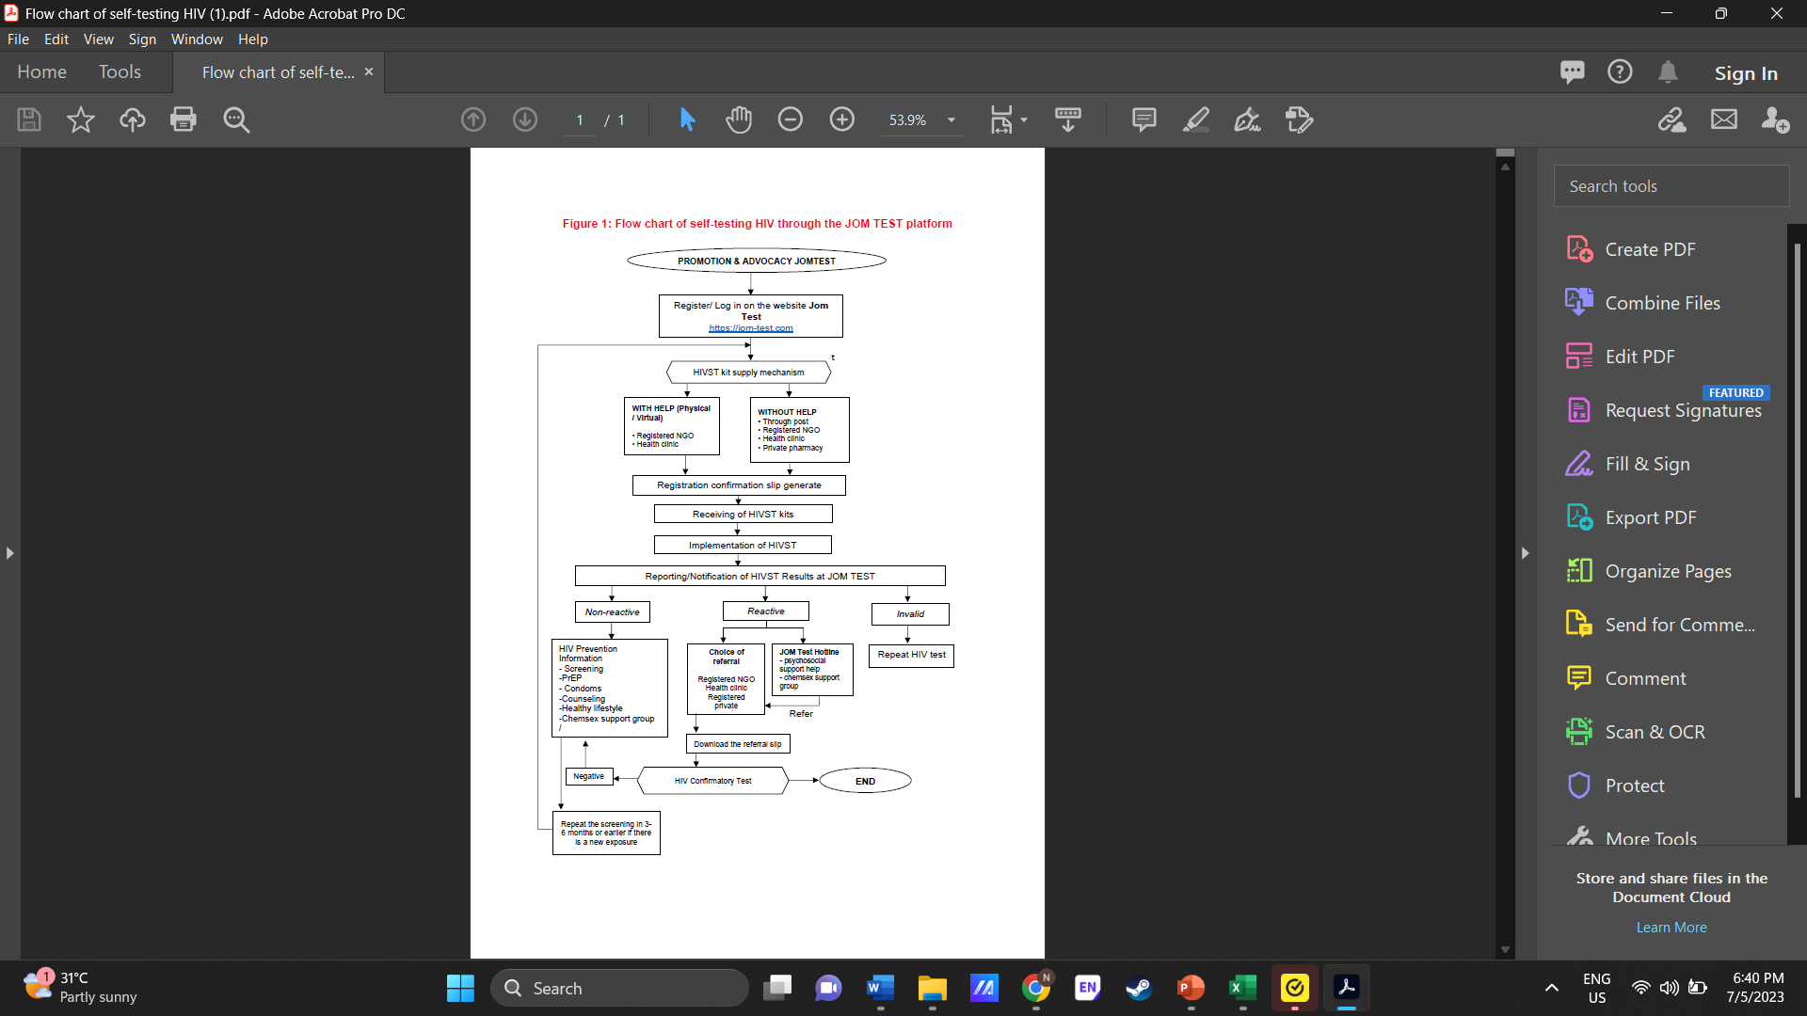
Flow chart of self-testing HIV through the platform
All results will be cross validated by program managers.
Positive cases will be alerted automatically to program managers and referral will be produced by the system once validation is confirmed- triggering HIV treatment cascade.
Invalid test result will trigger automated process to send new kit once validation has been confirmed.

Slide 53
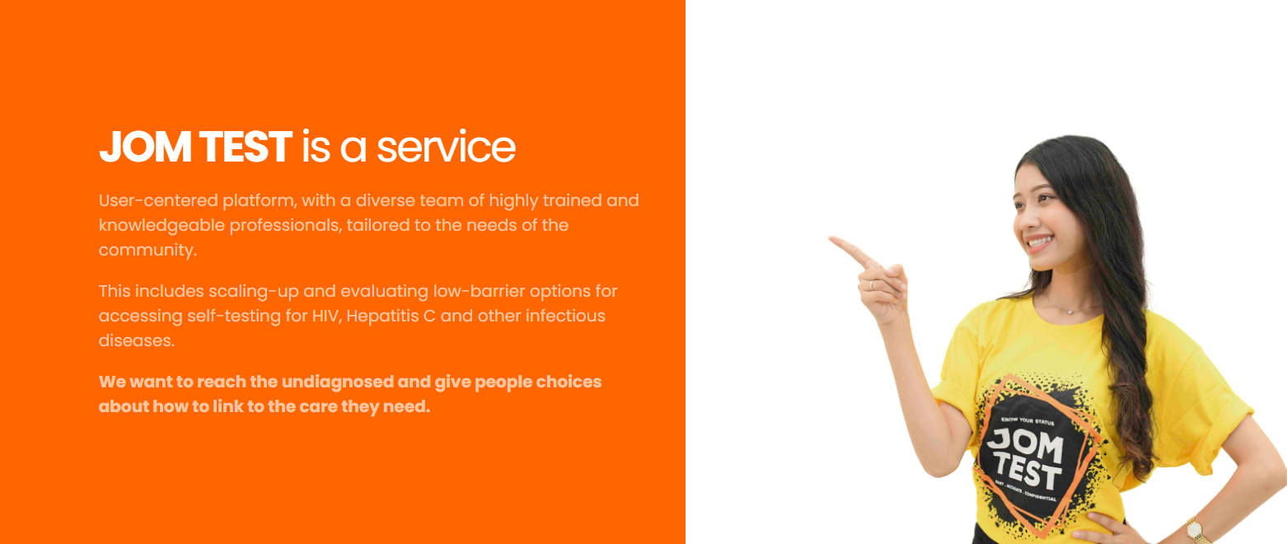
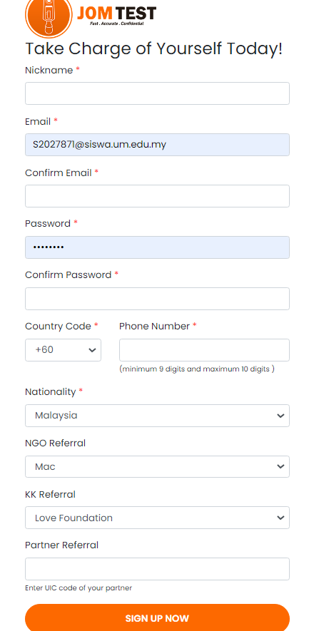
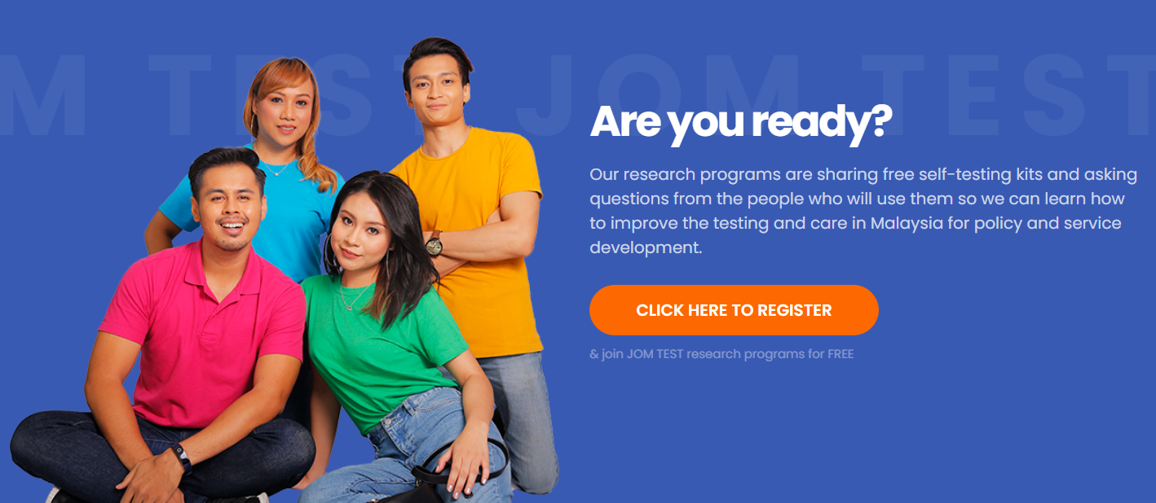

Slide 54

THANK YOU
Acknowledgement
Prof. Dato’ Dr. Adeeba Kamarulzaman
Prof Dr. Frederick Altice (Yale University)
Assoc. Prof. Dr. Iskandar (UM)
Davindren A/L Tharmalingam (MAC)
Yusral Hakim Yusoff (MAC)
Haridah Alias (UM)
Dr. Narish Kumar (UM)
Dr. Jeffrey Wickersham (Yale University)
Dr. Roman Shrestha (Yale University)
Teaka Sowaprux (“Love Foundation”)
Panyaphon Phiphatkhunarnon (“Love Foundation”)
Digital team from MAC (Malaysian AIDS Council)

Slide 55

Science “to” Service
Evidence-
Based
Innovations
IMPLEMENTATION
Best Practices
GAP
SERVICE
Implementation Research

Slide 56
Needs:
Implementers, Researchers
Enabling contexts (organizations, settings)
Effective Implementation Strategies
Resources, Trained Service Providers
Implementation of Evidence-Based Interventions

Slide 57
Qualitative Interviews to Evaluate JOMTEST: key findings

Slide 58
Definitions of Young Men Who Have Sex with Men (MSM)
Various age definitions used in previous studies (e.g., 13-24, 15-29, etc.)
Includes adolescent MSM
Importance of understanding the population for effective implementation

Slide 59
Participant characteristics
Participant | Age | Gender | Race | Category | Type of test kit | HIVST results
1 | 25 | Female | Bumiputera | PWUD | OraQuick®️ HIV Self-Test | Invalid
2 | 29 | Male | Chinese | SW | OraQuick®️ HIV Self-Test | Invalid
3 | 22 | Male | Bumiputera | MSM | OraQuick®️ HIV Self-Test | Positive
4 | 18 | Male | Malay | MSM | OraQuick®️ HIV Self-Test | Positive
5 | 27 | Male | Malay | MSM | OraQuick®️ HIV Self-Test | Negative
6 | 29 | Male | Malay | MSM | OraQuick®️ HIV Self-Test | Negative
7 | 22 | Male | Malay | SW | OraQuick®️ HIV Self-Test | Self-reported negative, yet to be verified by JomTest team
8 | 21 | Male | Malay | MSM,SW | OraQuick®️ HIV Self-Test | Positive
9 | 19 | Male | Malay | MSM | OraQuick®️ HIV Self-Test | Invalid
10 | 22 | Male | Malay | MSM | OraQuick®️ HIV Self-Test | Negative
11 | 18 | Female | Malay | Heterosexual | OraQuick®️ HIV Self-Test | Did not share the result

Slide 60
HIVST website : JOMTEST
Majority discovered JOMTEST through Twitter platform (Jomtest twitter account, strangers’ twitter tweet) with only 1 respondent discovered the website via peers.
General responses were positive regarding the website.
Interface was attractive. Navigation was easy and user friendly.
Information provided was comprehensive and compact. Easy to read and understand.
However, the Malay language option provided in the website was limited to certain sections only, such as pre- and post-testing survey.

Slide 61
Registration process
Generally registration was easy and the information asked for registration were necessary and reasonable
Nevertheless, few participants had difficulty in technical aspect. Since the content of the website was provided mostly in English, participant found this might hindering potential participants who cannot understand English to register, especially uneducated person or person from rural area.
Despite the pre-survey at the registration took almost 10 minutes to complete, most participants didn’t feel it as a burden.

Slide 62
HIVST delivery process
Participants found the delivery time was acceptable, mostly received the self-testing kit within 2 weeks. However, some participants experienced delay in receiving the self-testing kit during national lockdown.
Technical support during delivery was slow.
Delivery method and packaging was found to be acceptable.
Most participants were not afraid to accept the packaging as it was discreet despite being sent to their home address.
Mixed feeling (excited, nervous, happy) during receiving the self-testing kit.

Slide 63
HIVST process
All participants agreed the OraQuick was easy to use and the instruction provided in the package was informative and easy to understand.
However, they perceived that fingerstick blood self-testing kit to be more accurate compared to oral fluid self-testing kit.
Half of the participants conducted the test on the same day they received the self-testing kit. About half waited for 2 to 3 days to conduct the self-testing due to feeling nervous and looked for more information about HIV self-testing.
Majority conducted the test without companion, and they preferred to do it alone due to privacy.
Anxiety was reported in most participants but at acceptable level while waiting for the results. Only 2 participants reported having negative thoughts but not suicidal.
Majority expressed the level of their trust toward the accuracy of the self-testing results was 70% to 90%.

Slide 64
Sharing of HIVST results
The participants were split in between regarding sharing the results.
Those who did share their results understood that the need of data collection from the organisers to ensure proper follow up and link to treatment cascade.
Another group of participants did not share their result as they feel the result is too personal to be shared with others.
However, they expressed they understand the need for linkage to treatment in case it was positive and they would seek for it themselves.

Slide 65
Additional support
The program is reaching key population but not efficiently. Currently, the program is only reaching KP with higher SES and young adults who are Twitter users, majority who are living in Central region of Malaysia. Peer influence plays a big role in reaching them.
This program should also be actively promoted to secondary school students through SnapChat and TikTok as this population is increasing in number of people who engaging in high risk sexual activities.
A real time support is needed, especially when having difficulty performing the test so that participants can get real time help or counselling.
Participants who were tested negative expressed no need of pre-testing and post-testing counselling. However, they agreed that these counselling were useful for people who tested positive or first-timer who is not confident and anxious during the process of self-testing.

Slide 66
Sustainability
The program maintains its code of privacy and confidentiality throughout the process.
All participants perceived JomTest program to be very useful and should be continued.
All participants rated 10 out of 10 that they would definitely re-order the self-testing kit from this program.
In the future, participants are willing to pay MYR20 to MYR50 for the test kit.

Slide 67
In Summary
Online HIVST may be an ideal platform to scale up HIV testing among MSM and other KPs.
The implementation cascade was leaky.
Protection of confidentiality is needed to allow sharing of test results.
Explore financial incentives to encourage sharing of test results.
Human resources needed to expedite mailing of HIVST kits.
Quick response and engagement with participants are paramount.

Slide 68
Other Challenges of Implementing Evidence-based Interventions for YMSM in Malaysia
Cost
Availability of evidence-based interventions
Support from parents
Support from schools/colleges/universities
IRB approval to conduct studies under <18 years

Slide 69
Considerations for Conducting Implementation Science for YMSM in Malaysia
Demographic and Epidemiological Factors
Cultural and Religious Considerations
Legal and Policy Framework
Social Stigma and Discrimination
Healthcare System and Infrastructure
Mobile technology and social media
Roles of implementers

