Slide 1


Page 01
Rapid-Start initiation of Direct-Acting Antiviral (RS-DAA) strategy among people who inject drugs (PWID) with Hepatitis C infection in Malaysia
MIST BOOT CAMP
19 JULY 2023
Prepared by:
Dr. Nadhir Adi Azahar & Dr. Iqa Mohd Salleh

Slide 2
Page 02
Outline
Current situation of Hepatitis C among PWID in Malaysia
Evidence on rapid initiation: Learning from HIV
Proposed Study on RS-DAA
Feedback
20
22

Slide 3

Current situation of Hepatitis C among PWID in Malaysia
20
22

Slide 4
Page 04
In Malaysia
100,000 estimated people living with HCV
30,000 unreached people who inject drugs (PWID)
59% HCV infections nationally are concentrated in PWID
Suboptimal treatment in PWID despite free direct-acting antiviral (DAA) medications in Malaysia
Stigma towards PWID including unsubstantiated concerns on their adherence ability
Alternative implementation strategy required to jump-start HCV treatment and care
20
22

Slide 5
Page 05
The SEMARAK Study
SEMARAK study
Recruited 400 past or current PWID using respondent-driven sampling in Klang, Selangor
41% diagnosed with HCV
15% had ever initiated HCV treatment among those with HCV
Way forward for RS-DAA strategy
Leverage on the role of community-healthcare workers to facilitate engagement in care
Create opportunities for telemedicine to overcome some stigma-related issues associated with PWID
20
22

Slide 6

Evidence on rapid initiation: Learning from HIV
20
22

Slide 7
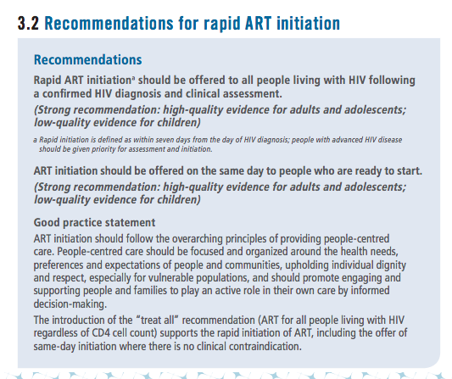
Page 07
Rapid-start treatment initiation
Rapid initiation of antiretroviral therapy (ART) is recommended by major guidelines to achieve Getting to Zero goal
Guidelines state that patients should be offered the option to initiate ART upon a confirmed HIV diagnosis and clinical assessment
The goals of rapid initiation are to reduce transmission, morbidity, and mortality
Le T. World Health Organization Guidelines for managing advanced HIV disease and rapid initiation of antiretroviral therapy. WHO. Geneva. Published July 2017.
Notes:
Rapid-start treatment is a practice of starting rapid treatment upon diagnosis, and is Increasingly more common among clinics serving people living with human immunodeficiency virus (PLWH)

Slide 8
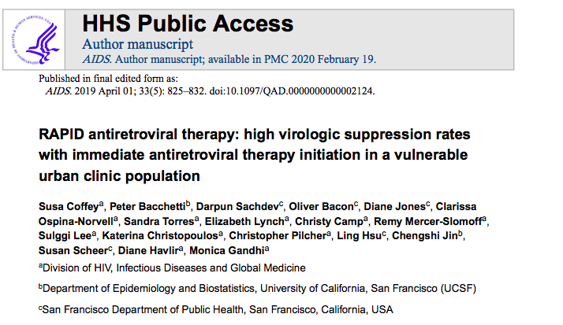
Page 08
Example: RAPID Trial
The Rapid Antiretroviral Therapy Program (RAPID) trial examined immediate ART initiation after a confirmed HIV diagnosis within a high-risk population (substance use disorder, mental health disorder and homelessness)
This retrospective analysis evaluated 225 patients who were referred for rapid antiretroviral therapy, with 216 patients started immediate antiretroviral therapy.
The overall median time from HIV diagnosis to ART start was approximately 7 days
More than 90% of patients achieved viral suppression over a median of 1 year
20
22
Notes:
This model proved that rapid initiation can be accomplished even when barriers are present.

Slide 9
Proposed Study on RS-DAA
20
22

Slide 10
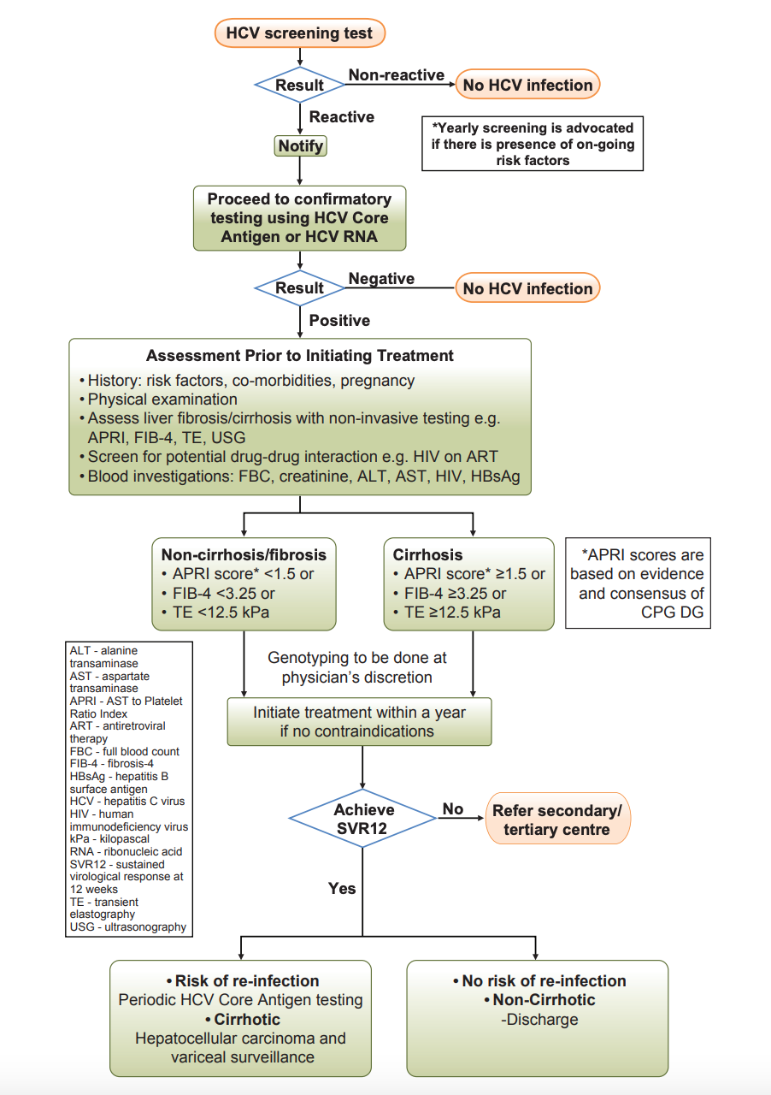
Current algorithm for HCV treatment
Page 10
Challenges in real-life practice
Multiple visits to healthcare facility for monitoring
Numerous blood taking procedures for PWID
Delay in treatment initiation pending confirmatory test
Opportunities in implementation science
Strengthen role of outreach workers as “agents” to guide and influence PWID along the HCV care cascade
Potential for expanded actions to address social-structural marginalisation
Guiding practice into eliminating delays in
treatment initiation
20
22

Slide 11
Page 11
RS-DAA
study aims
1.
2.
3.
Explore barriers and facilitators to implement RS-DAA strategy for PWID with HCV infection
Prepare RS-DAA strategy by combining patient navigators to support patients through telemedicine and monitoring visits
Enroll 150 PWID with HCV infection and implement RS-DAA strategy and report both efficacy and implementation outcomes
20
22

Slide 12
Methodology
Page 12
Aim 1: Explore barriers and facilitators to implement RS-DAA strategy for PWID with HCV infection
Nominal group technique (NGT) will be conducted to elicit ideas about the RS-DAA strategy, subsequently achieving group agreement of priorities by capturing participants votes or ranking for those ideas, among clinic staff, state department and community healthcare workers (Madden et al., 2017).
NGT involves the following steps:
1. Silent generation of ideas and writing them down.
2. Round-robin feedback from each participant in the group to record each idea on a flip chart.
3. Discussion of each recorded idea for clarification and evaluation.
4. Individual voting on priority ideas,
This technique seeks to answer:
1. What are the barriers to rapid-initiation of DAA?
2. What would need to change to allow the strategy to take place?
20
22
Studio In 2022

Slide 13
Page 13
Methodology
Aim 2: Prepare RS-DAA strategy by combining patient navigators to support patients through telemedicine and monitoring visits
Focus group discussions (FGD) will be conducted among, family medicine specialists, pharmacists, community-healthcare workers and community representatives to finalize the work processes,
including the use of telemedicine and monitoring visits
20
22
Studio In 2022

Slide 14
Methodology (2)
Page 14
Aim 3: Enrol 150 PWID with HCV infection and implement RS-DAA strategy and report both efficacy and implementation outcomes
Interested participants will be engaged with navigator throughout with brief tele-medicine assessment at weeks 1, 4, 12 (end of treatment) and 24 (SVR)
PWID will be recruited from SEMARAK study and through community outreach and screened for HCV if status is not known
Those with chronic HCV will be recruited for study enrolment and assessed for baseline interest in HCV treatment
Navigator will link them to tele-medicine with a trained expert on HCV on the same-day and focus on treatment initiation and baseline laboratory assessment
Non-interested participants will continuously be engaged by navigator to motivate them towards treatment, including introduction to other PWID on treatment
20
22
Studio In 2022

Slide 15
Methodology
Page 15
Initial visit
Once participant expresses readiness for treatment, navigator will coordinate a telemedicine appointment with a family medicine specialist (FMS) and inquire about ineligibility criteria
If no contraindication to DAAs, participant will be started on pan-genotypic DAA and navigator will arrange for phlebotomy to assess for HBV infection, HCV RNA level, fibrosis score on FIB-4 etc.
Participant will be presented with first 7 days of treatment from navigator after phlebotomy is completed
Navigator will also inquire about interest in methadone treatment, HIV co-morbidity, in treatment for HIV or other conditions
20
22

Slide 16

Methodology
Page 16
Week 1
Week 12 (end of treatment)
Navigator will arrange for tele-medicine visit to review laboratory investigation and see if any different course of action is required
Participant will be assessed by telemedicine to inquire about any treatment limitations, completion of treatment and adherence
Adverse effects and any evidence of decompensated cirrhosis will be inquired if FIB-4 scoring suggestive
After the visit, navigator will support patient to undergo phlebotomy for HCV RNA level
Participant will receive the remainder of his DAA to complete the 12 weeks of treatment
Week 4
Week 24 (SVR assessment)
Navigator will arrange another tele-medicine visit
Participant’s HCV RNA level will be reviewed
If participant does not achieve SVR, he or she will be referred to ongoing care
FMS will inquire about adverse side effects, potential drug-drug interactions and adherence
No laboratory assessments will be taken at this
point unless clinically indicated
20
22

Slide 17
Challenges
Page 17
Clinic acceptance of the proposed changes in initiating HCV treatment for PWID (i.e. protocol deviation)
Innovation-values fit (i.e. different values hold by different stakeholders)
Availability of resources, willingness to share resources
20
22

Slide 18
Thank you.
Page 18
Q&A
20
22

