Slide 1


Adapting Evidence-Based Interventions to New Contexts
Luke Davis, MD, MAS
Associate Professor of Epidemiology & Medicine
MIST Summer Bootcamp 2023
19 July 2023
Yale CMIPS
Center for Methods in Implementation & Prevention Science
Notes:
My name is Luke Davis, Associate Professor in the Department of Epidemiology of Microbial Diseases and the Center for Methods in Implementation & Prevention Science (CMIPS) at the Yale School of Public Health, where I focus on design, implementation, and evaluation research to improve the quality of HIV and tuberculosis care in low- and middle-income settings.
As a faculty member in the Malaysian Implementation Science Training Program program, it’s a honor to join you today to talk about
Implementation Research from Basics to Advanced:
Terminology, Frameworks, & Theories to Guide the Process

Slide 2
Learning Objectives
To describe when and why we might need to adapt evidence-based interventions to new contexts
To define the concepts of implementation fidelity and adaptation and select an approach to measuring them
Notes:
To describe the difference between process and outcome measures in implementation studies, and provide examples
To be able to define the concepts of implementation fidelity and adaptation and select an approach to measuring them
To be able to describe and choose among different techniques for combining qualitative and quantitative methods to characterize implementation processes

Slide 3
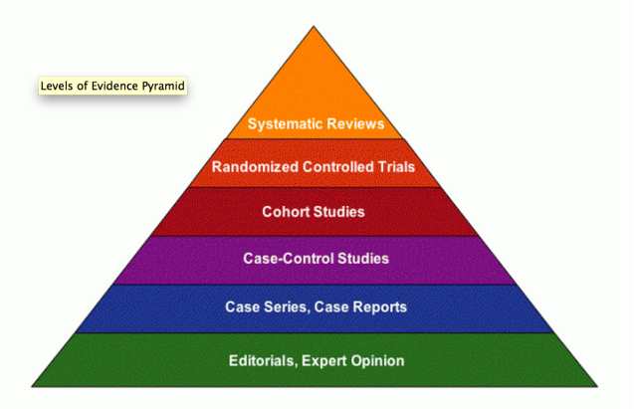
Implementation starts with evidence-based practices*
(*or, sometimes, empirically-supported treatments)

Slide 4
Context influences implementation & operates at multiple levels
Other Shareholders
Payors
Health Systems
Individuals
Practitioners
Product Makers
Hospitals/Practices
Policy Makers
Principal Investigators
Health Departments
People
Patients
EVIDENCE
PRACTICE
HEALTH
Gonzales R et al Academic Medicine 2012
Notes:
It’s important that implementation science engages people and organizations at multiple levels to effect translation of evidence into practice to improve heath. To understand the persons and systems that mediate change, implementation science starts with an ecological view of improving practice by understanding relationships, aligning priorities among and between players in these three domains and addressing barriers within each

Slide 5
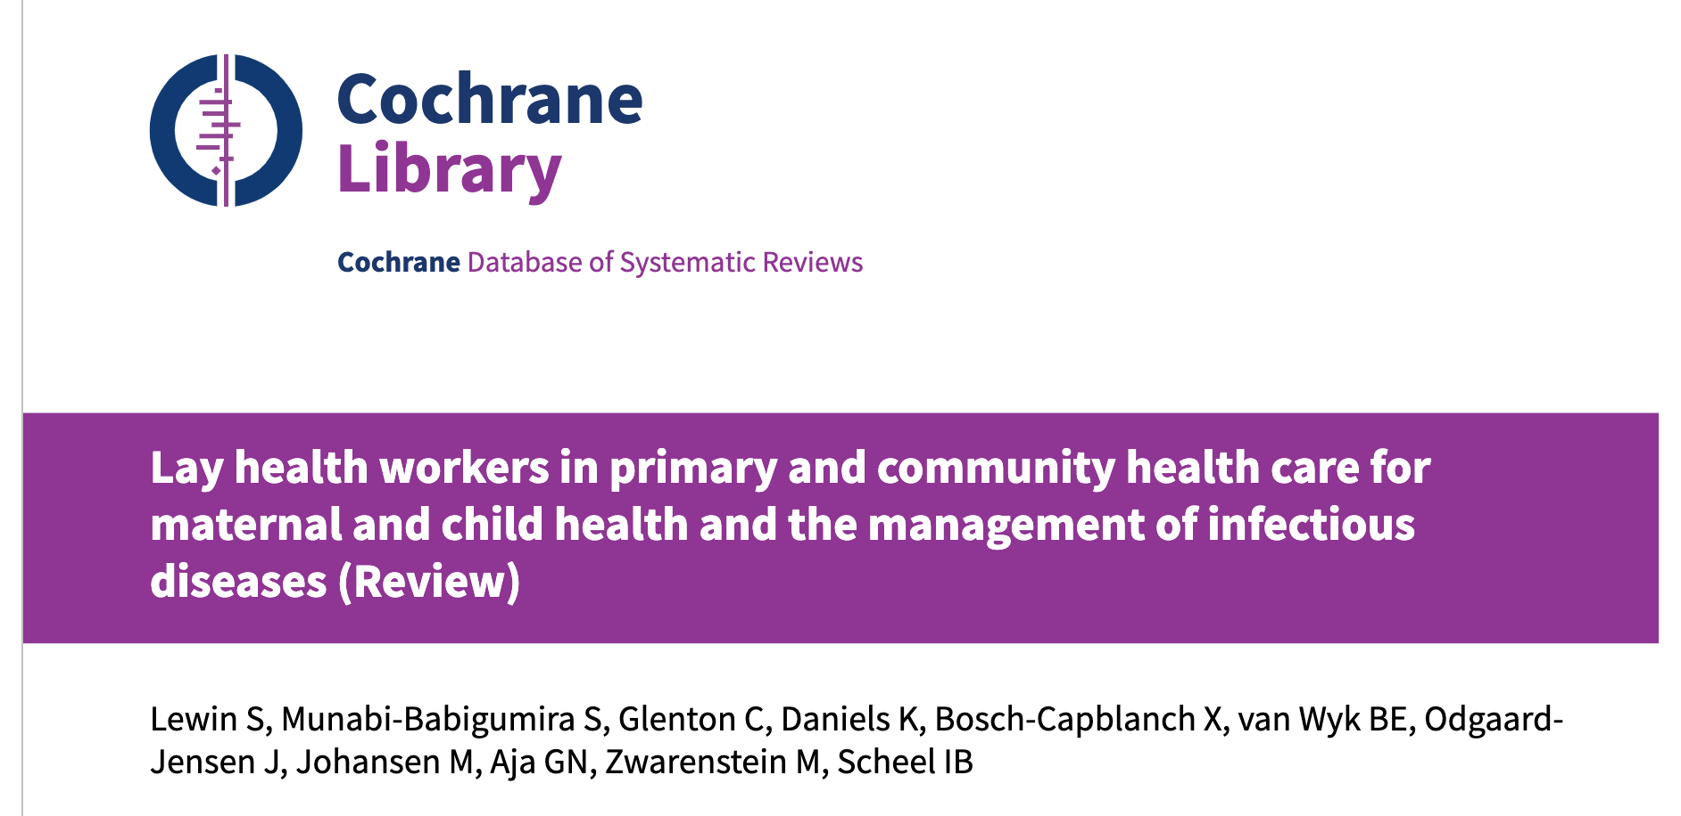
Example of the adaptable periphery:
Community Health Workers

Slide 6
We may need to adapt to new systems & conditions
e.g., to enable reproducibility & scalabilty
Notes:
The questions of sustainability and scalability are important concerns for implementation science and deal with these exact same issues. The expected effect of intervention X shown on the Y axis from initial implementation to the present demonstrates a loss of fidelity sometimes called “Program Drift.” Similar issue arise in which Intervention X experiences a decrease in the expected effect. Or “Voltage Drop”, as it is moving from demonstration to implementation in the context of scale up.

Slide 7
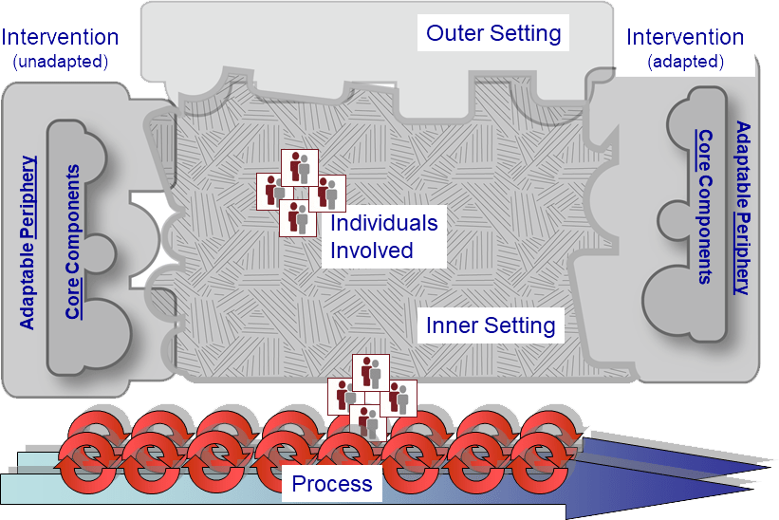
There is a process for adapting interventions to new settings/contexts/people
Consolidated Framework
for
Implementation Research (CFIR)
Fit!
Damschroder Implementation Science 2009
Notes:
You can see that the ERIC approach imagines a link between the 5 CFIR domains, shown at left, and the 9 ERIC categories shown at right, which are clustered together using an empirical approach called context mapping.

Slide 8
Fidelity vs Adaptation: Baking vs. Frosting a Cake
Notes:
To deal with different contexts, Implementation must balance fidelity & adaptation. Fidelity, or the degree to which an intervention is delivered as actually intended, requires precision for the key ingredients, similar to the flour sugar eggs butter etc used in baking a cake. You must have the exact right ingredients, ratios, and processes to make the cake itself taste good, but you may need to adapt the frosting and decoration on that cake to fit the tastes of your customers – whether that’s a wedding couple or kids at a birthday party – or you won’t achieve the effects that you intended.

Slide 9
Fidelity vs Adaptation: A more detailed look
Extent to which intervention delivered as intended
5 key dimensions of fidelity that can be assessed
  Adherence to protocol
  Dose of intervention delivered
  Quality of delivery
  Participant response
  Mechanisms of impact
But adaptability (fit) is also important, with a need to differentiate between adaptation (favorable) and maladaptation
Carroll C et al A conceptual framework for implementation fidelity. Implement Sci. 2007
Perez D et al. A modified theoretical framework to assess implementation fidelity of adaptive public health interventions. Implement Sci. 2016
Notes:
Important to all study types,

Slide 10
Why are fidelity/adaptation important?
Helps identify the “core ingredients” vs. the “adaptable periphery”
of the implementation strategy
If there is heterogeneity of effects seen across units
  Adaptive or maladaptive changes to implementation strategy in these units?
Notes:
Elements of internal validity (#1 and #2) and external validity (#1 and #2)

Slide 11
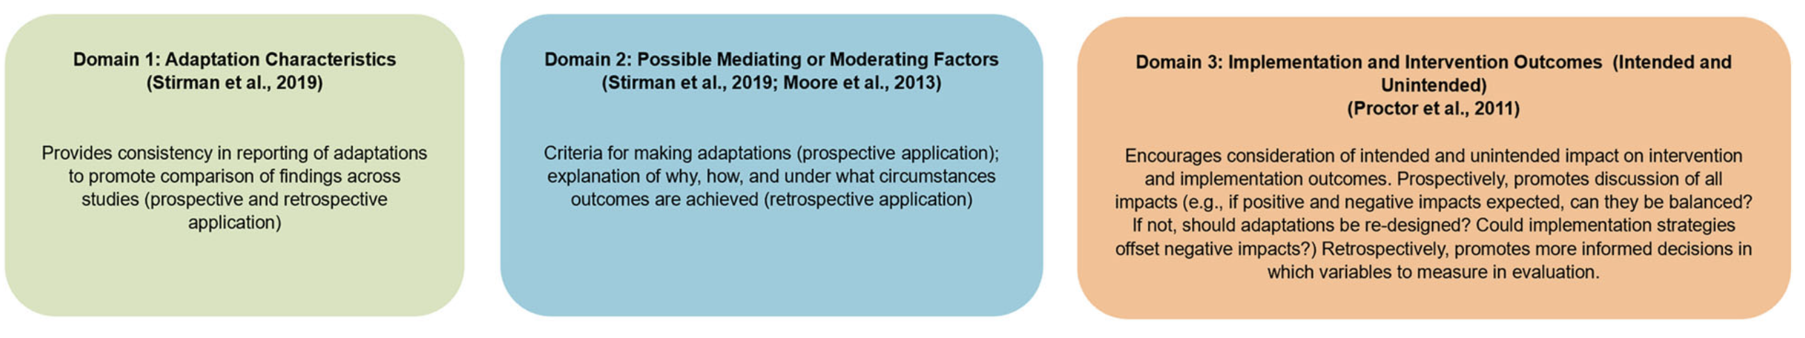
The Model for Adaptation Design and Impact (MADI)
Specify the Adaptations
What is modified?
Nature of adaptation?
Who adapted it
For whom/what adapted?
When adapted?
Are the adaptations well-justified?
Are core mechanisms preserved?
Do adaptations enhance fit?
Plan relevant implementation measures
Fidelity/adaptability
Context
Kirk et al Implementation Science (2020)

Slide 12


Example of adaptation: TB Contact Investigation, an evidence-based WHO-endorsed intervention
Notes:
3.6% Prevalent TB
+ 2.8% Incident TB @2y
6.4% Cumulative TB Yield

Slide 13
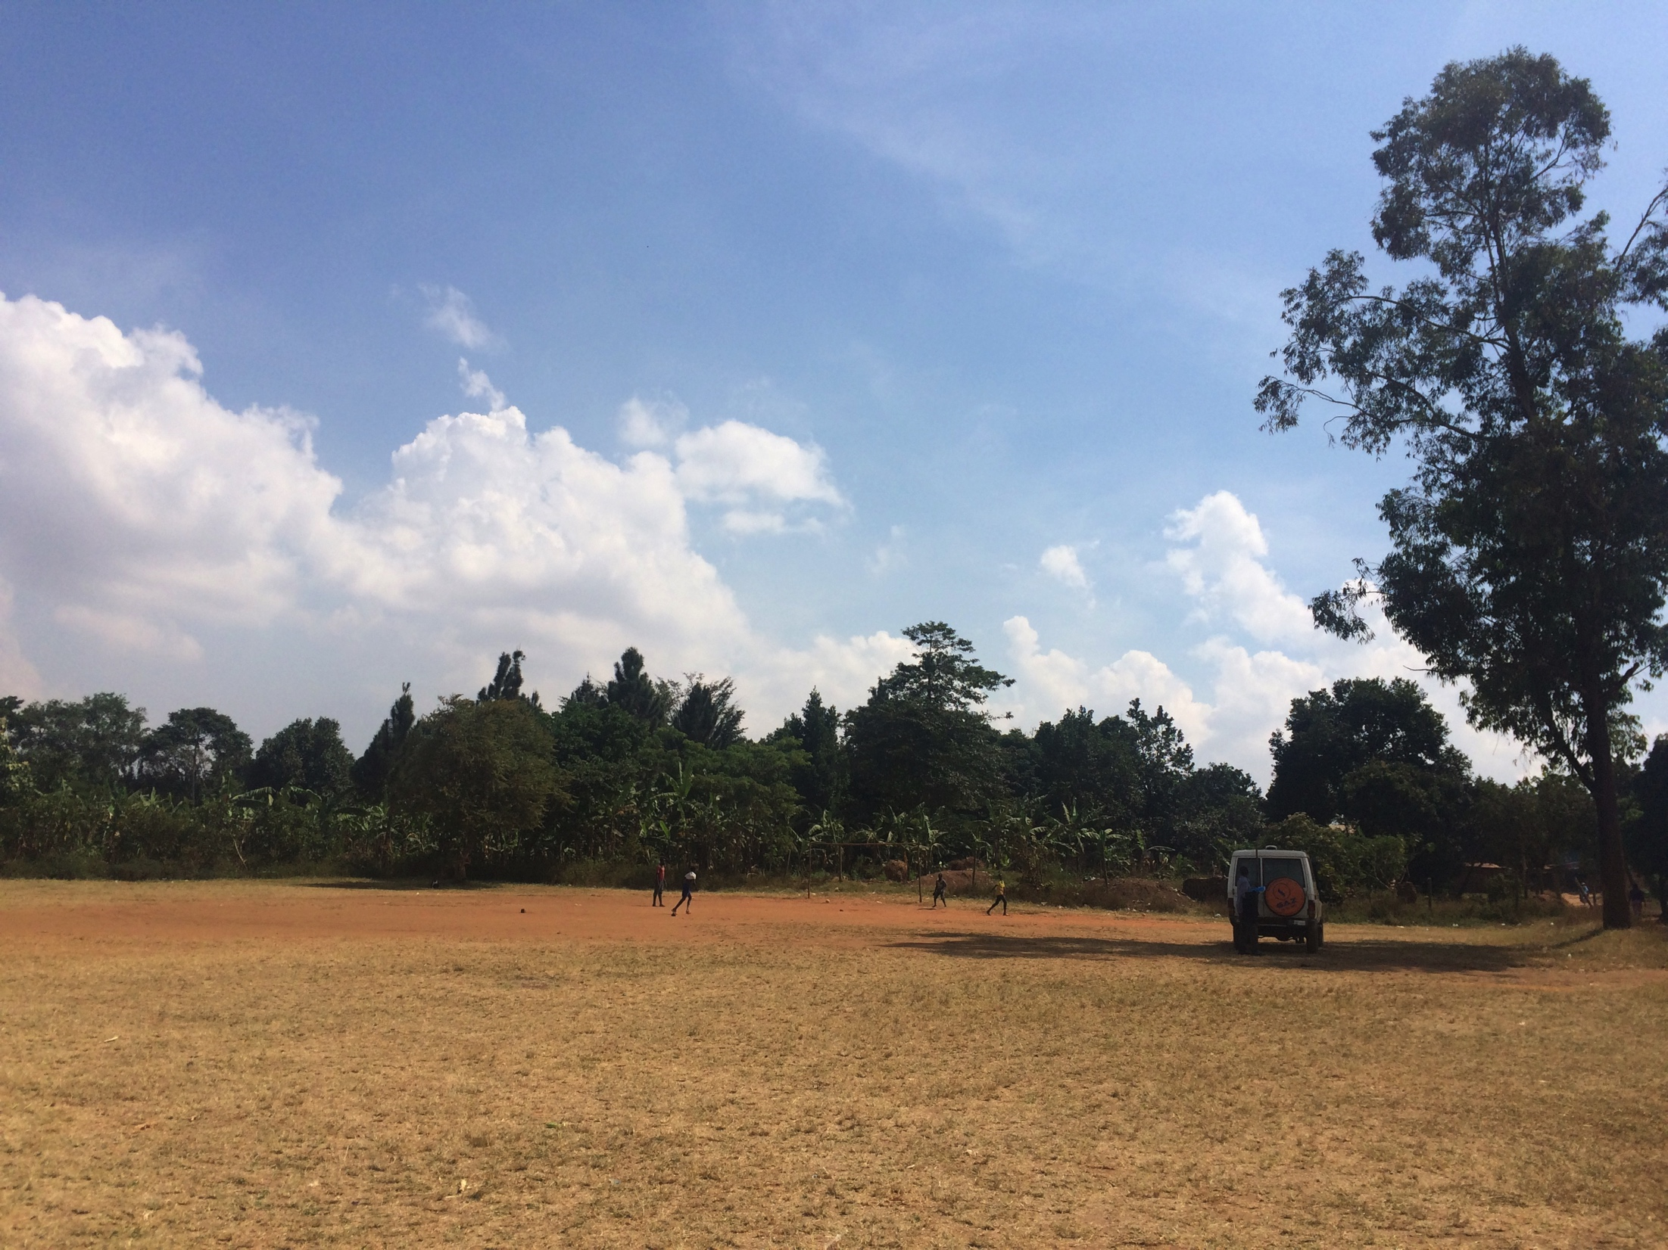
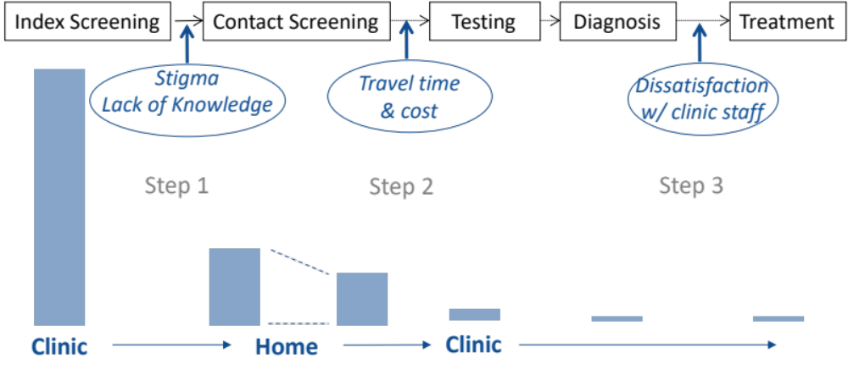
Standard TB contact investigation hard to implement in resource-constrained settings

Slide 14
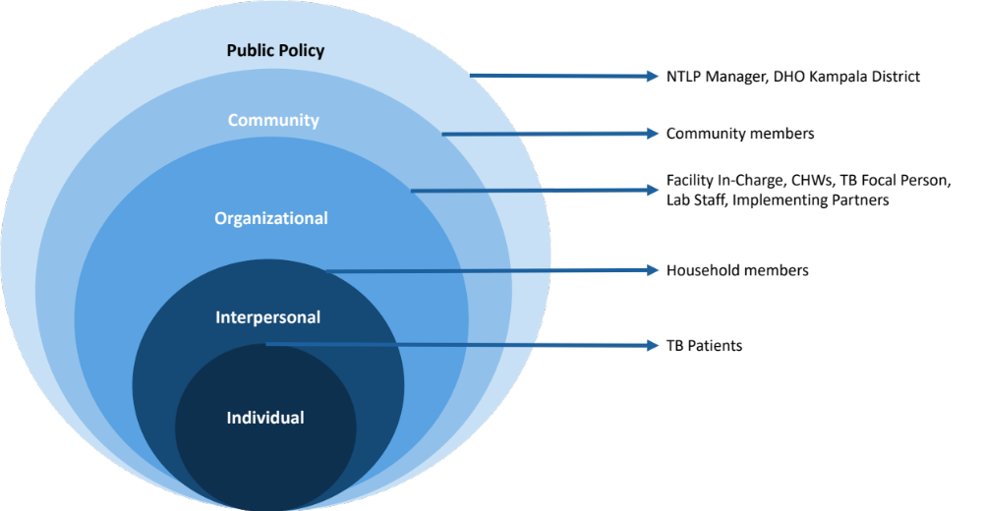
Multidisciplinary Adaptation team
Gupta Implement Sci Comm 2023

Slide 15
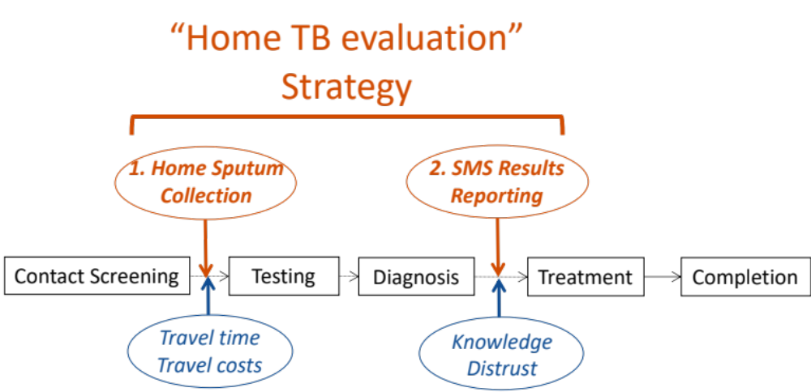
Adapted Contact Investigation
1. Home
TB & HIV Testing

Slide 16
Specified intervention adaptations….
Characteristic | Standard of Care Intervention: | Context-Adapted Intervention:
 | “Household TB Contact Investigation” | “Home-Based TB Contact Investigation”
Actors | Clinic-based Health Care Workers | Community Health Workers
Targets of action | Persons with TB (to help reach contacts) | Persons with TB (to help reach contacts)
 | Household contacts of persons with TB | Household contacts of persons with TB
Actions | 1. Enumerate contacts with index patient | 1. Enumerate contacts at home
 | 2. Screen contacts for TB at clinic, or at home | 2. Screen household contacts at home
 | 3. Evaluate contacts for TB in clinics | 3. Evaluate contacts for TB at home
 |  | a) Home-based sputum collection
 |  | b) Home-based HIV-testing
Temporality | Timeline not specified | Household visit within one week of TB diagnosis
Hoffman TiDIER Framework BMJ 2014

Slide 17
….mechanisms and implementation measures
Characteristic | Standard of Care Intervention: | Context-Adapted Intervention:
 | “Household TB Contact Investigation” | “Home-Based TB Contact Investigation”
Justification | Not applicable | Reduce anticipated stigma for clients
 |  | Decongest clinic
 |  | Minimize client costs
 |  | Increase completion of TB testing
 |  | Increase completion of HIV testing
Outcomes |  | Number of contacts identified
 |  | Number of contacts screened for TB
 |  | Number of contacts evaluated for TB
 |  | Number of contacts tested for HIV
 | Yield of TB diagnoses | Yield of TB diagnoses

Slide 18
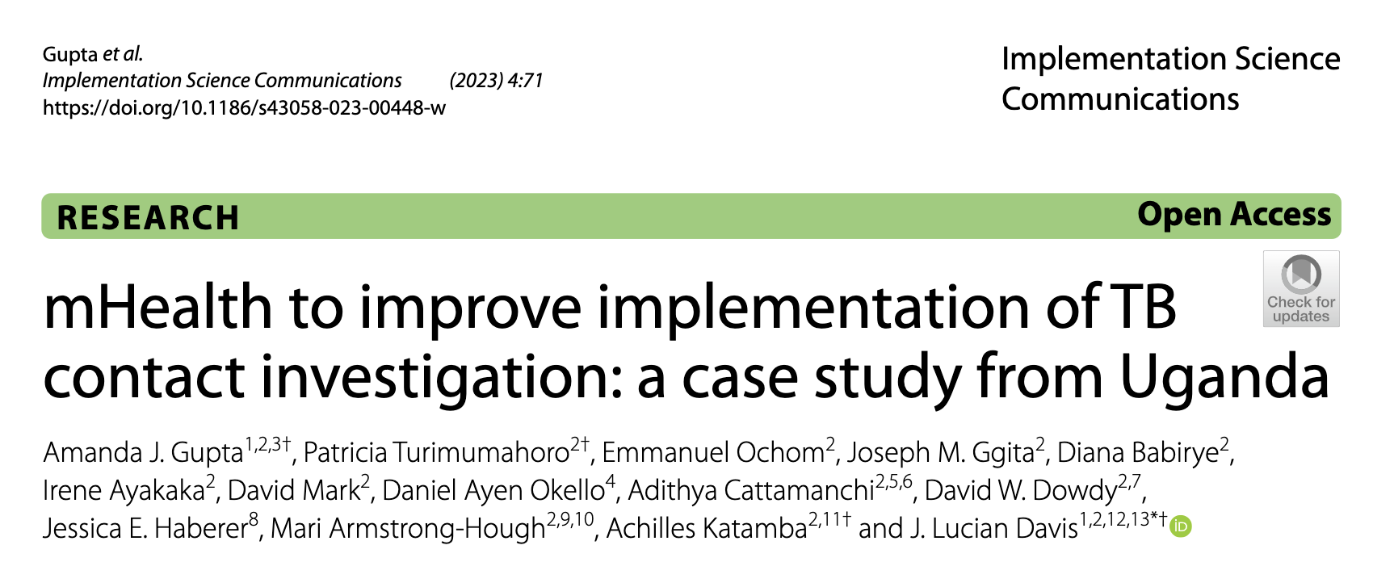
Implementation Science Communications Case Studies Series

Slide 19

Implementation Science Communications Case Studies Series
https://www.biomedcentral.com/collections/impscicasestudies

Slide 20



Questions, then an exercise!
Notes:
I welcome your questions and please free to reach out to me by email or on Twitter

Slide 21
It’s your turn to adapt an evidence-based intervention!
Work with the group at your table
Pick an evidence-based intervention relevant to this setting
  PrEP for persons at high risk of HIV
  OAT for PWID
  WHO mhGAP for major depression
  Interventions for unhealthy alcohol use or smoking
  NCDs or Cancer screening
  Anything else you wish!
Identify 1 rapporteur to record your adaptations using the MADI

Slide 22
The Model for Adaptation Design and Impact (MADI)
Specify the Adaptations
What is modified?
Nature of adaptation?
Who adapted it
For whom/what adapted?
When adapted?
Are the adaptations well-justified?
Are core mechanisms preserved?
Do adaptations enhance fit?
Plan relevant implementation measures
Fidelity/adaptability
Context
Kirk et al Implementation Science (2020)

Slide 23
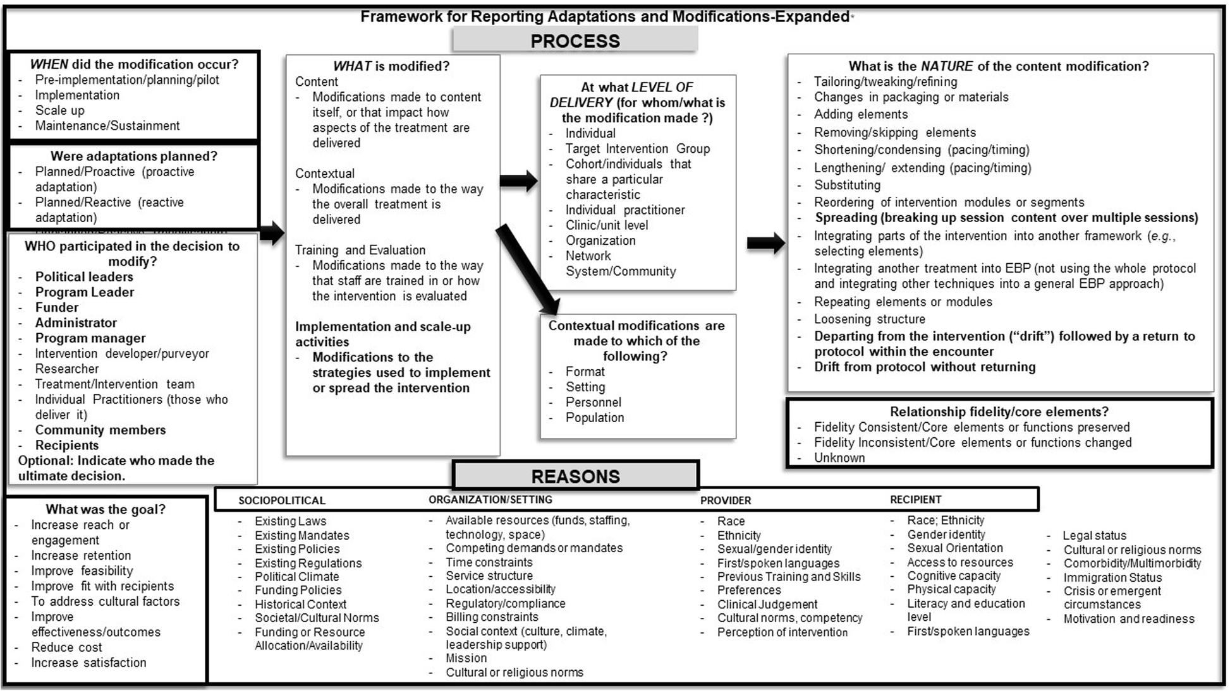
Framework for Reporting Adaptations & Modifications-Expanded (FRAME)
Specify the Adaptations
What is modified?
Nature of adaptation?
Who adapted it
For whom/what adapted?
When adapted?

