Slide 1
Incorporating Stigma Reduction Strategies into Implementation Research
MIST 2023
Frederick L. Altice, M.D., M.A.
Professor of Medicine and Public Health
Yale University
Academic Icon Professor
University of Malaya

Slide 2
Malaysia: Contextual Assessment
High middle-income, multi-cultural country with ~31 million people
HIV epidemic originated in PWID, but growing in MSM and other key populations – including sexual partners
HIV prevalence: 0.4% in adults, but concentrated in key populations:
  MSM: 21.6% (KL) – 8.9% nationally
  PWID: 19.8% (KL) – 16.9% nationally
  Transgender women: 12.4%
  Cisgender FSW: 11.1%
One of only four countries in the Asia-Pacific Region where HIV incidence and mortality are increasing
Each behavior is criminalized in Malaysia

Slide 3
The Many Veils (Intersectional) of Stigma and the HIV Health Disparities Model
Structural Level Mechanisms
Residential Segregation
Historical Trauma
Medical Mistrust
Criminalization
Stigma
HIV
Race/Ethnicity
Sexual Orientation
Gender Identity
Substance Use
Sex Work
Incarceration
Immigration
Individual Level Mechanisms: Target
Enacted Stigma
Internalized Stigma
Anticipated Stigma
Health Disparities
Risk-taking
Incidence and Screening
Treatment
Survival
Individual Level Mechanisms: Perceiver
Prejudice
Stereotypes
Discrimination
Earnshaw et al, American Psychologist, 2013

Slide 4
Individual Level Mechanisms: Perceiver
Stigma Mechanism | Definition: May apply to PWH or key population (MSM, PWID, TW, SW)
Prejudice | Negative emotions and feelings felt towards PWH
Stereotypes | Group-based beliefs about PWH, often applied to individuals with HIV
Discrimination | Behavioral expressions or actions of prejudice directed towards PWH
Notes:
Prejudice is “negative emotions and feelings felt towards PLWHA”. People who aren’t living with HIV may feel things like disgust, anger, or fear towards people living with HIV.
Stereotypes are “group-based beliefs about PLWHA, often applied to individuals living with HIV”. These could be assumptions that most people living with HIV are gay men, sex workers, or drug addicts.
Discrimination is “behavioral expressions of prejudice directed towards PLWHA”. People who aren’t living with HIV may refuse to be friends, not hire, or even physically attack people living with HIV.

Slide 5

Mechanisms of Stigma
Stereotypes
“This is what I think about … ”
Prejudices
“This is how I feel about…”
Discrimination
“This is how I treat …”
Earnshaw et al, American Psychologist, 2013

Slide 6
The Many Veils of Stigma and the HIV Health Disparities Model
Structural Level Mechanisms
Residential Segregation
Historical Trauma
Medical Mistrust
Criminalization
Stigma
HIV
Race/Ethnicity
Sexual Orientation
Gender Identity
Substance Use
Sex Work
Incarceration
Immigration
Individual Level Mechanisms: Target
Enacted Stigma
Internalized Stigma
Anticipated Stigma
Health Disparities
Risk-taking
Incidence and Screening
Treatment
Survival
Individual Level Mechanisms: Perceiver
Prejudice
Stereotypes
Discrimination
Earnshaw et al, American Psychologist, 2013

Slide 7
Individual Level Mechanisms: Target
Enacted Stigma – “I have been harmed by …”
  i.e., experienced stigma, perceived stigma
  experiences of discrimination
Internalized Stigma – “I feel badly about myself because I am …”
  i.e., self-stigma
  endorsement of negative beliefs/feelings associated with characteristic
Anticipated Stigma – “I am concerned about seeing the doctor because s/he may … because I am … ”
  expectations of discrimination in the future

Slide 8
Stigma and Health
Health Stigma and Discrimination Framework
Often a multi-level construct and can have layering of stigmas within a single person (e.g., HIV, substance use, incarceration)
Enhances health disparities through decreased health-seeking (internalized, perceived), dyadic engagement with healthcare providers (perceived, enacted, structural) and through clinical guidelines and regulatory policies (enacted, structural).

Slide 9
Health & Social Impacts
Incidence, morbidity, mortality, quality of life, social inclusion
Outcomes
Affected Populations
Experienced stigma, discrimination, internalized, perceived anticipated, secondary stigma
Organizations & Institutions
Laws, policies, media, right to health, law reform
Manifestations
Stigma Experiences
Experienced stigma, discrimination, internalized, perceived anticipated, secondary stigma
Stigma Practices
Stereotypes, prejudice, stigmatizing behavior, discriminatory attitudes
Stigma ‘Marking’
Health condition-related stigmas (e.g., HIV, PWID, justice-involved)
Intersecting Stigmas
Race, gender, sexual orientation, occupation, class-related stigmas
Drivers & Facilitators
Fear of infection or economic & social ramifications, blame, social judgment, stereotypes, prejudice, authoritarianism, low awareness
Cultural norms, social & gender norms and equality, occupational safety, legal environment, health policy
Individual
Interpersonal
Organizational
Community
Public Policy

Slide 10
Criminalization Laws and HIV Prevalence
Laws targeting people at highest risk for HIV in Malaysia:
  People who use drugs → imprisonment & CDDCs
  MSM – both secular and Shariah law
  Transgender women
  Sex workers
HIV Prevalence
Number of Criminalization Laws
Oldenburg C, 2018

Slide 11
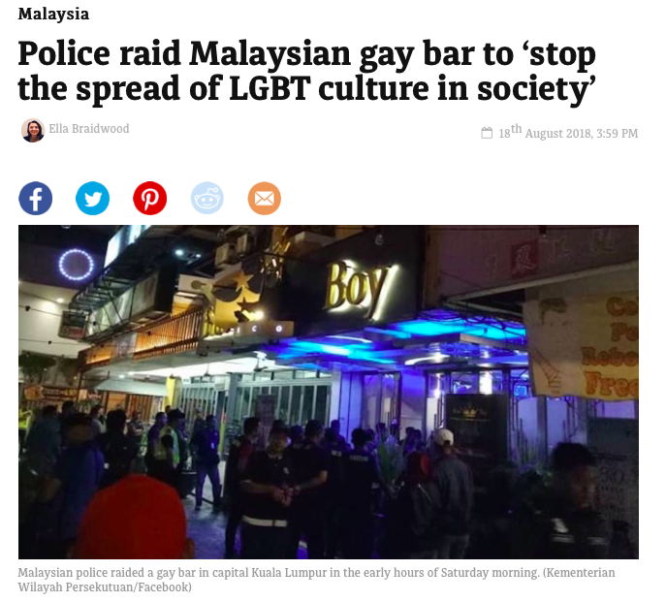
Public Shaming – Perpetuating Stigma

Slide 12


Sodomy Laws in the Political Forefront

Slide 13
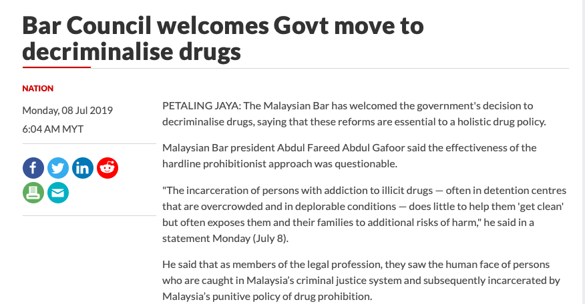
EARLY Progress on Decriminalization of Drug Use?

Slide 14
How Do Stigma and Discrimination Extend to Healthcare?

Slide 15
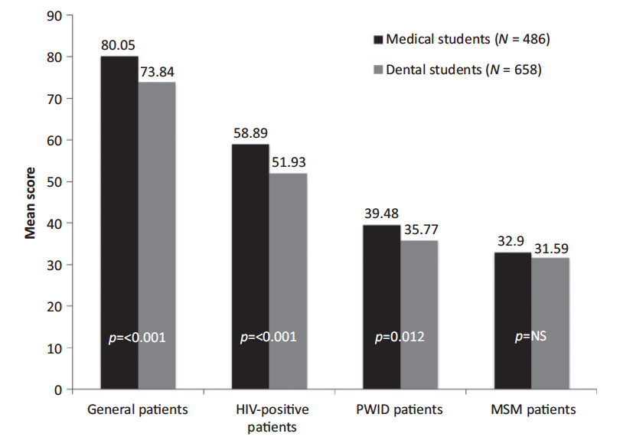
Attitudes Toward Patients With or At Risk for HIV Among Medical and Dental Students in Malaysia
Jin H et al, AIDS Care, 2014

Slide 16
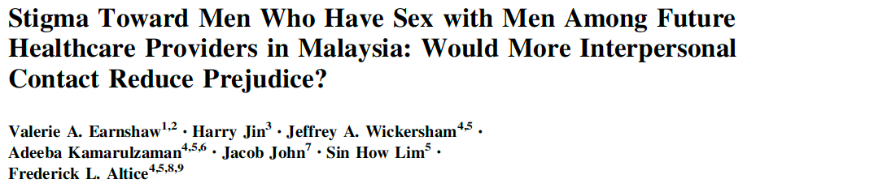

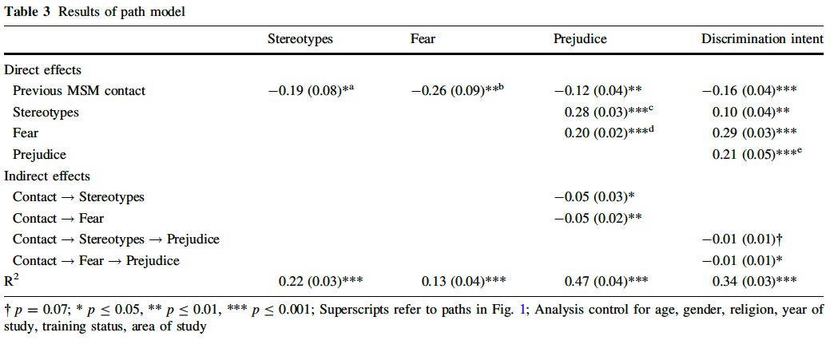

Slide 17
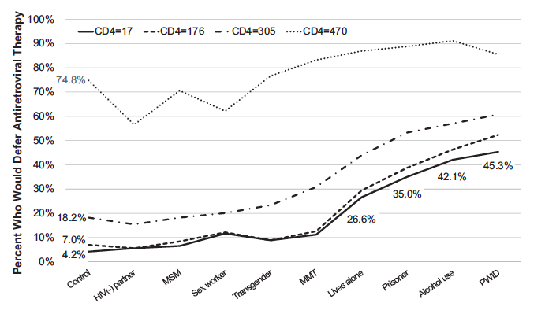
HIV Experts in Malaysia will Withhold HIV Treatment to Some Key Populations with HIV
Ferro E et al, Open Forum ID, 2017

Slide 18
People With Advanced HIV Who HIV Doctors Would Withhold Life-Saving Medications
Characteristic | Key at-risk Population | CD4 <200
 |  | AOR (95% CI)
Substance Use | Uses/injects drugs | 14.5 (8.6– 24.6)
 | Consumes alcohol | 11.4 (6.7– 19.5)
 | Receives methadone | 1.9 (1.2– 2.9)
Social circumstance | Released prisoner | 8.4 (5.0– 14.0)
 | Lives alone | 5.5 (3.3– 9.1)
 | Has HIV- partner | 0.79 (0.5– 1.1)
Sexual minority | Sex worker | 1.8 (1.1– 2.8)
 | MSM | 1.2 (0.76–1.9)
 | Transgender | 1.2 (0.84–2.0)
Ferro E et al, Open Forum ID, 2017

Slide 19
Brief Overview of Stigma Reduction Interventions

Slide 20
Types of Stigma Reduction Strategies
Systematic Review (N=24 --> 6 RCTs)
Types included:
  Increased education (most common)
  Increased contact (individual, system)
  Social marketing
  Problem solving
17/24 showed statistically significant reductions in at least one type of stigma
11/24 showed declines in stigma that are practically significant
Effect size was mostly in the small to moderate size in stigma reduction – contact being most significant
Rao et al, BMC Med, 2019

Slide 21
Pathways to Stigma Reduction
Dimension of Stigma
Pathways to Stigma Reduction
Drivers of Stigma Reduction
Internalized
↓ fear of dying
↑ optimism
Restored value & role via productivity
Universal ART access
ART efficacy on a community level (other PWH getting better)
Perceived /
Anticipated
+ experiences with HIV disclosure
↑ social support from others (staff, PWH, etc)
Universal HIV testing (i.e., prison)
Visibility at clinics (i.e., care seeking closer to home)
Not labeled as the PWH but instead as regular patient
Enacted
Power of appearance (healthy bodies)
↓ fears (medical harms, death, sin)
Reduced social normative behaviors by others
RS-ART (no waiting)
Intervention messaging (e.g. by staff as they normalize PWID with HIV)
Broader ART coverage to other PWID with HIV

Slide 22
Current Targets for Better Implementation
Medical school curriculum changes – seasoned clinicians seldom change, but …..
Same Day ART Initiation
Implementation science strategies to have better facilitation with addiction treatment to improve HIV treatment parity
Drug policy reform – drug decriminalization
Jump-starting the HIV treatment (ART) and prevention (PrEP) cascade - mHealth
Self—testing for HIV
Prison transitional programs

Slide 23
Cluster Randomized Controlled Trial of Integrating Methadone into Primary Care Clinics
Three arms: Specialty Clinic (control), and two integrated primary care sites (with and without P4P)
High levels of stigma and discrimination constructs in healthcare providers – less in those providing direct care and much higher in others in the clinic.
Primary clinical outcomes are pre-specified quality healthcare indicators (QHIs)
  Total
  Primary Care (Screening for HBP, cholesterol, cancer, etc)
  Specialty (HIV, TB, addiction)
Providers – direct and indirect providers were assessed every 6 months over 24 months

Slide 24
Feeling Thermometers Toward Patients
P=NS

Slide 25
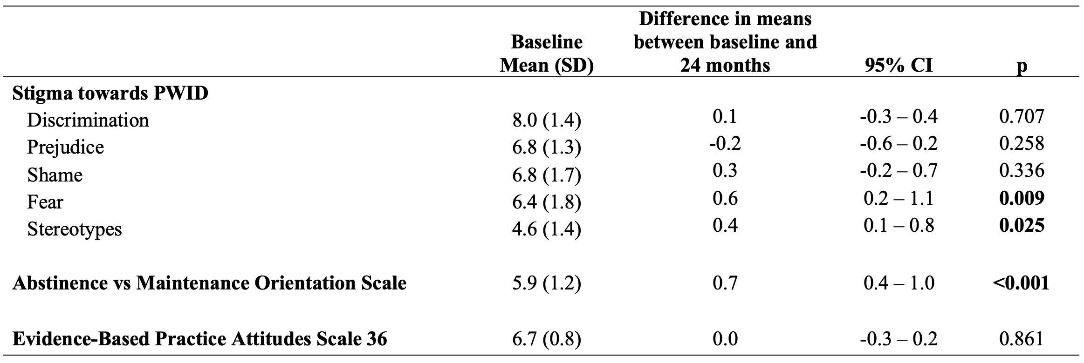
Impact of Integrating Methadone into Primary Care Clinics on Clinical Providers

Slide 26
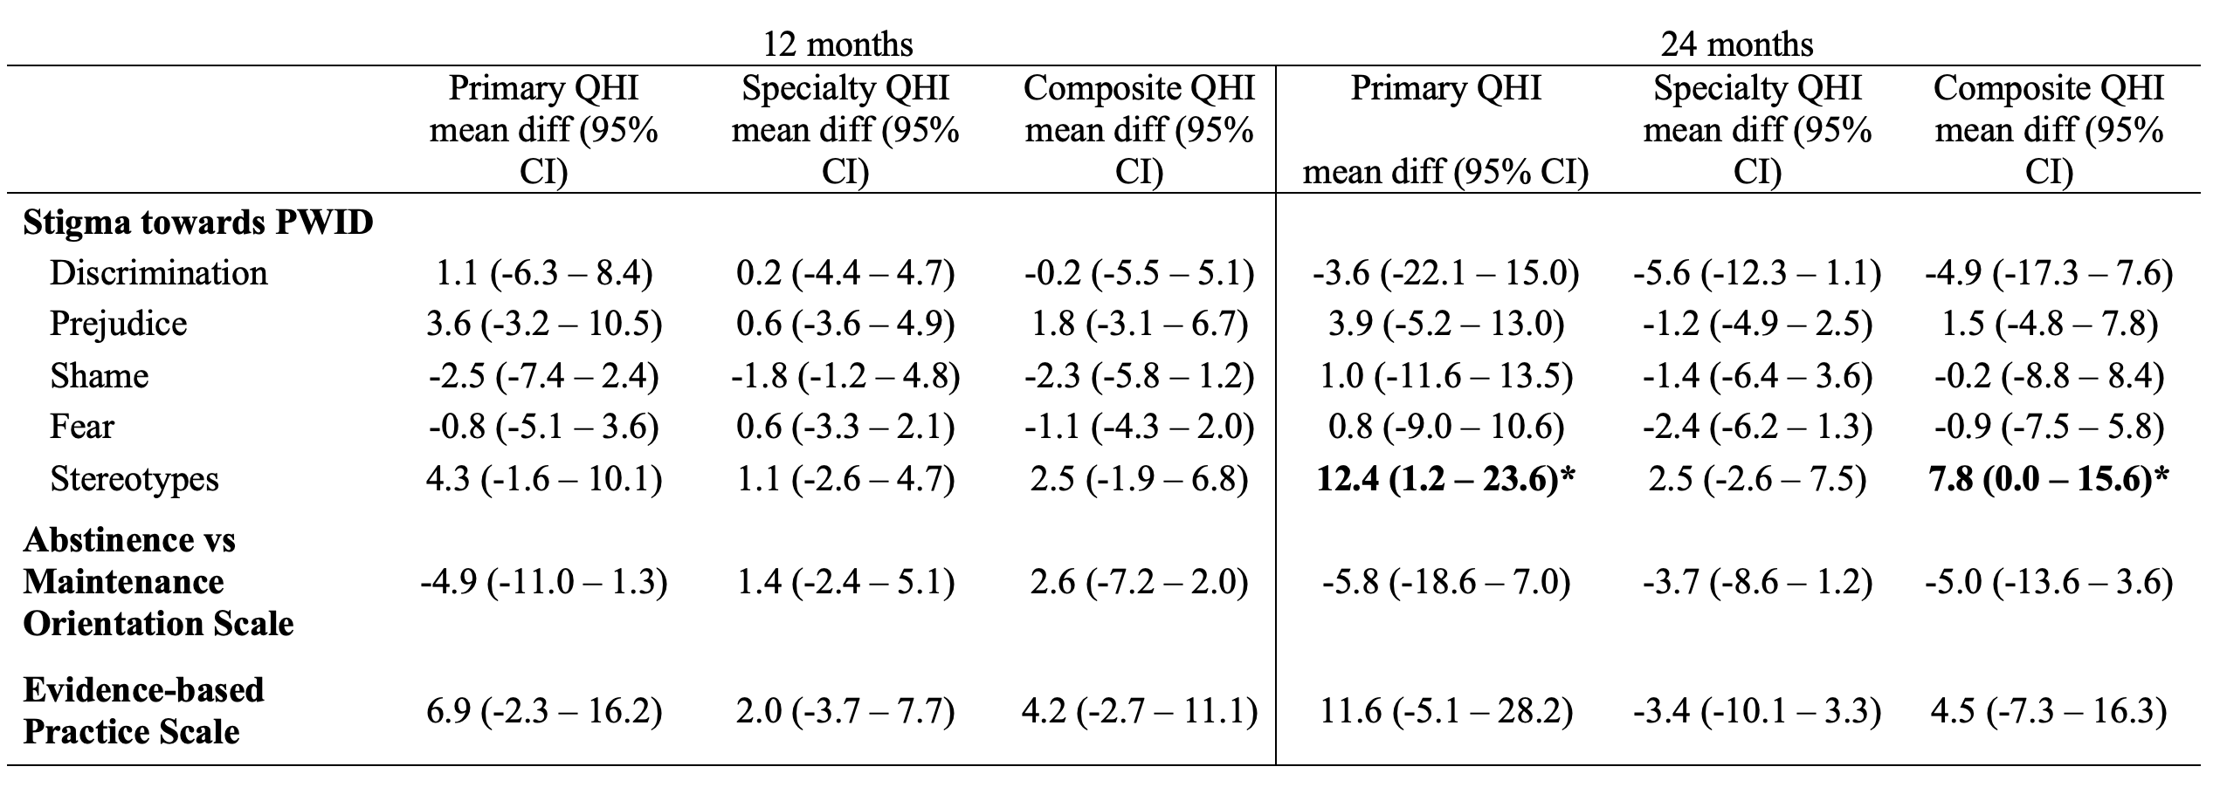
Impact of Changes in Stigma Constructs on Healthcare Outcomes (QHIs) in Primary Care Clinicians

Slide 27
Behavioral Design Interventions – Might they Reduce Stigma in Health?
Used mostly in marketing and to constrain opportunities for sexism
Values-based approach that seeks to promote ethical behaviors and attitudes within social and environmental contexts
Influencing behavior that is based on the idea that the way choices are presented to individuals can have a significant impact on their decision-making process
Key elements to guide individuals towards making specific choices or behaviors
  choice architecture
  framing
  nudging
Presenting options in a certain order, or highlighting certain options more prominently, can influence an individual's choice without altering the inherent value of the options themselves
Balance “pains” with “gains” of the current behavior with the “comforts” of continuing the current behavior vs the “anxieties” of making the change

Slide 28
Rapid Start –ntiretroviral Therapy

Slide 29
Why mHealth strategies are urgently needed?
MSM account for the most new infections in Malaysia
Lifetime HIV testing is LOW and recommended HIV testing (every 3 to 6 months for at risk MSM) is even lower (~10%)
HIV testing is the FIRST step in the HIV treatment (ART) and prevention (PrEP) cascade
Smartphone use is highly prevalent in Malaysia
  General population (86%) and MSM (98%)
MSM use smartphone apps for geosocial networking (Grindr, Hornet, Scruff, Blued, Tinder, etc) and ATS use – both associated with increased HIV risk-taking
A recent study of technology assessment found that technology is most useful in health when algorithms for clinical decision-making can be deployed → HIV testing & PrEP

Slide 30
Potential Model for HIV Transmission
ATS Users
HIV+

Slide 31
What gets in the way of starting PrEP in MSM?
(N=13 individuals or 39 votes)
Fear of HIV testing (N=13)
  Not wanting to be seen in person
  Not wanting to openly disclose their risk
  Having to come back for results
Fear of discussing HIV risk to a prescriber (N=10)
Cost (N=6)
  For medications – this has reduced markedly but differs by site
  For testing for STIs frequently
Side effects (N=4)
  Were not sure what side effects were but were afraid of them
Other: not sure where, didn’t believe it works, might have withdrawal if you stopped it

Slide 32
Potential Features of a mHealth App using Tailored Messages – Removes human interface
Domain | Features
HIV risk | Assess at baseline and foll0w-up risks - risks change
Find my testing frequency | Suggests HIV testing frequency (3 or 6 months) based on five questions (ALASKA criteria): UAI, number of partners, partners' HIV status, STI infections in past 12 months, and club drug use
HIV testing preferences | Recommends location type, sample collection method, cost, HIV counseling available, wait time for results, self-testing, and window period of test based on their preferences
Planning to test | Users can plan their HIV test by date, time, and location, using automated reminders keeps a record of testing history.
Testing reminders | Patient preferences for reminders (SMS, email, pop-up), based on a menu or can write their own text
Ordering | Self-testing kits, condoms, lubrication – Amazon model
PrEP screening | Assess eligibility for PrEP based on an algorithm
PrEP preferences | Location, clinic type, cost, counseling method, wait time
Map/Locator | Selects location based on patient preferences with link to clinic

Slide 33
Potential Features of a mHealth App using Tailored Messages
Domain | Features
”Green Light” option | Gives the option of getting the assessment and testing without having to be seen in person – can have virtual encounter, potentially with avatar
Online payment system | Can use existing money transfer methods for payment
Counseling options | May decide on online standardized option, virtual counseling or even in-person counseling
Video options | Embed either video or online link for self-testing for HIV, STIs, proper condom use, ATS treatment options
Clinic virtual tour | When making a decision about where to go for testing or PrEP, a virtual tour of the clinic and procedures can be seen in advance
FAQs | Access to frequently asked questions
Interactive module | Users can add questions to experts – if relevant, these may be added to the FAQ options
Patient navigator option | Can provide either virtual or peer navigator to help overcome entry barriers

Slide 34
HIV Self-Testing
Endorsed by WHO since 2016 – including guidance
With about ~25% of PWH not knowing their status, it is crucial to use new methods for identifying cases since treatment as prevention relies on >90% of PWH knowing their status
Self-testing is especially important for key populations where their behavior is criminalized and where stigma and discrimination exist
The best data have been for MSM and have used pharmacy purchase, mail order, kiosk pick-up
Concerns about Self-Testing
  Suicide – not substantiated
  Test interpretation – not substantiated even for low literacy
  Counseling – pre-test counseling has never been found to reduce HIV risk, BUT post-test counseling is crucial for addressing concerns and linking patients to care → virtual counseling during or after testing, patient navigation for +ves (ART) or –ves (PrEP)
  Linkage to HIV care
Numerous forms of guidance are available

Slide 35
Rapid Start ART – Why Wait?
RS-ART
  Three large RCTs in low-income settings have shown that same day (<72 hour) ART initiation is feasible and results in faster ART initiation – generalized HIV epidemics
  Thai implementation science strategy shows success for general population and MSM
    Highly variable implementation based on provider (mis)beliefs
  Pilot studies show it being very effective with PWID, including those with multiple comorbidities.
  It is recommended in Malaysian MoH – yet not done
PrEP?

Slide 36
RS-ART as Behavioral Design Intervention
Current strategy for ART initiation
  Multiple visits (each can contribute to stigma generation) to assess and counsel patients before receiving ART
  PWID are often asked to practice taking vitamins for 30 to 90 days depending on concerns about non-adherence
  Systematic reviews and meta-analyses suggest that ART adherence is no different for PWID relative to non-PWID
  Yet, OAT increases each stage in the HIV treatment cascade
What if:
  The choices about initiating ART were re-arranged?
  Rule-out risk for opportunistic infections first (the only unsafe part of ART) → start ART → counseling and support
  Will it have an impact on stigma?

Slide 37
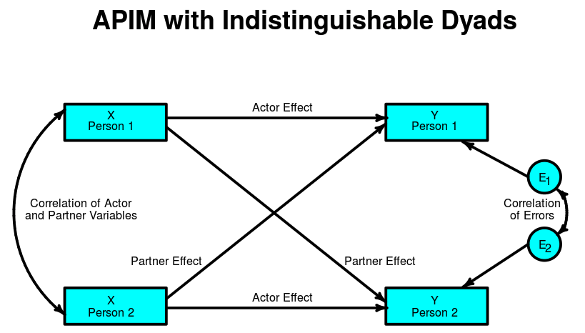
Clinical Interactions are a Dyadic Process that Occurs Over Time
X
Patient
Y
Patient
X
Clinician
Y
Clinician

Slide 38
Targets for Intervention
Societal / Policy
  Decriminalization of homosexuality and personal drug use
Healthcare settings
  Change the way services are delivered (e.g., same-day ART/PrEP)
  Training/contact of clinical staff (physicians, nurses, medical assistants)
  Differentiated models of care for key populations
mHealth intervention innovations with key populations
  Risk reduction
  HIV testing – DIAGNOSIS
  Linkage to PrEP initiation (if HIV negative)
  Linkage to care - ART initiation (if HIV positive)
  Remaining virally suppressed (Treatment as Prevention)

