Slide 1
mHealth Strategies and Implementation Science
App-Based Platform for HIV Prevention
Roman Shrestha, PhD, MPH
Assistant Professor
University of Connecticut
June 23rd, 2022
Malaysian Implementation Science Training Program
MIST Summer Bootcamp 2022

Slide 2

Why HIV?
Why MSM?
Why mHealth?

Slide 3


Formative Work
  Access
  Preference
    MSM
      Interface with ‘apps’ rather than health professionals
      Reduce in-person interaction with clinicians
    Stakeholders
      App platform to deliver HIV prevention services

Slide 4



mHealth for HIV Prevention in Malaysia?
A promising platform
    Screening
    Linkage to prevention services
    Adherence to medication
    Persistence on care

Slide 5
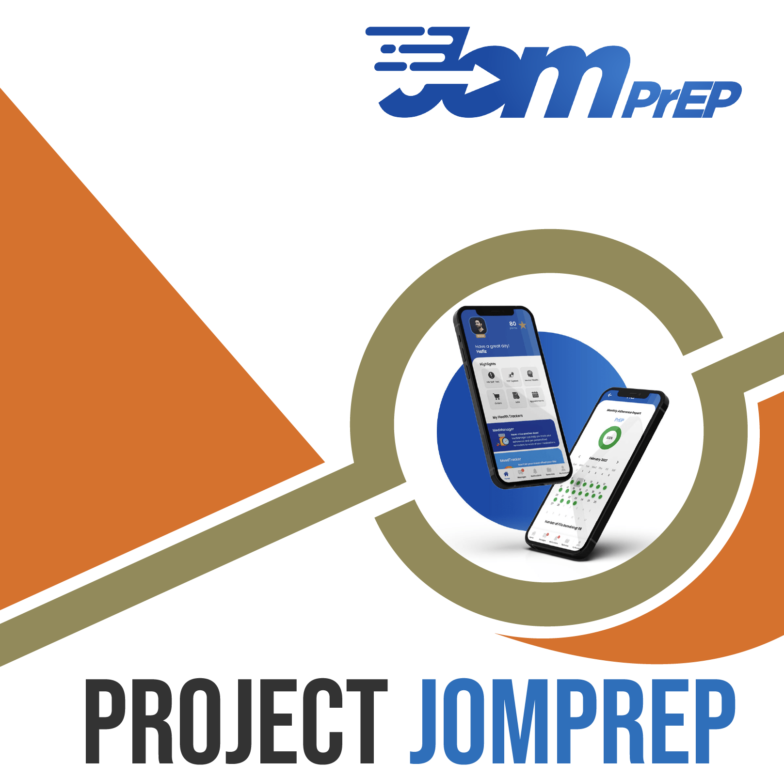

Slide 6

JomPrEP Project: Timeline

Slide 7
mHealth Approach to HIV Prevention
Stage 1: Understanding the problem & user preferences
Stage 2: Translating research findings into app features
Define the problem
Select the target behavior
Understand the problem
Understand user preferences for technological components
Stage 3: Testing & refinement
Select user preferences
Translate components into app features
Prototype design (alpha version)
Alpha testing
Beta testing
Large-scale RCT

Slide 8
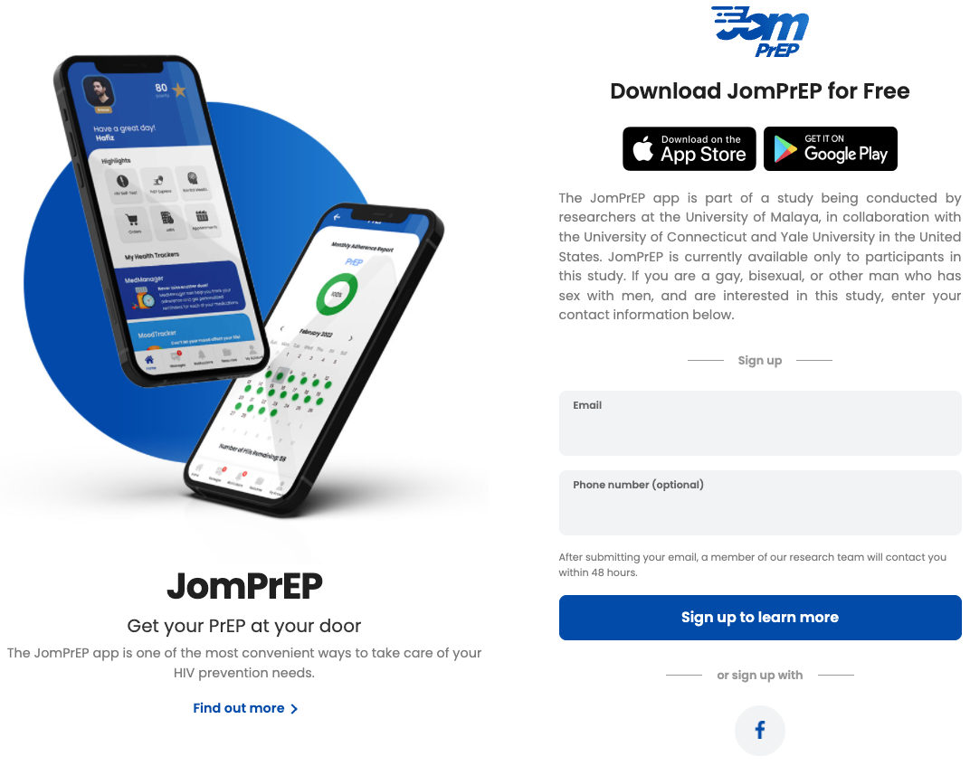
mHealth Approach to HIV Prevention
JomPrEP: Clinic-Affiliated Platform
App Front-End
Clinic Dashboard
Research Team Dashboard
JomPrEP Platform

Slide 9
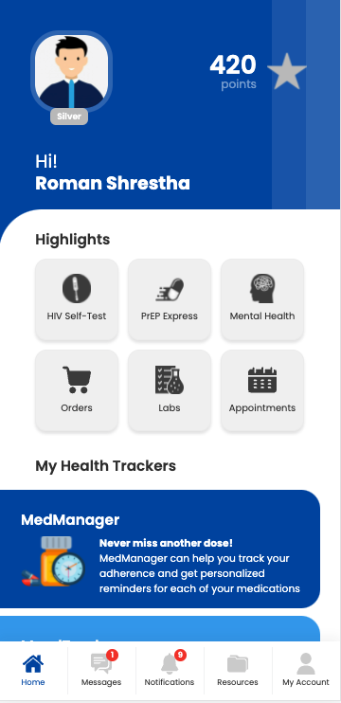
JomPrEP App: Front-End
Notes:
Work in progress

Slide 10
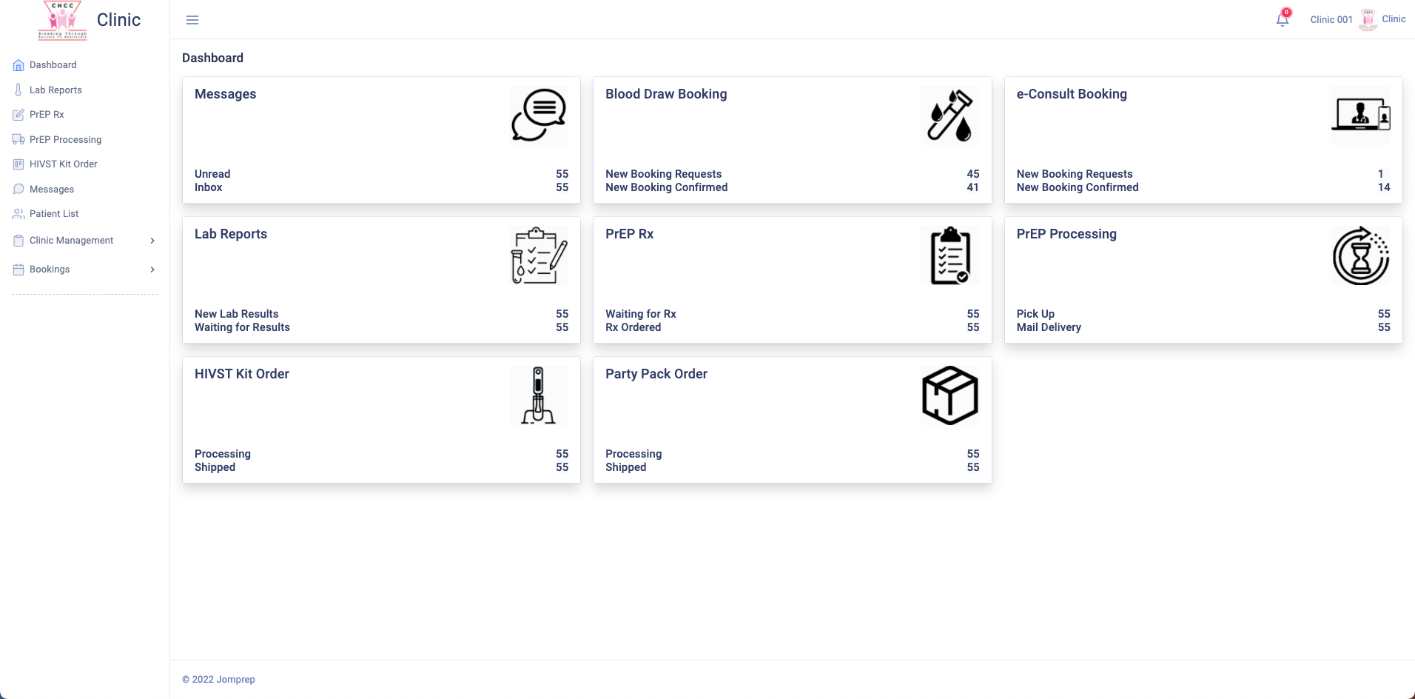
JomPrEP: Clinic Dashboard

Slide 11
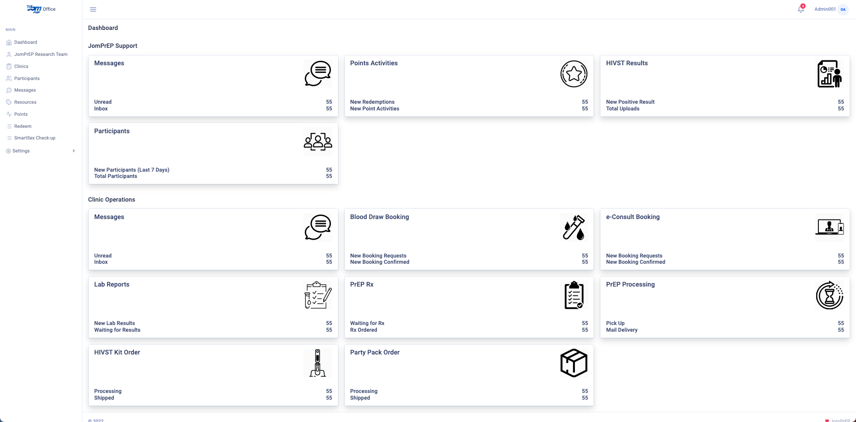
JomPrEP App: Research Dashboard

Slide 12




Beta Testing Results: Metrics
  Active Devices:
    IOS: 42.6%
    Android: 57.3%
  User Engagement
    App Use: 8 (SD 5.0; Range 2-18)
    Engagement Time: 15 min 15 secs
    Daily Page Views: 638.0
    Daily Sessions: 51.5
    Daily Visitors: 32.6

Slide 13
Beta Testing Results: Evaluation
ª Very Satisfied & Extremely Satisfied [Not included: Not at all Satisfied, Slightly Satisfied, Moderately Satisfied]

Slide 14
Beta Testing Results: Evaluation
ª Agree & Strongly Agree [Not included: Strongly Disagree, Disagree, Neither Agree nor Disagree]

Slide 15
Beta Testing Results: Evaluation
ª Very Easy [Not included: Very Difficult, Difficult, Neutral]

Slide 16
Beta Testing Results: Outcomes
ª HIVST result verified by providing an image of the result
^{b} Harm reduction kit that contains condoms, lubricant, pill keychain, hand sanitizer, mask
^{c} Receive PrEP at the first doctor visit (no need to wait for lab results)
^{d} Get PrEP after lab results are complete (need follow-up doctor visit to review lab results)
^{e} Applies only to those who choose same-day PrEP
^{f} Includes referral letter for mental health

Slide 17
JomPrEP: Next Steps
AIM 1: Randomized Controlled Trial (N=236)

Slide 18




mHealth Approach to HIV Prevention: JomPrEP
AIM 2: Assess Implementation Factors
Outer Setting
MSM needs & resources
External policies & incentives
Inner Setting
Readiness to implement
Combability w/ existing settings
Alignment with clinic goals
Structural characteristics
Process
Intervention Characteristics
Evidence
Advantage
Adaptability
Complexity
Design
Cost
Planning
Engaging
Reflecting & evaluating
Knowledge & beliefs
Self-efficacy
Perception of app use
Confident to use the app
Levels of open-mindness to use the app
Characteristics of Individuals

Slide 19











Acknowledgements
  Collaborators
    Jeffrey Wickersham (Yale University, USA)
    Frederick L. Altice (Yale University, USA)
    Patrick Sullivan (Emory University, USA)
    Iskandar Azwa (University of Malaya, Malaysia)
    Adeeba Kamarulzaman (University of Malaya, Malaysia)
    Anne Yee Hway Ann (University of Malaya, Malaysia)
    Panyaphon Phiphatkhunarnon (Thailand)
    Raymond Tai (PT Foundation, Malaysia)
    Andrew Yap (The Red Clinic, Malaysia)
    Malaysian AIDS Council (Malaysia)
    Ezra Akbar (University of Malaya, Malaysia)
    Ed Aziz (University of Malaya, Malaysia)
    Vincent Tee (University of Malaya, Malaysia)
Partners
    Funding
    K01DA051346 (PI: Shrestha)
    R21TW011665 (PI: Shrestha)
    R21AI157857 (PIs: Wickersham/Shrestha)
Roman Shrestha
roman.Shrestha@uconn.edu
QUESTIONS?

